Slide 1
Unit6 What Subjects Do They Have This Morning? 第4课时
陕旅版四年级上册
WWW.PPT818.COM

Slide 2
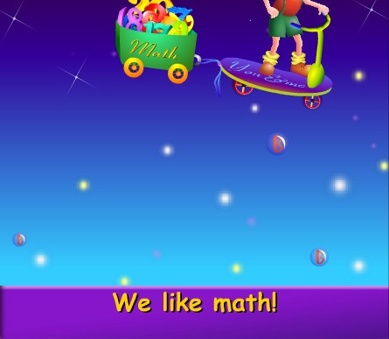
Let’s sing—We like Math

Slide 3
Review
用英语表达所学科目：
(1) —How many subjects do you have this morning?
—We have four.
—What are they?
—They are…
(2) —What subjects do they have this morning?
—They have…/ Let me see…

Slide 4
表达对不同学科的喜好用句型：
—Do you like+学科名词？
—Yes. I like it very much./ No, I don’t./
I’m good at…
我擅长……

Slide 5
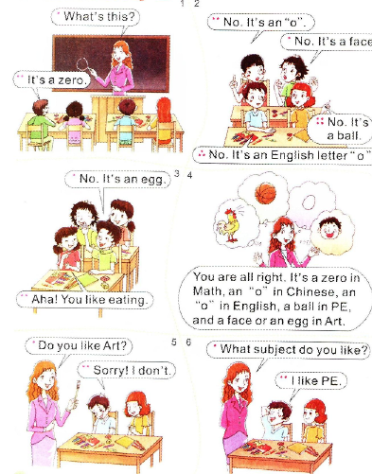
Read a story
略读小故事，初步了解故事大意

Slide 6
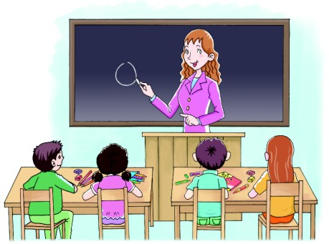
Read a story
What’s this?
It’s a zero.

Slide 7
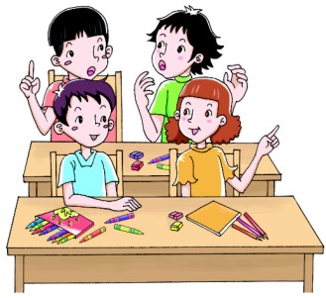
Read a story
No. It’s an “o”.
No. It’s a face.
No. It’s a ball.
No. It’s an English letter “o”.

Slide 8
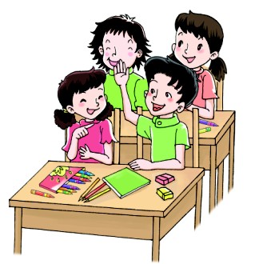
Read a story
No. it’s an egg.
Aha! You like eating.

Slide 9
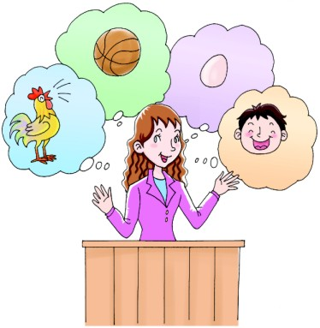
Read a story
You are all right. It’s a zero in Math, an “o” in Chinese, an “o” in English, a ball in PE, and a face or an egg in Art.

Slide 10
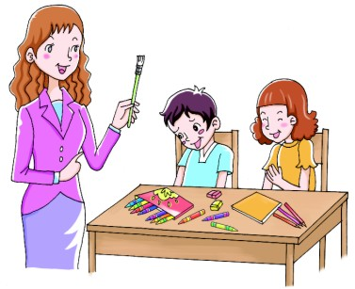
Read a story
Do you like Art?
Sorry! I don’t.

Slide 11
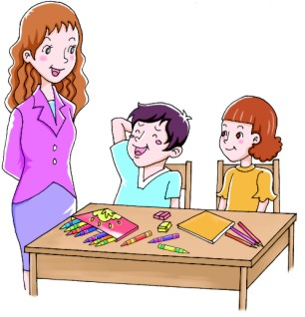
Read a story
What subject do you like?
I like PE.

