Slide 1
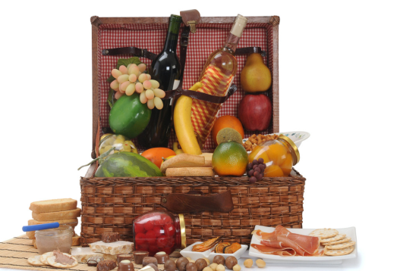
Food and drinks
第三课时
WWW.PPT818.COM

Slide 2
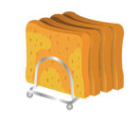
Say and spell
bread
milk
egg
water
juice
biscuit

Slide 3
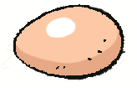
Read and guess
It is a drink.
It is white.
It is nice.
It comes from cows.
It is a drink.
It is sweet.
It is from a fruit.
It is food.
It is yellow.
It is nice.
It is from a hen.

Slide 4
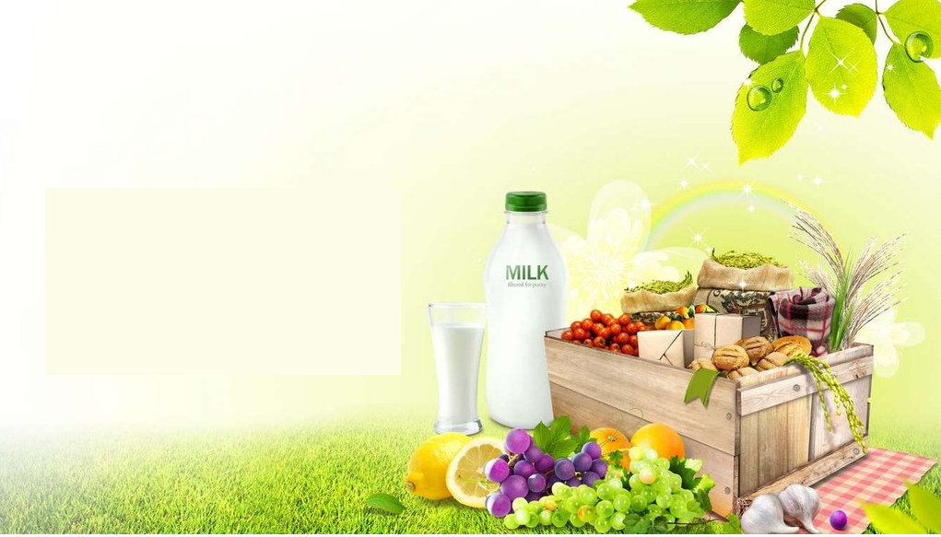
Make a report
Picnic
We have a picnic.
Food
Drinks
Fruit
Toys
We like our picnic.

Slide 5
Make a report
Picnic
We have a picnic.
Food
Drinks
Fruit
Toys
We like our picnic.

Slide 6
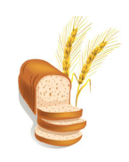
Write a report
Picnic
We have a picnic.
We have ____________ and ______________. We have __________ and ____________. We ______ ______________________.
We like our picnic.

Slide 7
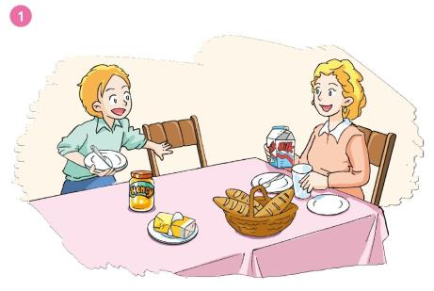
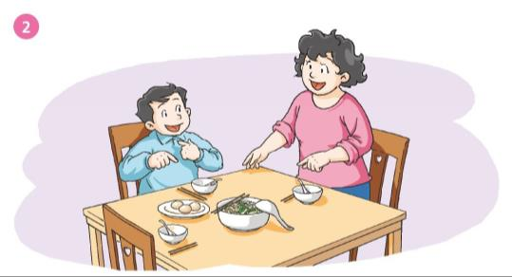

Slide 8
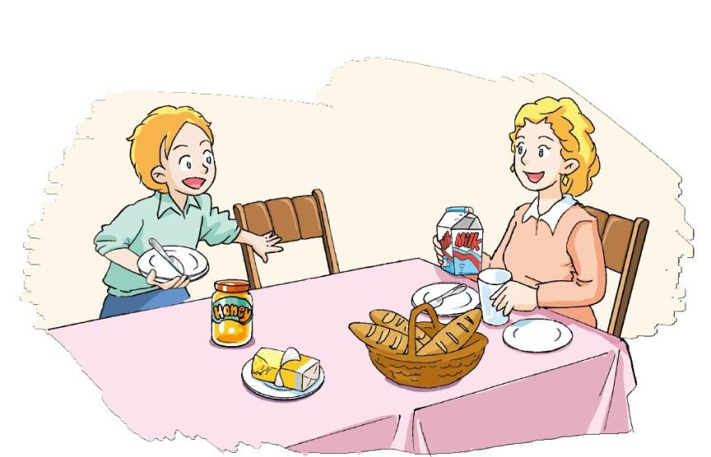
What do we have for breakfast, mum?
We have some bread and milk.

Slide 9
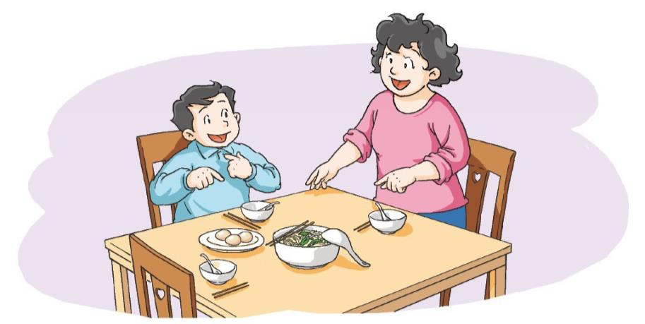
What do we have for breakfast, Mum?
We have some noodles and eggs. I like noodles. What about you, Joe?
I like noodles too.

Slide 10
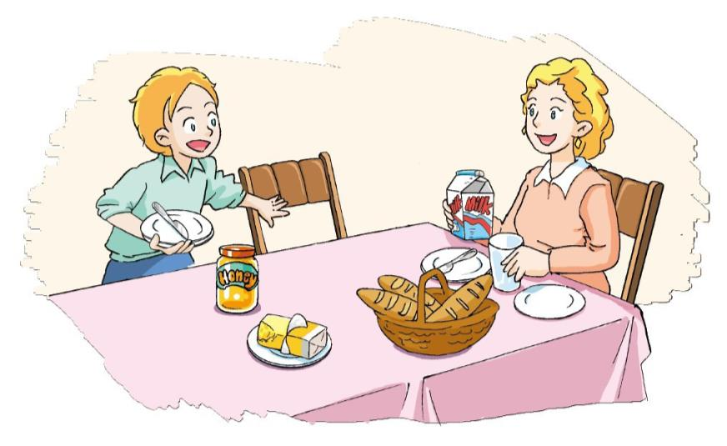
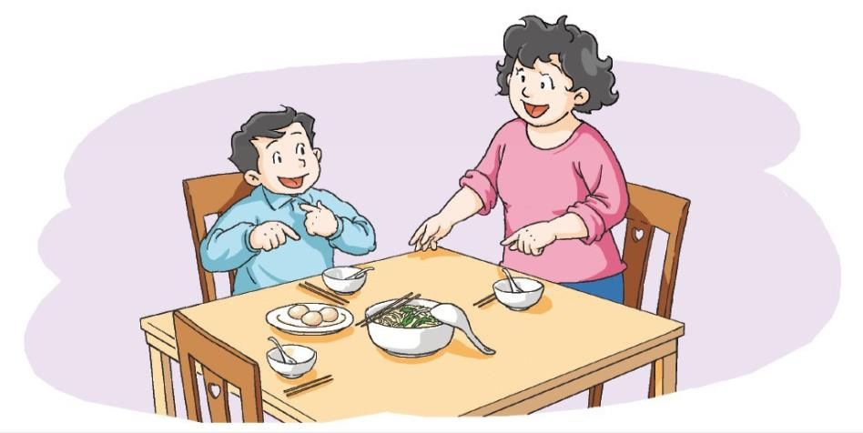
Act it out

Slide 11
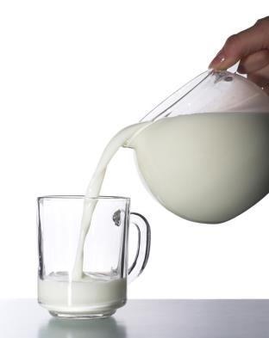
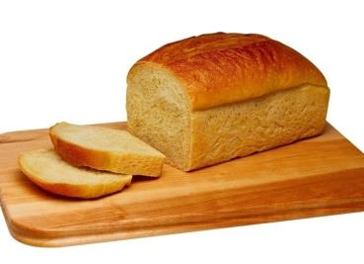
Think and answer
What do Peter and his mum have for breakfast?
bread
milk

Slide 12
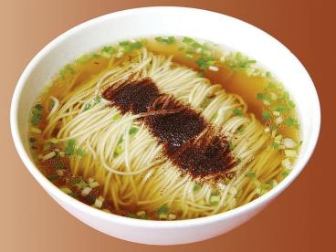
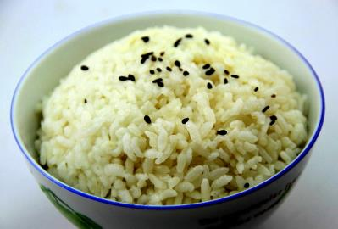
Think and answer
What do Joe and his mum like?
noodles
rice

Slide 13
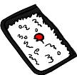
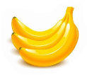
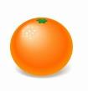
Ask and answer
What do you have for breakfast?

Slide 14
Say and read
What do you have for breakfast?
bread
I have some________, _____________ and ____________ for breakfast.
some milk
an egg

Slide 15
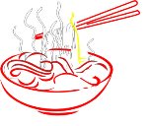
Ask and answer
What do you have for breakfast?

Slide 16
Look and write
What do you have for breakfast?
I have ____________, _____________ and for breakfast.
I like ___________.
I don’t like _________.

Slide 17
Ask and answer
What do you have for breakfast?

Slide 18
Look and write
What do you have for breakfast?
I have ____________, _____________ and ____________ for breakfast.
I like ___________.
I don’t like _________.

Slide 19
Draw and write
What do you have for breakfast?
I have ____________
_________________________for breakfast.
I _________________.

Slide 20
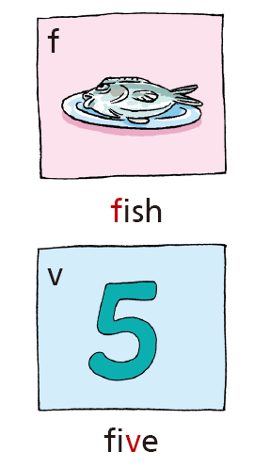
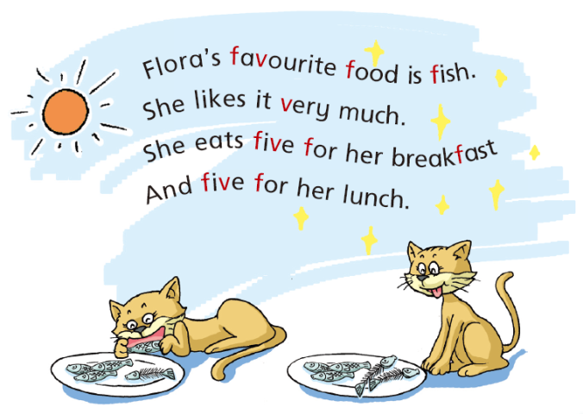

Slide 21
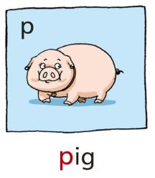
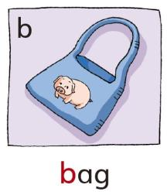
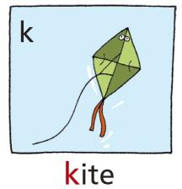
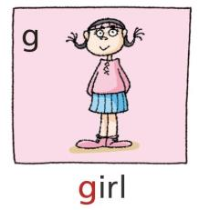
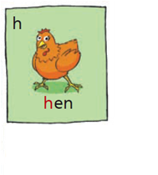
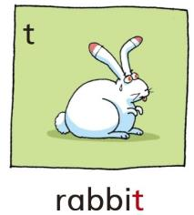
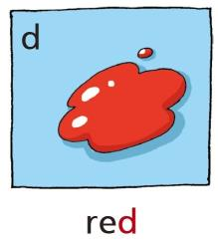
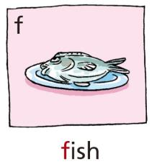
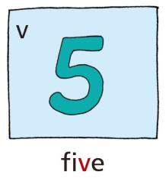
Look and say

Slide 22
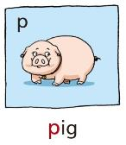
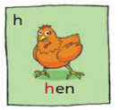
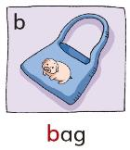
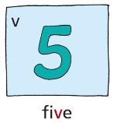
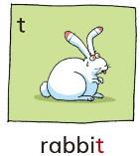
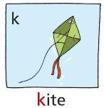
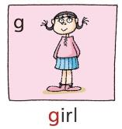
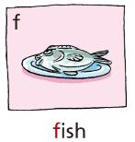
Listen and write
____an 2. ___an
____ id 4. ___ot
le____ 6. na____
7. ba____ 8. no____
v
f
k
h
g
p
t
d

Slide 23
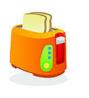
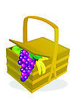
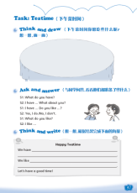
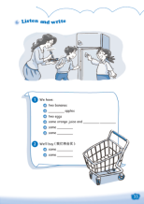
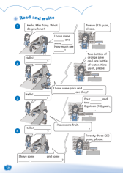
Homework
1 Read Listen and say & Say and act.
2 Complete Workbook pages 33, 36 and 37.

