Slide 1


添加标题
卡通儿童教育活动通用版

Slide 2


CONTENTS
Part 01
Part 03
Praesent sodales odio sit amet odio tristi Praesent sodales odio sit
Praesent sodales odio sit amet odio tristi Praesent sodales odio sit
Part 02
Part 04
Praesent sodales odio sit amet odio tristi Praesent sodales odio sit
Praesent sodales odio sit amet odio tristi Praesent sodales odio sit

Slide 3


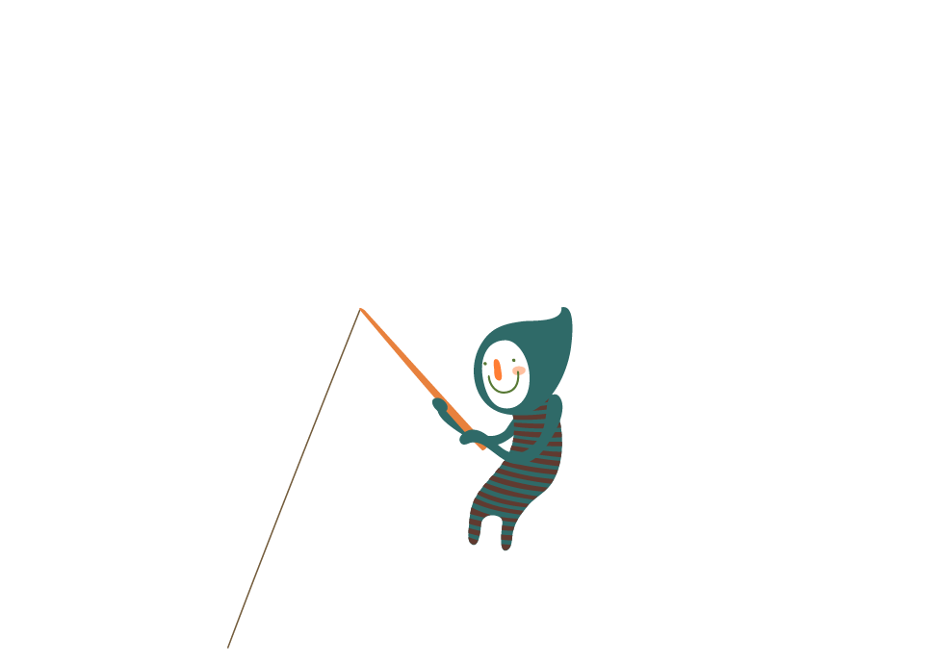


PART.01
添加标题
I love you more than I've ever loved any woman. And I've waited longer for you than I've waited for any woman.

Slide 4



添加标题
I love you more than I've ever loved any woman. And I've waited longer for you than I've waited for any woman. I love you more than I've ever loved any woman. And I've waited longer for you than I've waited for any woman.
I love you more than I've ever loved any woman. And I've waited longer for you than I've waited for any woman. I love you more than I've ever loved any woman. And I've waited longer for you than I've waited for any woman.. I love you more than I've ever loved any woman.

Slide 5
添加标题
I love you more than I've ever loved any woman. And I've waited longer for you than I've waited for any woman. I love you more than I've ever loved any woman. And I've waited longer for you than I've waited for any woman.
1200
998
1120
1445
832
添加标题
I love you more than I've ever loved any woman. And I've waited longer for you than I've waited for any woman. I love you more than I've ever loved any woman. And I've waited longer for you than I've waited for any woman.
text
text
text
text
text

Slide 6
添加标题
添加标题
添加标题
I love you more than I've ever loved any woman. And I've waited longer for you than I've waited for any woman.
I love you more than I've ever loved any woman. And I've waited longer for you than I've waited for any woman.
I love you more than I've ever loved any woman. And I've waited longer for you than I've waited for any woman.
添加标题
添加标题
添加标题
I love you more than I've ever loved any woman. And I've waited longer for you than I've waited for any woman.
I love you more than I've ever loved any woman. And I've waited longer for you than I've waited for any woman.
I love you more than I've ever loved any woman. And I've waited longer for you than I've waited for any woman.

Slide 7
PART.02
添加标题
I love you more than I've ever loved any woman. And I've waited longer for you than I've waited for any woman.

Slide 8


添加标题
I love you more than I've ever loved any woman. And I've waited longer for you than I've waited for any woman. I love you more than I've ever loved any woman. And I've waited longer for you than I've waited for any woman.
添加标题
I love you more than I've ever loved any woman. And I've waited longer for you than I've waited for any woman.

Slide 9
82%
60%
18%
添加标题
添加标题
添加标题
I love you more than I've ever loved any woman. And I've waited longer for you than I've waited for any woman. I love you more than I've ever loved any woman.
I love you more than I've ever loved any woman. And I've waited longer for you than I've waited for any woman. I love you more than I've ever loved any woman.
I love you more than I've ever loved any woman. And I've waited longer for you than I've waited for any woman. I love you more than I've ever loved any woman.

Slide 10

添加标题
I love you more than I've ever loved any woman. And I've waited longer for you than I've waited for any woman. I love you more than I've ever loved any woman. And I've waited longer for you than I've waited for any woman.
添加标题
I love you more than I've ever loved any woman. And I've waited longer for you than I've waited for any woman. I love you more than I've ever loved any woman. And I've waited longer for you than I've waited for any woman.

Slide 11
PART.03
添加标题
I love you more than I've ever loved any woman. And I've waited longer for you than I've waited for any woman.

Slide 12
添加标题
I love you more than I've ever loved any woman. And I've waited longer for you than I've waited for any woman. I love you more than I've ever loved any woman. And I've waited longer for you than I've waited for any woman.

Slide 13

添加标题
I love you more than I've ever loved any woman. And I've waited longer for you than I've waited for any woman. I love you more than I've ever loved any woman. And I've waited longer for you than I've waited for any woman.
添加标题
I love you more than I've ever loved any woman. And I've waited longer for you than I've waited for any woman. I love you more than I've ever loved any woman. And I've waited longer for you than I've waited for any woman.
添加标题
I love you more than I've ever loved any woman. And I've waited longer for you than I've waited for any woman. I love you more than I've ever loved any woman. And I've waited longer for you than I've waited for any woman.

Slide 14
01
02
添加标题
添加标题
I love you more than I've ever loved any woman. And I've waited longer for you than I've waited for any woman.
I love you more than I've ever loved any woman. And I've waited longer for you than I've waited for any woman.
03
添加标题
I love you more than I've ever loved any woman. And I've waited longer for you than I've waited for any woman.

Slide 15
PART.04
添加标题
I love you more than I've ever loved any woman. And I've waited longer for you than I've waited for any woman.

Slide 16
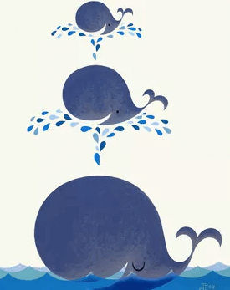
添加标题
I love you more than I've ever loved any woman. And I've waited longer for you than I've waited for any woman. I love you more than I've ever loved any woman. And I've waited longer for you than I've waited for any woman.
I love you more than I've ever loved any woman. And I've waited longer for you than I've waited for any woman. I love you more than I've ever loved any woman. And I've waited longer for you than I've waited for any woman. I love you more than I've ever loved any woman. And I've waited longer for you than I've waited for any woman. I love you more than I've ever loved any woman. And I've waited longer for you than I've waited for any woman.

Slide 17
添加标题
添加标题
I love you more than I've ever loved any woman. And I've waited longer for you than I've waited for any woman
I love you more than I've ever loved any woman. And I've waited longer for you than I've waited for any woman.
添加标题
添加标题
I love you more than I've ever loved any woman. And I've waited longer for you than I've waited for any woman
I love you more than I've ever loved any woman. And I've waited longer for you than I've waited for any woman.

Slide 18

添加标题
I love you more than I've ever loved any woman. And I've waited longer for you than I've waited for any woman.
添加标题
I love you more than I've ever loved any woman. And I've waited longer for you than I've waited for any woman.
添加标题
I love you more than I've ever loved any woman. And I've waited longer for you than I've waited for any woman.

Slide 19
谢谢欣赏

