Slide 1
Unit 3 Birthday
We sang and danced
WWW.PPT818.COM

Slide 2
Guess: Was I happy yesterday?
Yesterday, I went to KFC with my son.
I ate a hamburger. I love it very much.
I sang with the music.
We played toys.
We had a good time.

Slide 3
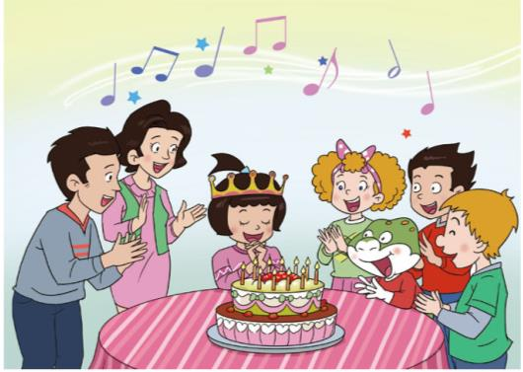
What did they do? （他们的聚会中都做了什么？）

Slide 4
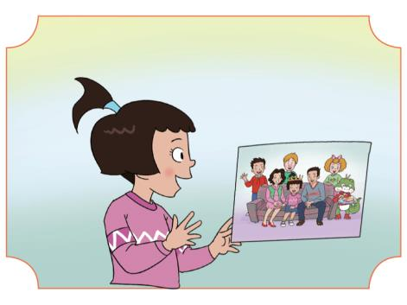
Watch and answer：
Was Wang Hong happy yesterday? Why?

Slide 5
Wang Hong was happy yesterday.
It was her birthday.
She had a birthday party.
It was great!

Slide 6
What did they do at the party yesterday?
（昨天他们在聚会中都做了哪些事情？）
讨论发生过的事情：过去式

Slide 7
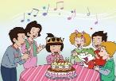
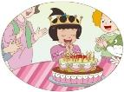
What did the children do at the party?
They______the birthday song.
sang
Wang Hong_______a wish.
made
Tips: 听读第二段，圈出答案。

Slide 8
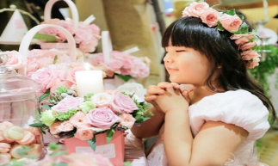
Learn and say :
It was her birthday yesterday.
She ______ a wish.
made

Slide 9
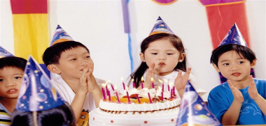
Learn and say:
It was her birthday yesterday.
They ______ the birthday song.
sang

Slide 10
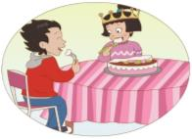
What did the children do at the party ?
ate
Then they ______ the cake.
They ______the cake very much.
loved
Tips: 听读第三段，圈出答案。

Slide 11
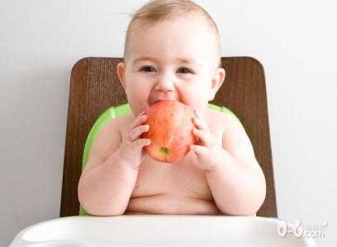
Learn and say:
ate
The baby ______ a big apple yesterday.

Slide 12
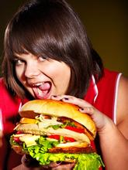
Learn and say:
ate
The boy ______ a big hamburger yesterday.

Slide 13
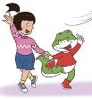
What did the children do at the party?
sang
danced
They ________ , __________
and _______ games.
played
had
They ______ a good time .

Slide 14
Read and match:
They ate the cake.
They sang the birthday song.
Wang Hong made a wish.
They sang, danced and played games.

Slide 15
Let’s write:

Slide 16
Summary:
is
was
eat
ate
--
--
sing
sang
make
made
--
--
have
had
play
played
--
--
love
--
loved

Slide 17
Thank You

