Slide 1
Unit 5
Why do you like pandas?
Section A 第2课时
WWW.PPT818.COM

Slide 2
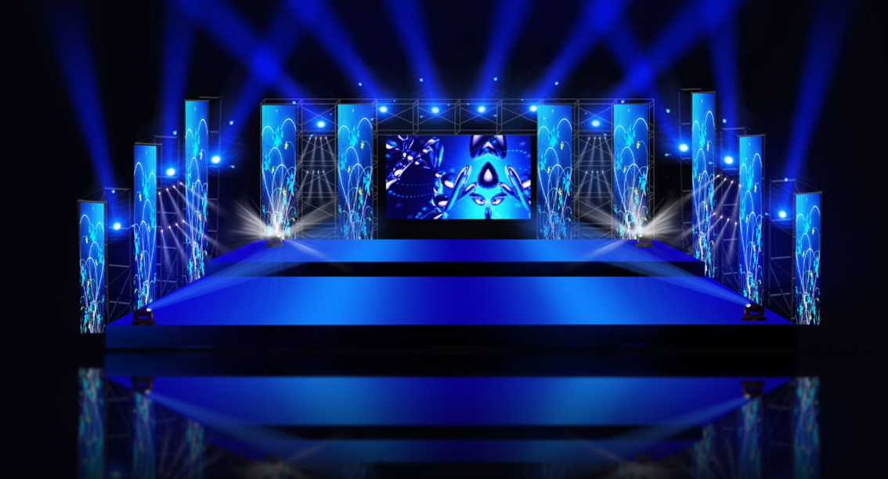
Guessing game

Slide 3
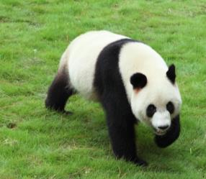
Task 1
I live only in China.
I’m black and white.
I’m usually friendly.
But sometimes I’m shy.
Who am I?

Slide 4
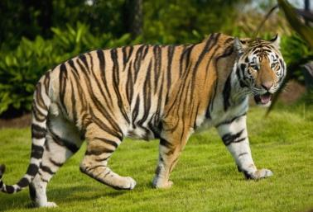
Task 2
I live in Africa.
I often eat small animals.
I’m lazy.
Sometimes I’m very scary.
Who am I?

Slide 5
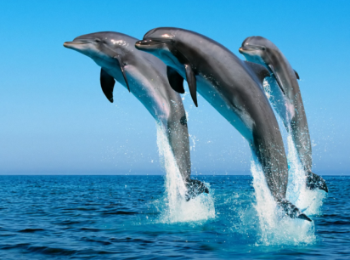
Task 3
I’m a cute animal.
I’m friendly to people.
I live in the water.
I have fish for food.
I can swim very well.
Who am I?

Slide 6
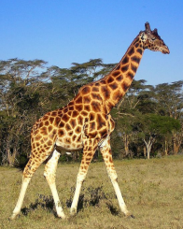
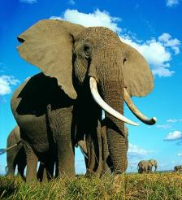
Say and guess with your partner.
very tall
big
a long nose
eat grass
beautiful
a long neck

Slide 7
Review
— What animal is it?
— It’s ___________.
— Do you like __________.
— Yes, I do.
— Why do you like them?
— ________ they’re friendly.
— Where are they from?
— ____________ Africa.
an elephant
elephants
Because
They’re from

Slide 8
— What animal is it?
— It’s ___________.
— Do you like ________.
— Yes, I do.
— ________ you like them?
— Because they’re _____.
— ______ are they from?
— ___________________.
a panda
pandas
Why do
cute
Where
They’re from China

Slide 9
Grammar Focus
Why do you like pandas? | Because they’re kind of interesting.
Why does John like koalas? | Because they’re very cute.
Why don’t you like tigers? | Because they’re really scary.
Where are lions from? | They’re from South Africa.
当主语是第三人称单数时，用助动词does，表否定含义时用doesn’t
当主语非单三时，用助动词do，表否定含义时用don’t

Slide 10
一、Why引导的特殊疑问句
1. Why是疑问副词，意为“为什么”，常用来引
导询问做某事的原因或理由。
句型结构：“why+一般疑问句”?
意为“为什么做某事?”。
例句：你为什么不喜欢这只猫?
Why don’t you like the cat?

Slide 11
2. Why引导的特殊疑问句，一般用because回答。
because是连词，后面接句子。
例句：莉莉为什么又迟到了？因为她起床晚。
——Why is Lily late again?
——Because she gets up late.

Slide 12
3. why可用于提出建议
Why don’t you + 动词原形 + 其他？
Why not + 动词原形 + 其他？
意为“你为什么不做……呢？”
答语：That’s a good idea. / Good idea.
That sounds good.

Slide 13
根据汉语意思完成句子，每空一词。
1. — 你为什么喜欢大象？
— 因为它们非常聪明。
— _____ ____ you like elephants?
— ________ they’re very smart.
2. 为什么不和我们去购物呢？
_____ ____ go shopping with us?
Why do
Because
Why not

Slide 14
二、Where is ... from?
1. where疑问副词，用于询问地点，意为“哪里；
什么地方”
回答：用be from回答，意为“来自于……”
例：他来自哪里？他来自澳大利亚。
— Where is he from?
— He is from Australia.

Slide 15
询问“来自于哪里”的其它方式
Where do/does +主语+ come from?
答语：主语+ come(s) from ...
be from = come from

Slide 16
根据汉语意思完成句子，每空一词。
1. — 你来自哪里？
— 我来自澳大利亚。
— ______ _____ you _____?
— _________ Australia.
2. 约翰来自于非洲。
John ______ ______________ Africa.
Where are from
I’m from
comes from / is from

Slide 17
三、形容词的基本用法
形容词通常用来描述和修饰名词或代词，说明人或事物的性质、状态和特征。大多数形容词既可作定语又可作表语。

Slide 18
1. 作定语
用于修饰名词，表示名词的属性，常置于它所修饰的名词前。
例句：他是一个帅气的男孩。
He is a handsome boy.

Slide 19
2. 作表语
形容词可以置于be, seem, look, become, get, feel, turn, grow等连系动词后面作表语.
例句:这些花儿很漂亮.
The flowers are beautiful.

Slide 20
3. 作宾语补足语
形容词可放在宾语之后作宾语补足语.
例句: 这部有趣的电影使我很开心.
The funny movie makes me happy.

Slide 21
Fill in the blanks with the words from the box. Then practice the conversation.
3a
because they’re do don’t cool like why where
Where
A: _______ are lions from?
B: _______from South Africa. Do you _____ lions?
A: No, I don’t.
B: Why ______ you like lions?
They’re
like
don’t

Slide 22
A: Because they’re really scary. But I like giraffes.
B: Really? _____ do you like giraffes?
Why
because
A: Well, ________ they’re kind of interesting. Do
you like pandas?
B: Yes, I do. But I like tigers a lot.
A: Tigers? Why ___ you like tigers?
B: They’re really _____!
do
cool

Slide 23
Write names of animals in the blanks to make sentences that are true for you.
3b
I like _______ because
they’re interesting.
giraffes
I like _________because
they’re smart.
elephants
I don’t like________
because they’re lazy.
cats
I like _______ because
they’re cute.
pandas

Slide 24
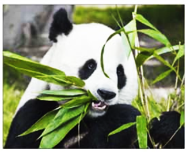
Think of an animal. Ask and answer questions with your partner to guess each other’s animal.
3c
A: Is the animal big?
B: Yes, it is.
A: Where’s the animal from?
B: It’s from China.
A: Is it black and white?
B: Yes, it is.
A: It’s panda!
B: Yes, you’re right.

Slide 25
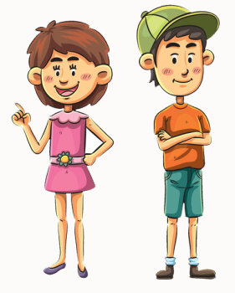
Play roles
Is the animal smart?
Yes, it is.
Where is the animal from?
It’s from India.
Is it big and fat?
Yes, it is.
It’s an elephant.
Yes, you’re right.

Slide 26
Exercise
Ⅰ. 用所给词的适当形式填空
1. Koalas look kind of (interest)and cute.
2. There are many (animal)in the zoo.
3. I don’t like the tigers. Because they are ________
(real) scary.
interesting
animals
really

Slide 27
4. —Where (be)the monkey from?
—Sorry, I don’t know.
5. My sister always wants (shop)with my
mother on Sundays.
is
to shop

Slide 28
Ⅱ. 句型转换
1. I like dolphins. (改为一般疑问句并作肯定回答)
— you dolphins?
—Yes, I .
2. What about going to see the elephants first?
(改为同义句)
Why to see the elephants first?
Do
like
do
not go

Slide 29
3. do, want, see, to, you, why, the, pandas(连词成句)
_______________________________________?
Why do you want to see the pandas
4. The lions are from Africa. (对画线部分提问)
the lions from?
5. Bill likes koalas because they’re very cute.
(对画线部分提问)
Bill koalas?
Where are
Why does
like

