Slide 1
How was your school trip?
Section B 第1课时
WWW.PPT818.COM

Slide 2
形容词 | 名词 | 短语
exciting 使人兴奋的 | museum 博物馆 | fire station消防站
lovely可爱的 | fire 火;火灾 | all in all 总的说来
expensive昂贵的 | painting 绘画 | be interested in对……感兴趣
cheap廉价的 | robot 机器人 | everything所有事物;一切
slow 缓慢的 | guide向导 | hear 听见
fast 快地(的) | gift 礼物;赠品
interested 感兴趣的
dark 黑暗的

Slide 3
Lucy is a lovely girl. She is interested in movies.
/'lʌvli/adj.可爱的
/'ɪntrəstɪd/ adj.感兴趣的
be interested in对……感兴趣
She likes exciting movies best.
/ɪk'saɪtɪŋ/ adj.使人兴奋的;令人激动的

Slide 4
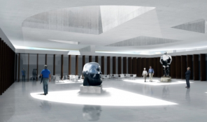
This is a modern museum.
/mju:'ziəm/ n.博物馆
There is a robot guide in it. It can tell you everything you want.
/'rəʊbɒt/ n.机器人
/'evriθɪŋ/ pron. 所有事物;一切
/gaɪd/ n.导游;向导
You can get some gifts when you leave there.
/gɪft/ n.礼物;赠品
The tickets aren’t expensive.
/ɪk'spensɪv/ adj.昂贵的
cheap /tʃi:p/ adj.廉价的;便宜的

Slide 5
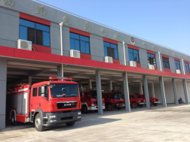
This is a fire station.
/'faɪə(r)/ n.火;火灾
fire station消防站
The fire policemen run very fast.
/fɑ:st/ adv.&adj.快地(的)
slow /sləʊ/ adj. 缓慢的;迟缓的

Slide 6
painting /'peɪntɪŋ/ n.油画;绘画
dark /dɑ:(r)k/ adj.黑暗的;昏暗的
We can see many paintings in the museum.
It’s dark outside, be careful please.
hear sb. do sth. 表示“听到某人做了某事”
或“经常听到某人做某事”。
I often hear him sing in the music room.
hear /hɪr/ v.(heard /hɜ:(r)d/) 听到;听见
all in all 总的说来
hear sb doing sth.表示“听到某人正在做某事”。
I heard him singing in the room just now.
All in all, it was a failure.

Slide 7
根据句意和首字母提示填空
1. --Alice, here are some g for your birthday. --Thank you.
2. I don’t feel good today. I can’t run very f_____.
3. A: How was the movie?
B: It was so e _______. I think you’ll like it.
4. The food in that restaurant was too e __________.
A meal cost me 1000 dollars.
ifts
ast
xciting
xpensive

Slide 8
单项选择
1. Tom _____ reading books. He is _____ in history books.
A. enjoy, interested B. enjoys , interesting
C. enjoy, interesting D. enjoys, interested
2. Grandpa hears a boy _______ upstairs every night.
A. sing B. sings C. to sing D. singing
D
A

Slide 9
词
形容词：expensive昂贵的；lovely可爱的…
短语
be interested in对……感兴趣
名词：fire火…
动词：hear听见的用法…
all in all 总体来说…

