Slide 1
Unit 6
Family life
WWW.PPT818.COM

Slide 2
读一读
1. cake grape name
snake face plate
2. have apple bag cat
hat fat
上面单词中a的发音相同吗？
想一想：

Slide 3
我发现：
[ei]
Aa
[ei]
[æ]

Slide 4
cake face name make place take
snake grape
baby potato
[ei]

Slide 5
pants map at cap can many
has black
[æ]

Slide 6
读一读，找出划线部分发音不同的单词。
A B C
( ) 1、many cap potato
C
( ) 2、plate have lamb
A
( ) 3、water rabbit washroom
B
( ) 4、tomato tasty splash
C
( ) 5、and cat want
C

Slide 7
bedroom
bathroom
living room
kitchen
study
[bedru:m] n.卧室，寝室
英 [bɑ:θru:m] 美 [bæθru:m] n.浴室; 卫生间
[liviŋ ru:m] n.客厅，起居室
[kɪtʃɪn]] n.厨房; 厨师
[stʌdi] n书房

Slide 8
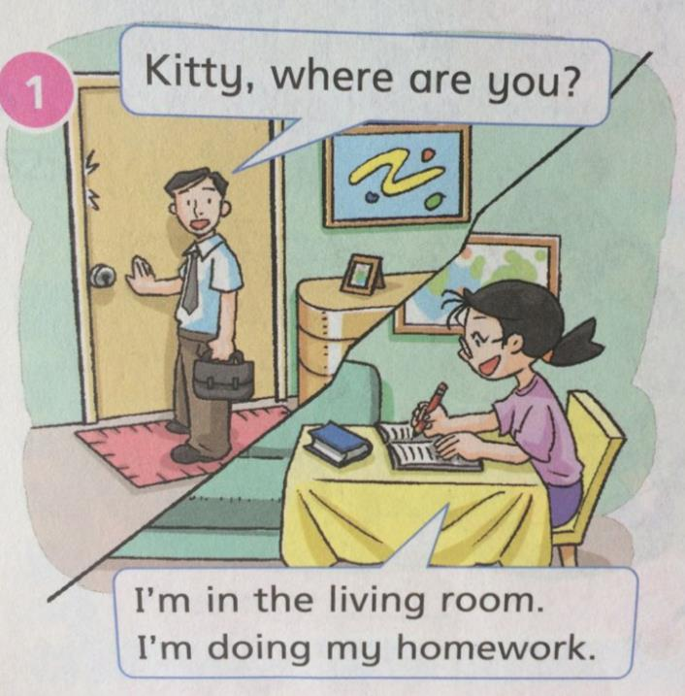

Slide 9
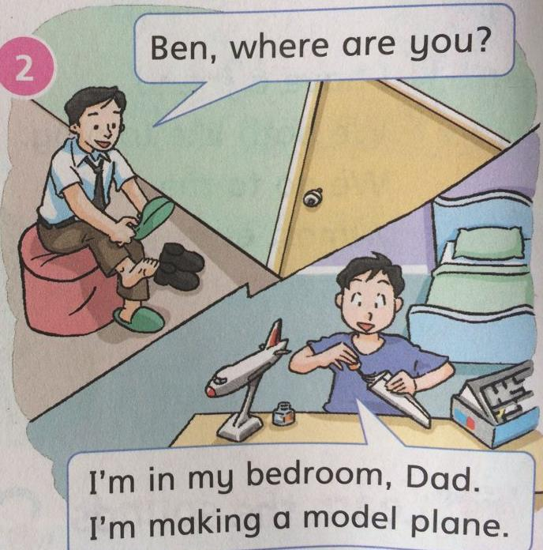
[mɒdl] n.模型

Slide 10
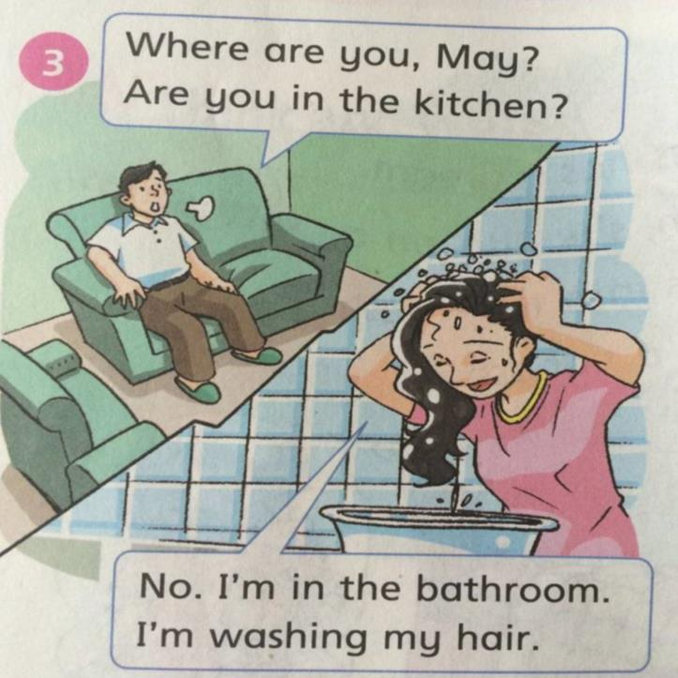

Slide 11
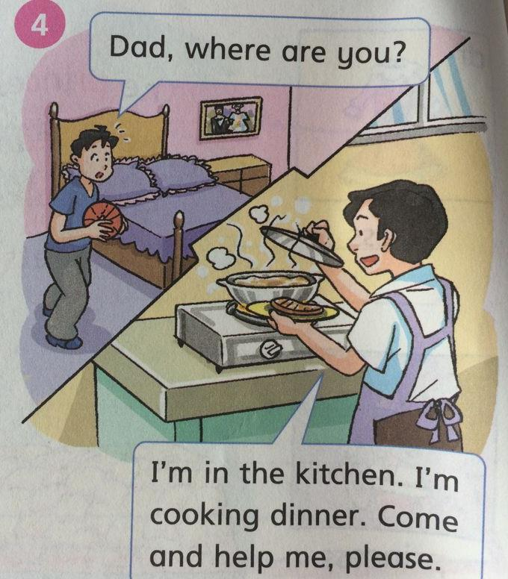

Slide 12
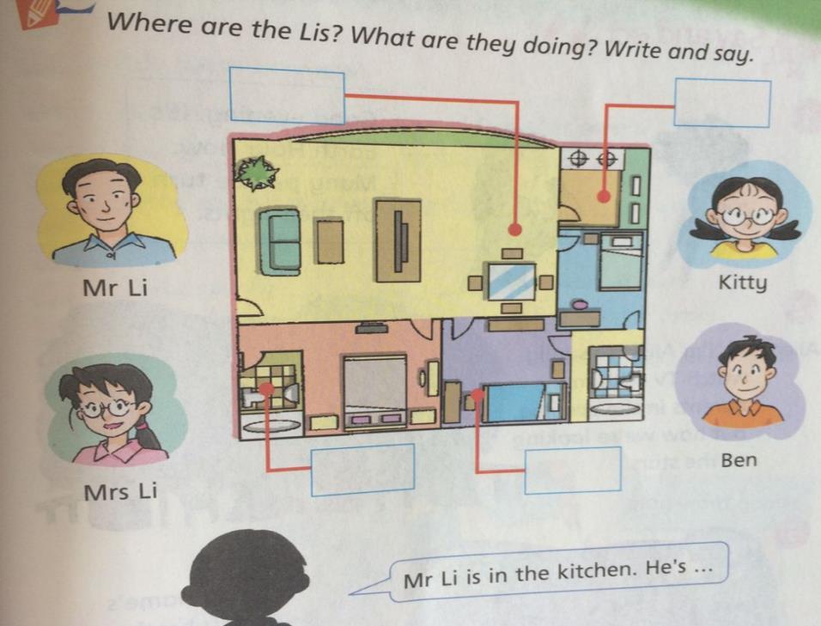
Mr Li
kitchen
cooking dinner
Kitty
living room
doing her homework
Mrs Li
bathroom
washing her hair
Ben
bedroom
making a model phone

Slide 13
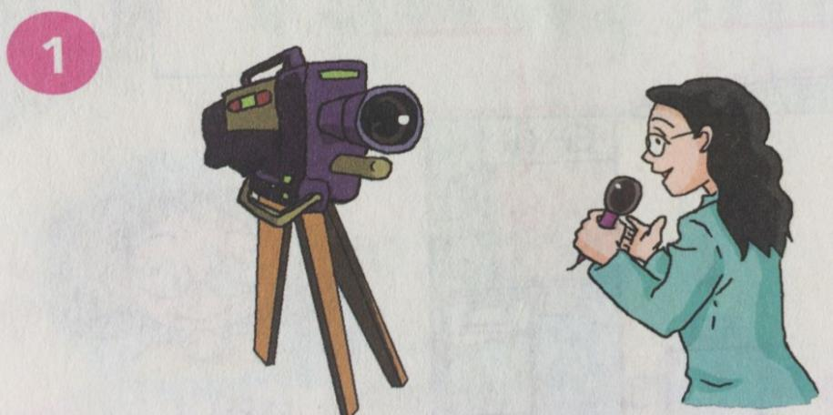
[ɜ:rθ] n.地球
Good evening. It’s Earth Hour now. Many people turn off their lights.
[aʊr] n.小时
[tə:n ɔf] 关掉

Slide 14
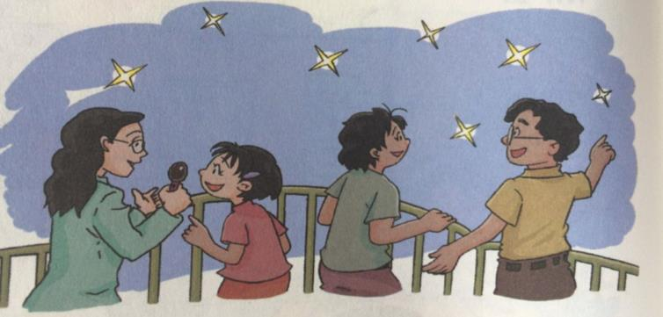
Alice：Hi, I’m Alice. I usually watch TV with my parents in the evening, but now we’re looking at the stars.
[stɑ:z]

Slide 15
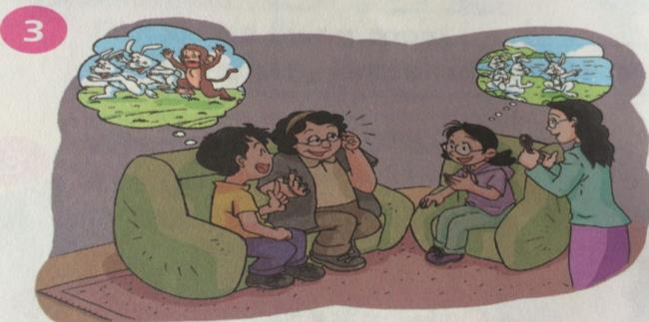
Kitty: Hello, my name’s Kitty. My brother Ben and I usually read storybooks before bedtime, but now Grandma is telling us a story.

Slide 16
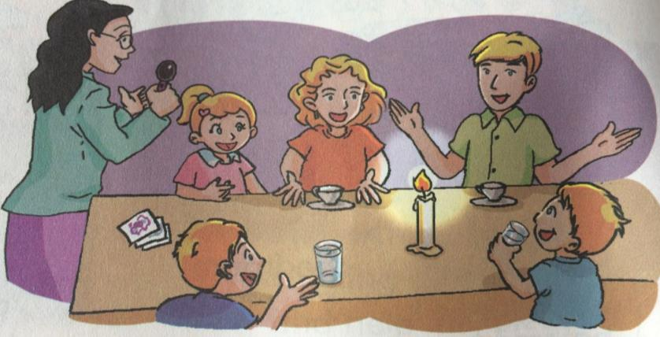
Sally: Hi, I’m Sally. I usually do my homework at night, but now I’m playing word games with my family.

Slide 17
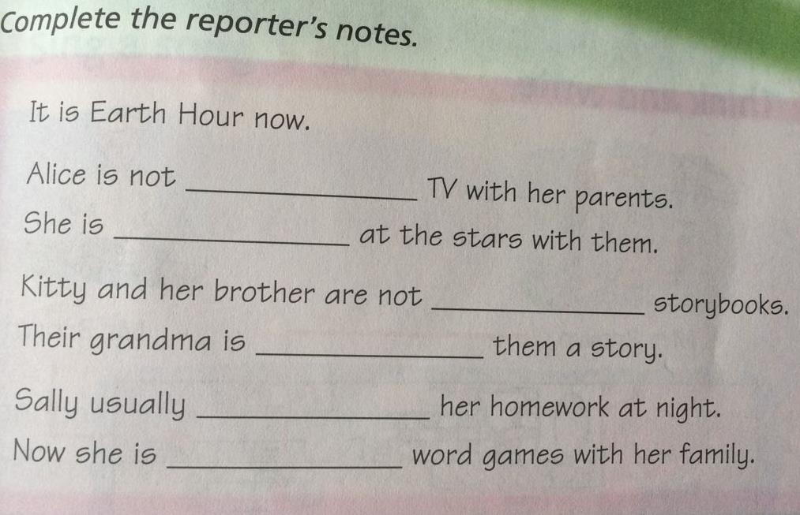
watching
looking
reading
telling
doing
playing

Slide 18
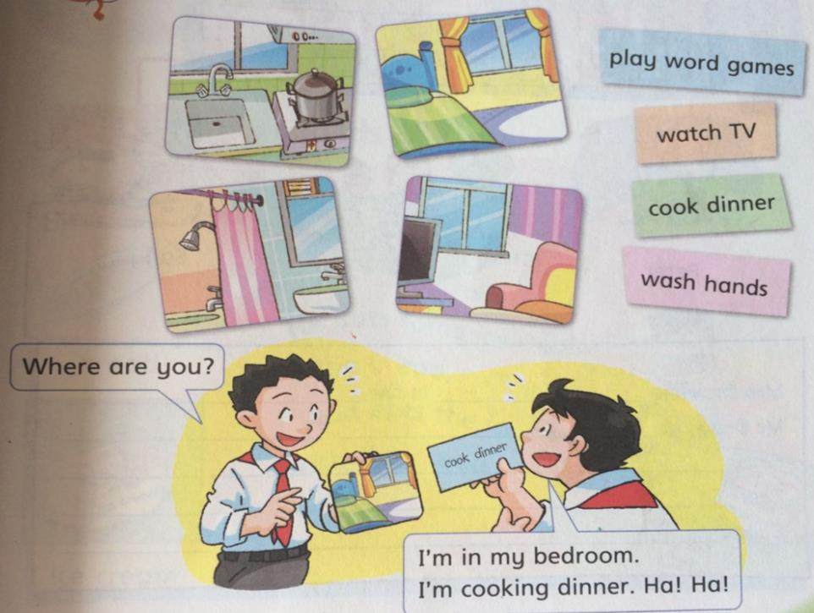

Slide 19
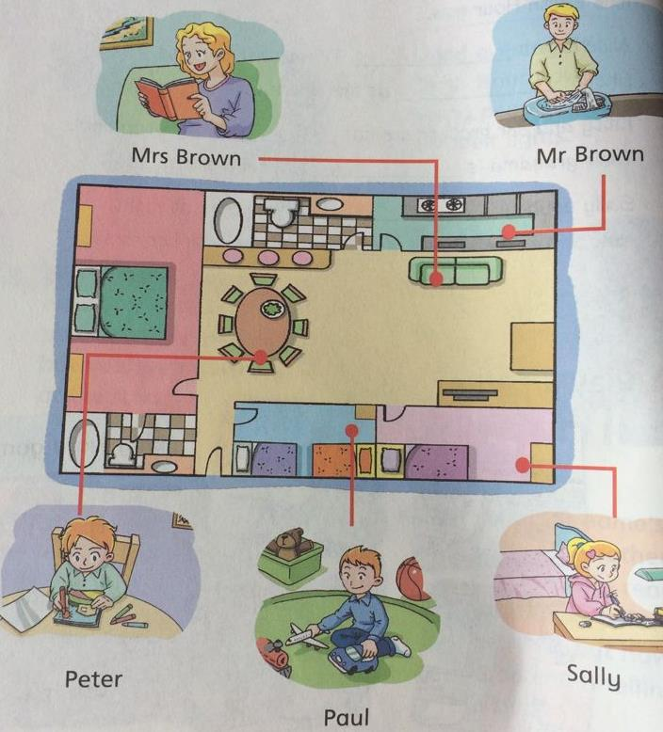
[sæli] 莎莉
[pɔ:l] 保罗

Slide 20
Mrs Brown is ____________in the _________.
Mr Brown_______________________________.
Peter__________________________________.
Paul___________________________________.
Sally___________________________________.
reading a book
living room
is washing the plates in the kitchen
is drawing pictures in the living room
is playing in the bedroom
is doing her homework in the bedroom

Slide 21
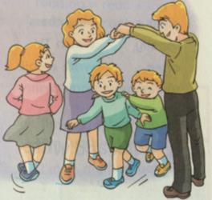
Song
London Bridge is falling down
[brɪdʒ]
伦敦桥要倒了
London Bridge is falling down,
Falling down, falling down.
London bridge is falling down,
My fair lady
[leɪdi]女士; 夫人
[feə(r)] 美丽的

Slide 22
sound
Brian likes ice cream.
He likes bread too.
He puts some ice cream on the bread.
And eats the ice cream with the bread.
布赖恩
[kri:m] 奶油
[bred] n.面包
br--- [br] cr--- [kr]

Slide 23
bedroom 卧室
bathroom浴室
living room客厅
kitchen厨房
study书房
Sow nothing, reap nothing.
春不播，秋不收。
bread面包
ice cream冰淇淋
model 模型

