Slide 1
Unit 2 Topic 3
Must we exercise to prevent the flu?
Section A
WWW.PPT818.COM

Slide 2
Review
牙痛
have a toothache
感冒
have a cold
背痛
发烧
have a backache
have a fever
illnesses
咳嗽
胃痛
have a cough
have a stomachache
流感
have the flu
头痛
have a headache

Slide 3
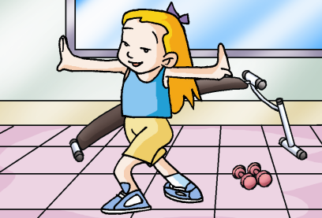
What should we do to prevent the illnesses?
Ask and answer
预防
We should do exercise to build us up.
使身体强壮

Slide 4
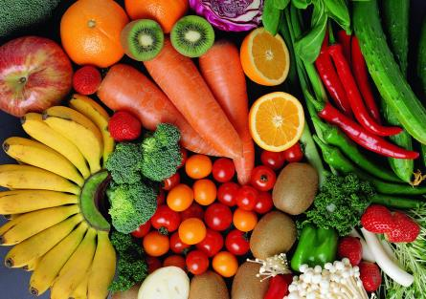
What should we do to prevent the illnesses?
Ask and answer
We had better eat more fruit
and vegetables.

Slide 5
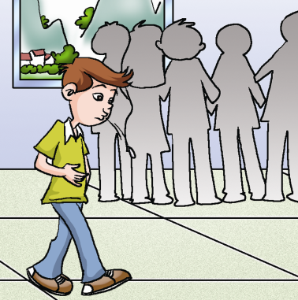
Ask and answer
What should we do to prevent the illnesses?
We shouldn’t spit everywhere.

Slide 6
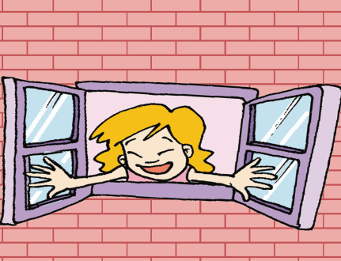
What should we do to prevent the illnesses?
Ask and answer
We must keep our rooms clean
and the air fresh.

Slide 7
Ask and answer
What should we do to prevent the illnesses?
We mustn’t keep fingernails long.

Slide 8
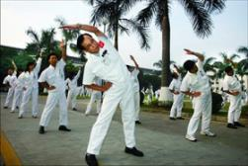
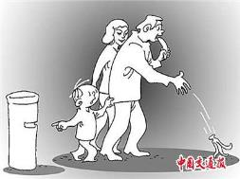
What should we do to have healthy living habits?
We should do morning exercises.
We should wash our hands before meals.
We must not throw litter about.

Slide 9
What are the symptoms of the flu?
high fever (>38°C)
dry cough

Slide 10
breathing difficulties
muscle aches
chills and shivering

Slide 11
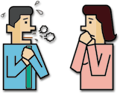
The flu spreads quickly among people.

Slide 12
1a Listen, look and say.
Journalist: May I ask you some questions, Dr. Li?
Dr. Li: Sure, go ahead.
Journalist: These days many people have the flu.
So what should we do to prevent it?
Dr. Li: Well, first, we should exercise keep our
rooms clean and the air fresh all the time.
Third, we should wash our hands and
change our clothes often. Finally, we
should keep away from crowed places.
Journalist: Must we go to see a doctor at once
when we have the flu?

Slide 13
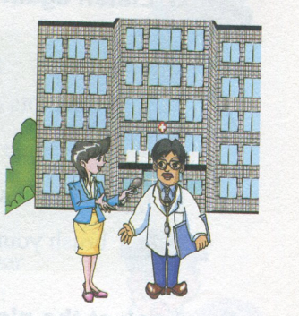
Dr. Li: Yes, we must.
Journalist: We’ll take your advice. Thank you.

Slide 14
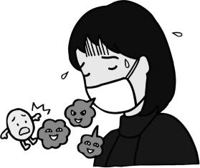
Flu is a serious illness, what should we do to prevent it？
Listen to 1a and check Dr. Li’s advice.
√
 1.exercise often
 2.keep the air fresh
 3.go to bed early
 4.wash hands and change clothes often
√
√
√
 5.keep our rooms clean
 6.drink enough water
 7.take some medicine
 8.keep away from crowded places
√

Slide 15
Listen again and write down Dr. Li’s advice.
First, ________________________________________________
Second, ____________________________________________
Third, _______________________________________________
Finally, ______________________________________________
we should exercise often to build us up.
we should keep our rooms clean and the air fresh all the time.
we should wash our hands and change our clothes often.
we should keep away from crowded places.

Slide 16
Key points
Must we go to see a doctor at once when we
have the flu ?
肯定回答： Yes, we must.
否定回答： No, we needn’t. /
No, we don’t have to.
注：此处不能用 mustn’t (禁止；不准)回答
e.g. Must I finish my homework now ?
No, you needn’t. /
No，you don’t have to.

Slide 17
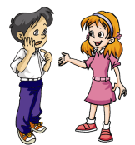
Pair work
1d Make similar conversations after the example.
Example:
A: Must we do exercise to prevent the flu?
B: Yes, we must.
A: Must we take some medicine to prevent the flu?
B: No, we don’t have to. /
No, we needn’t.

Slide 18
2. A. Listen to the passage and circle the symptoms that you hear.
fever
cough
headache
backache
toothache
stomachache
sore throat
sore eyes

Slide 19
B. Listen again and check the advice you hear.
Should
√
drink lots of boiled water
take some cold pills
lie down and take a good rest
brush your teeth twice a day
√
Shouldn’t
work on the Internet too long
go to crowded places
play sports too much
eat hot food
√
√

Slide 20
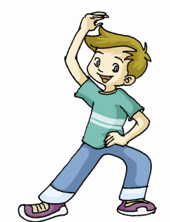
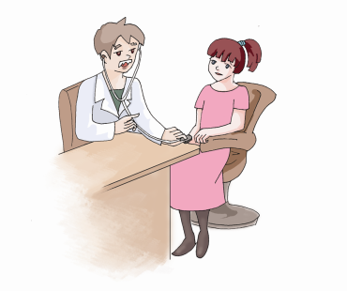
3. Look at the pictures and write down the advice on how to prevent the flu, using should, had better or must.
1.
2.
We must go to see
a doctor at once when we have the flu.
We should exercise
often.

Slide 21
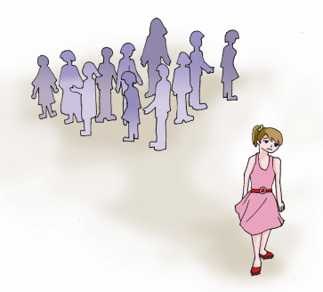
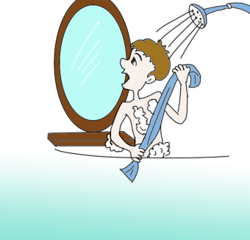
4.
3.
We had better keep away from crowded places.
We should take a
shower often.

Slide 22
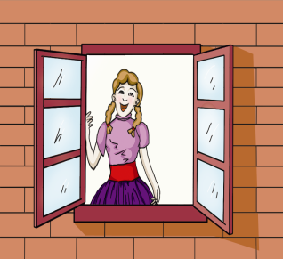
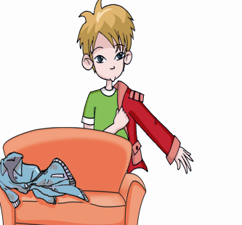
5.
6.
We should keep
the air fresh.
We should change
our clothes often.

Slide 23
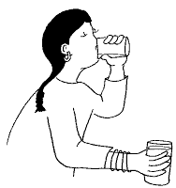
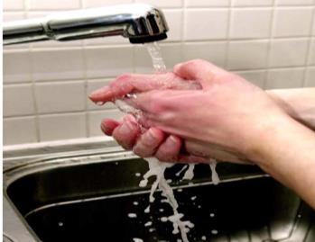
Give more advice to prevent the flu
Drink a lot of water.
Wash hands often.

Slide 24
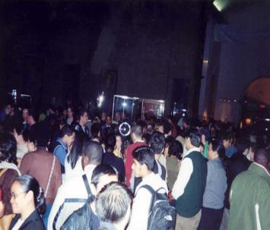
Eat healthy food.
Don’t go to crowded places.

Slide 25
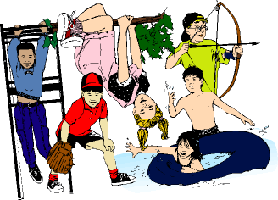
Do more exercise.
Open the windows.

Slide 26
选择方框中的句子完成对话，其中有两项多余。
A: You look pale, Dr. Li. _________
B: I only feel a little tired.
A: It looks more serious than being tired. _________
B: No, thanks. Nothing serious, I think.
A: __________ But you have worked for thirty-six hours without
having a rest.
B: I’m a doctor. _______
A: __________
Exercises
F
G
B
A. I have to save the patients. B. I know SARS is spreading. C. So you should care for yourself first. D. And it’s my duty to save the patients. E. You must be tired. F. What’s the matter with you? G. May I take you to the office?
D
C

Slide 27
完成下列句子。
你先走，我一会就赶上你。
You _________, I will catch up with you in a few minutes.
2. 我们应该远离危险的地方。
We should ________________ the dangerous places.
3. 小敏每天在家都帮助妈妈做扫除。
Xiao Min helps her mother ______________
_________ at home every day.
4. 这封信一直都在我的口袋里。
The letter is in my pocket _____________.
go ahead
keep away from
do some
cleaning
all the time

Slide 28
5. The good news __________ (传播) fast. We are very happy to hear it.
6. – Where is Doctor Chen?
– He is __________ (检查) a sick baby.
7. A young man jumped into the river to ______ (挽救) the child in the water.
8. – Can you find Mr. Li in the photo?
– Yes. He is sitting ________ (在……中间)
his students.
9. The doctor is very kind. He is always
friendly to his __________ (病人).
spreads
examining
save
among
patients

Slide 29
根据句意和首字母提示写出单词。
1. H_____ up, or we’ll be late for school.
2. We must do e_______ every day to keep healthy.
3. – Do you have any q________?
- Yes. But I will ask them after class.
4. After he walked out of the train station, he saw his father standing a _____ the crowd at once.
5. The bad news s_______ quickly.
urry
xercise
uestions
mong
preads

Slide 30
将下面的对话排好顺序：
I have a bad cold. I’m afraid I can’t go to work.
B. I think so. I’m tired easily. What do you think I should do?
C. Hello! Mike.
D. You’d better go to see a doctor, and you should stay in bed and rest for several days.
E. Hello! John. You look pale. What’s the matter?
F. See you!
G. Well, I think you should do more exercise. It
can build you up. I keep running every morning.
Do you like to join me?
H. Yes, I’d like to. See you tomorrow morning.
3
5
1
4
2
8
6
7

Slide 31
summary
1.We know how to prevent the flu.
2.We can use must/had better/
should to give advice.

Slide 32
Homework
写一篇小短文来说明如何预防流感。
背诵1a。

