Slide 1
七年级英语（JJ下）教学课件
Unit4 After-School Activities
How Was Your Weekend?
WWW.PPT818.COM

Slide 2
Learning Targets
Key words & phrases:
yummy, everybody, climb a mountain, take a bus,
be away from, sing songs, on the bus, write back
Key sentences:
1. How was your weekend?
2. I can make donuts myself now.
3. Next weekend, I am going to climb a mountain！
4. We are going to take a bus there.

Slide 3
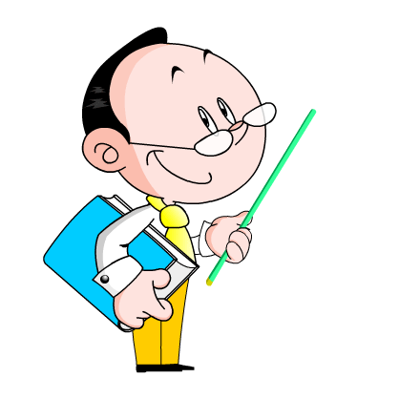
5. We are going to sing songs and play games on the bus.
6. My uncle is going to bring his camera and I am going to bring some donuts for everybody.
7. Will it be fun?
Let’s have a look at some pictures and have a talk first!

Slide 4
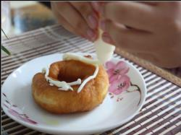
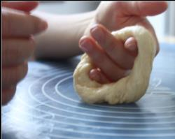
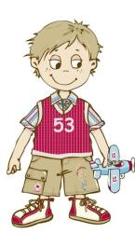
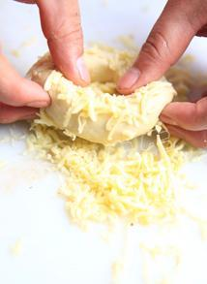
Lead in
Look and say
What did Lily do this Sunday?
She ____________
____________.
learnt to make
some donuts

Slide 5
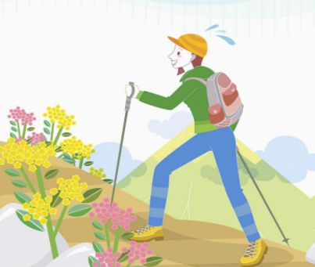
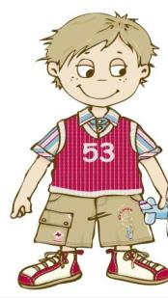
What did Rosa do this weekend?
And where?
She went to Hubei, and she climbed a mountain there.

Slide 6
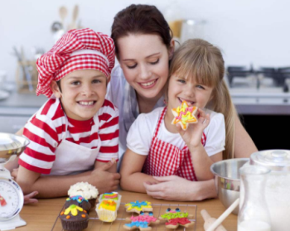
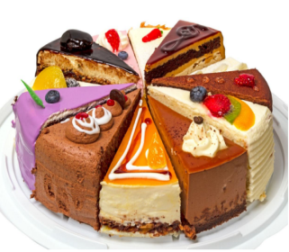
They made cakes with their mother. The cakes tasted delicious.
What did Jenny and Danny do ?

Slide 7
Free Talk
1. What do you usually do on weekends?
2. What did you do yesterday?
3. What are you going to do tomorrow?
① I often / sometimes / usually / seldom do...
② I did /... yesterday / ...
③ I am going to do /...

Slide 8
What do you usually do on weekends?
I often do my homework at home.
What else do you
do?
I sometimes take a walk with my father in the park.

Slide 9
What did you do yesterday?
I played volleyball with my sister and brother.
What did you do
yesterday? Did you
do any sports?
No. I just stayed at home and watched TV.

Slide 10
What are you going to do tomorrow?
I am going to draw some pictures in the painting house.
What are you going to do tomorrow?
I am going to learn
swimming. I joined
the club last week.

Slide 11
Words and expressions
yummy
everybody
climb a mountain
take a bus
be away from
sing songs
on the bus
write back
好吃的；美味的
每人；人人
爬山
乘公交车
远离
唱歌
在公交车上
回信；回复

Slide 12
stay still
in a hurry
have plans for...
stay home
surf the Internet
help sb. with
join sb.
静止不动
匆忙
对于……的计划
待在家
上网
帮忙（做）……
加入某人的活动

Slide 13
Presentation
Hey Li Ming,
How are you? How was your weekend?
I had a great weekend! Guess what! I can make donuts myself now. My mum taught me on Saturday. Jenny came over and helped us. It was a lot of work, but it was fun. Fresh home-made donuts are so delicious. Yummy!
Next weekend, I am going to climb the mountain!

Slide 14
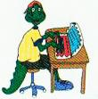
I will go with my parents, cousins, aunt and uncle.
Mountain climbing is so fun.We are going to take a bus there.It`s three hours away from my house. We are going to sing songs and play games on the bus. I’m so excited! My uncle is going to bring his camera and I am going to bring some donuts for everybody.
Did you have a good weekend? What are you going to do next weekend?
Write back soon,
Danny

Slide 15
Translate the phrases into English.
在课文中找出对应的短语。
周末玩得愉快
乘公共汽车
爬山(名词短语)
离……有三个小时的距离
给……带面包圈
和父母一起去
have a great/good weekend
take a bus
climb a mountain
three hours away from... bring some donuts for ...
go with my parents

Slide 16
Let's Do It!
1
Listen and match the pictures with the questions.
What did Danny do last weekend?
What is Danny going to do next weekend?

Slide 17
2
Read the lesson and answer the questions.
1. Who taught Danny to make donuts?
2. What does Danny think of home-made donuts?
3. How is Danny going to the mountain?
4. How far is the mountain from Danny’s house?
5. What is Danny going to bring for everybody?
Some donuts.
His mum.
They are so delicious.
Take a bus there.
It’s three hours away from his house.

Slide 18
3
Fill in the blanks with the words in the box.
take fresh climb bring everybody
____________ is here. Let’s begin our class.
I have a cake for the party, but can you _______ some drinks?
The air is very clean and _______ after the rain.
I can _______ the tree and pick some apples for you.
They are going to _______ a ship to Dalian for their holiday next week.
Everybody
bring
fresh
climb
take

Slide 19
Pair work
4
Work in groups. What did you do last weekend? What are you going to do next weekend? Interview your group members and fill in the table. Then present it to the class.

Slide 20
Name | What did you do last weekend? | Was it fun? | What are you going to do next weekend? | Will it be fun?
Linda | I visited my grandparents. |  | I’m going to see a doctor.

Slide 21
Grammar
一般过去时态
一般过去时表示过去发生的动作或存在的状态, 通常与过去的时间状语如: yesterday, last week/ month / year等连用。
例：How was your trip last weekend？ 你上周末的旅行怎么样？
I did some homework and housework last night. 昨晚我做了点作业和家务。

Slide 22
知识结构
构成
动词的过去式
1. 表示过去某个时间发生的动作
或存在的状态。
2. 表示过去经常或反复发生
的动作。
一般
过去时
用法
陈述句：He was at home yesterday.
否定句：He wasn’t at home yesterday.
疑问句：Was he at home yesterday?
Yes, he was./No ,he wasn’t.
句式

Slide 23
动词变为一般过去式的常见变化
1. 动词be的变化：
am /is → was are → were
例：① I am a little girl. 我是一个小女孩。
→ I was a little girl ten years ago. 十年前我是一个小女孩。（现在不是了）
② You are the best student. 你是最优秀的学生。→ You were the best student before. 你以前是最优秀的学生。（现在不是了）

Slide 24
2. 助动词do的变化：
do/does→did (过去时中助动词没有人称和数的变化)
例：① Do you play soccer everyday? 你每天都踢足球吗？→ Did you play soccer yesterday? 你昨天踢足球了吗？
② Does he often cook dinner for you? 他经常给你做饭吗？→ Did he cook dinner last Friday? 他上周五给你做饭了吗？

Slide 25
3. 实义动词的变化（一）：
实义动词分规则变化和不规则变化。
（1）规则变化：
A）一般情况下在动词后加 -ed。
如： play—played；visit—visited ；walk—walked ；clean—cleaned；work—worked；watch—watched
例：She often helped us in those days. 那些天她总是帮助我们。
I worked five hours yesterday. 昨天我工作了五小时。

Slide 26
（1）规则变化：
B）以不发音的 e 结尾的词，在词尾加-d。
note—noted; live—lived; use—used;
move—moved; like—liked ; dance—danced
name—named; love—loved
例：She moved to a new town last year.
去年她搬去了一个新的小镇。
I danced with my friends at the party happily yesterday.
昨天我和朋友们在聚会上愉快地舞蹈。

Slide 27
（1）规则变化：
C）以一个元音加一个辅音字母结尾的重读闭音节结尾的单词，要先双写这个辅音字母，再加-ed。
stop—stopped ; drop—dropped;
plan—planned; shop—shopped;
travel—travelled
例：She stopped crying suddenly. 她突然不哭了。
I shopped in the supermaket yesterday morning and I bought some eggs and vegetables. 昨天早上我去超市购物，买了一些鸡蛋和蔬菜。

Slide 28
（1）规则变化：
D）以辅音字母加y结尾的单词, 先改y为i, 再加-ed。
study—studied ; carry—carried;
hurry—hurried; marry—married
例：Jack and I studied in Sunshine School five years ago. 五年前，我和杰克在阳光学校读书。
I hurried to the airport but found the flight was cancelled. 我赶去机场，却发现航班被取消了。
My mother married to my father twenty years ago.
我妈妈二十年前嫁给了我的爸爸。

Slide 29
3. 实义动词的变化（二）：
（2）不规则变化：
beat-beat；become -became；begin-began
cost--cost；cut-cut
do/does--did；draw--drew；dream-dreamt
get--got；give--gave；go--went
have--had；hear--heard；hold--held
meet--met；pay-paid；put--put
say--said；see--saw；sell-sold 等。

Slide 30
What did they do last weekend?
play soccer
played soccer
They played soccer last
weekend!

Slide 31
What did she do last weekend?
go to the park
went to the park
She went to the park
last weekend!

Slide 32
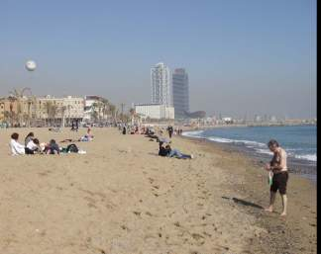
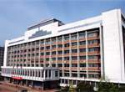
What did he do last weekend?
go to the beach
go--went
went to the beach
study in the library
study--studied
studied in the library

Slide 33
Language points
1. How was your weekend？
how 是疑问副词，意为“怎样”，它引导的特殊疑问句常用来对意见、打算、程度、方式、手段等进行提问。常用短语：how much 多少 (询问价钱或者不可数名词的数量)；how many 多少 (询问可数名词的数量)；how long 多长 (对时间、长度提问)；how far 多远(对距离提问)。
例：How do you usually go to school？你通常是怎样去上学的？

Slide 34
2. We are going to take a bus there.
take a bus 乘公共汽车，相当于“by＋交通工具名词”。表示“乘坐某种交通工具”用“take＋冠词＋交通工具名词”，这个结构类似的用法还有：take a cab/taxi 坐出租车；take the subway 坐地铁。
例：He took the subway to the train station.
= He went to the train station by subway.
他乘地铁去了火车站。
Don't take the taxi at the airport. It's too expensive.
别在机场打车。太贵了。

Slide 35
3. We are going to sing songs and play games on the
bus.
on the bus 在公共汽车上。“on＋冠词/名词所有格/形容词性物主代词＋交通工具”，表示“在某种交通工具上”，也可以用来表示“乘坐某种交通工具”，这样的交通工具一般是指 plane、train 等大型交通工具或者 bike （自行车）。
【拓展】当表示乘坐 taxi、car 等小型交通工具的时候，一般用“in＋冠词/名词所有格/形容词性物主代词＋交通工具”结构。例：He went to work in her car. 他坐她的车去上班。

Slide 36
4. My uncle is going to bring his camera and I am
going to bring some donuts for everybody.
bring v. 带来。例：Bring your camera to school. 把你的相机带到学校来。
【辨析】bring与take
① bring是指把人或物从别处带到说话人所在地。例：You should bring your homework today. 你今天应该把作业拿来。
② take是指把人或物从说话人所在地带到别处。如：Please take the book to the library.请把这本书带到图书馆去。

Slide 37
Exercises
一、单项选择。
1. Please ________ these cookies to your brother.
A．take B．bring
C．get D．fetch
2. —Does your father go to work by______
car every day?
—No，he sometimes takes ________ bus.
A．a；the B．the；a
C．\；a D．a；\

Slide 38
3. —Do you know _____ Ann goes to work
every day?
—Usually by underground. (2017·安徽)
A．why B．how
C．when D．whether
4. — ________ did you work out the problem in
such a short time?
— With Mr.Li's help.
A．When B．Where C．How D．Which

Slide 39
二、根据句意，用所给词的适当形式填空。
1. That little girl said to her mother, “I can look after________ (I) now, Mum.”
2. We are so ________ (excite) to pass the exam.
3. What about _______ (climb) the mountain with us?
4. The children are singing and dancing ______
(happy) in the park.
5. Everybody looked happy when they heard the
________ (excite) news.
myself
excited
climbing
happily
exciting

Slide 40
三、按要求进行句型转换。
1. She had a great weekend last week. （改为否定句）
She ______ ______ a great weekend last week.
2. They wanted to join the swimming club in the city center. （对划线部分提问）
______ did they ______ to ______?
3. He is going to bring some apples for everybody.
（对划线部分提问）
______ ______ he going to bring for everybody?
didn’t
have
What
want
do
What
is

Slide 41
4. They are going to do some cleaning tomorrow.
（改为一般疑问句）
____ ______ going to do ______ cleaning tomorrow?
5. —____________________________? （写出问句）
—I had a great weekend.
6. It’s about five kilometers away from here. （对画线部分提问）
______ ______ _______ _______ from here?
Are
they
any
How was your weekend
How far
is it

Slide 42
Summary
语法: 1.学习了一般过去时；
2.学习了动词过去式的变化规则。
日常交际用语
（1）What did you /your friend/he/she/they do last
weekend?
（2） —How was your weekend?
—It was great!/ It was OK./ It was fantastic.
— It was not good./ It was terrible.

Slide 43
Homework
1.Finish the exercises in Activity Book.
2.Preview the new words and expressions
of Unit 5.
3.Try to write about your activities of last
weekend and your plan for the next weekend.

