Slide 1
Unit 3
How do you get to school?
Section A
WWW.PPT818.COM

Slide 2
创设情境
Chant: How do you get to school?
bike. bike. ride a bike
taxi. taxi. take a taxi
bus. bus. take the bus
boat. boat. take the boat
train. train. take the train
subway. subway. take the subway

Slide 3
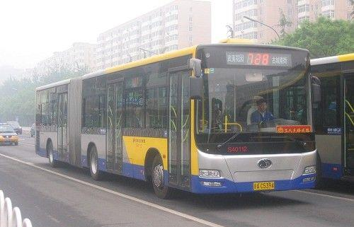
启发思考
How do you get to school every day?
I take the bus to school.

Slide 4
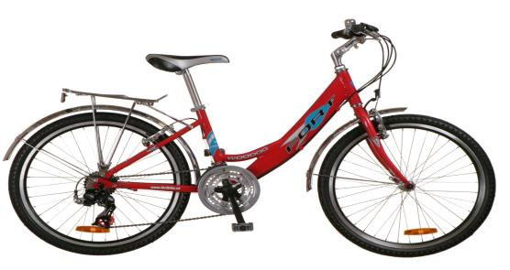
How do you get to school every day?
I ride a bike to school.

Slide 5
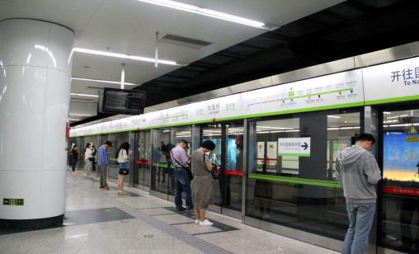
How do you get to school every day?
I take the subway to school.

Slide 6
Summary:
A: How do you get to school ?
walk
ride a bike /…
take the bus/…
B: I to school.

Slide 7
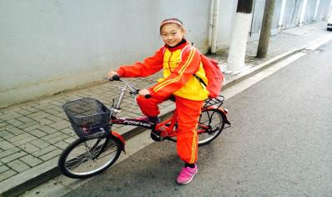
How does she get to school?
She rides her bike to school.

Slide 8
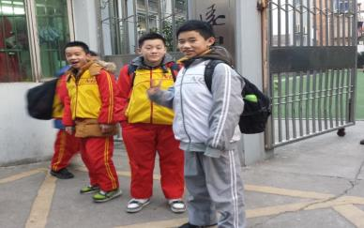
How do they get to school?
They walk to school.

Slide 9
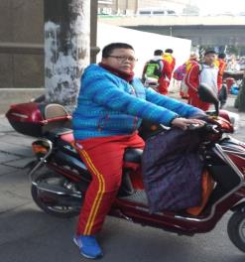
How does he get to school?
He rides an electric bike to school.

Slide 10
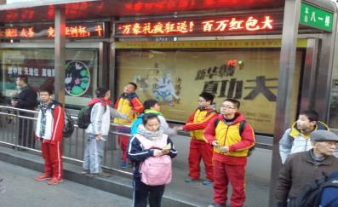
How do they get to school?
They take the bus to school.

Slide 11
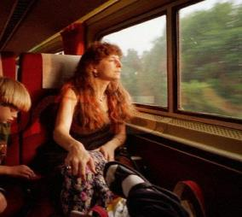
How does she get to work?
She takes the train to work.

Slide 12
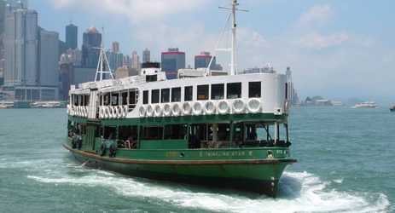
How does he get to Hong Kong?
He takes the ship to Hong Kong.

Slide 13
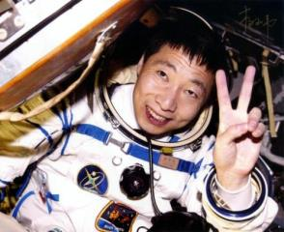
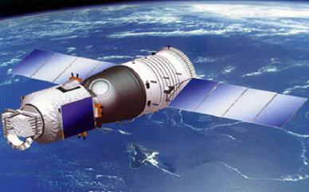
How does Yang Liwei get to the space?
spaceship
He takes the spaceship to the space.

Slide 14
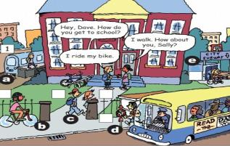
自主或小组探究
1a
Match the words with the pictures.
a
d
take the train ___ 2. take the bus ___
3. take the subway ___ 4. ride a bike ___
5. walk ____
e
b
c

Slide 15
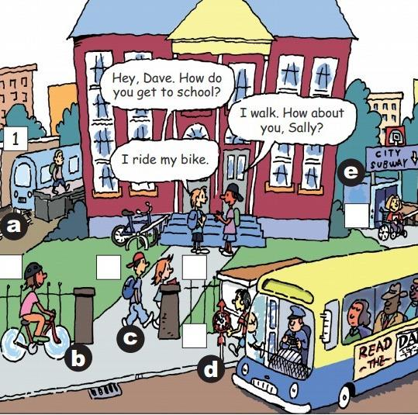
1b
Listen and write.
Bob 2. Mary 3. John 4. Paul 5. Yang Lan 6. Jim
2
6
4
5
3

Slide 16
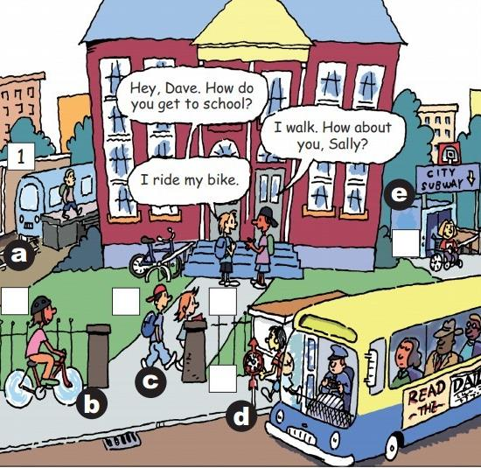
Bob 2. Mary 3. John 4. Paul 5. Yang Lan 6. Jim
A: How does Bob get to school?
B: He takes the train.
2
6
4
5
3

Slide 17
Check your answers again! Read aloud.
Bob takes the train.
Mary takes the subway.
John takes the bus.
Paul walks.
Yang Lan walks.
Jim rides his bike.

Slide 18
Repeat.
2a
84 105 99 200 72 61

Slide 19
Read the numbers
fifty-eight
one hundred and three
nine hundred
How long?
How far?
twenty-five minutes.
ten kilometers(公里).

Slide 20
20 minutes
A: How does Tom get to school?
B: He walks to school.
A: How long does it take?
B: It takes twenty minutes.

Slide 21
6:30
30
minutes
7:00
A: How does Jack get to school?
B: He takes the bus to school.
A: How long does it take?
B: It takes about 30 minutes.
Notes:
21

Slide 22
Listen and complete the chart.
2b
How long ?
(minutes)
How far?
(kilometers)
How
Tom
walks
20
2
Jane
takes the bus
90
60

Slide 23
2e
Role-play the conversation.
Lisa: Hey, Jane. Is this your new bike?
Jane: Yes, I ride it to school every day. How do you get to school?
Lisa: I usually take the bus.
Jane: How far is it from your home to school?
Lisa: I’m not sure …about 10 kilometers? The bus ride takes about 20
minutes. How long does it take you to get to school?
Jane: About 15 minutes by bike. It’s good exercise.
Lisa: Yeah. Well, have a good day at school.
Jane: You, too.

Slide 24
Read the conversation and fill in the blanks.
 | How | How long (minutes) | How far (kilometers)
Lisa
Jane
takes the bus
20 minutes
10 kilometers
rides the bike
15 minutes
Notes:
24

Slide 25
协作交流
Grammar Focus
How do you get to school? | I ride my bike.
How does she get to school? | She usually takes the bus.
How long does it take to get to school? | It takes about 15 minutes.
How far is it from your home to school? | It is only about two kilometers.
Does Jane walk to school? | No, she doesn't. She goes by bike.
Do they take the bus to school？ | No, they don't. They walk.

Slide 26
Language Point
get to 某地
1. How do/does + 某人 + ___________ ?
某人怎么去某地?
how是疑问副词, 本句中用来提问__________ 等。
你叔叔通常怎样去香港？
___________________________________
出行方式
How does your uncle get to Hong Kong?

Slide 27
2. 回答方式有两种:
A: 某人 + take(s) + ____________ + to 某地。
B: 某人 + get(s) to 某地 + _____________
我叔叔乘飞机去香港。
___________________________________
___________________________________
the 交通工具
by 交通工具
My uncle takes the plane to Hong Kong.
My uncle gets to Hong Kong by plane.

Slide 28
3. It takes sb. some time to do sth.
意为：___________________________
步行大约要花我15 分钟的时间。
_________________________________
做作业大约花费Jane30分钟的时间。
_________________________________
_________________________________
某事花费某人……时间
It takes me about 15 minutes to walk.
It takes Jane about 30 minutes to do
her homework.

Slide 29
4. 如果对时间段提问的话，就用
_________ + does it take sb. to do sth.? 句型。
How long
How long does it take to walk to school?
How long does it take to do her homework?

Slide 30
5. 对两地间的距离提问下列句型：
_______ + is it _____ 某地 ___ 某地？
从他家到服装店多远？
_______ is it _____ his home __ the clothes store?
从北京到上海有多远？
_______ is __ from Beijing ___ Shanghai?
How far
from to
How far
from to
How far it
to

Slide 31
Practice
1. Fill in the blanks:
1. I take the train to school.
= I get to school __________.
2. She takes the subway to school. (同义句)
She _____ to school ___ _________.
by train
gets
by subway

Slide 32
3. Jenny rides the bike to school
= Jenny gets to school ___ _____.
by bike
4. Mr. Wang walks to school. (同义句)
Mr. Wang _____ to school ___ ____.
gets
on foot

Slide 33
2. Translate:
1. 你怎样去学校？我骑车去学校。
2. 她怎样去学校？她乘火车去学校。
How do you get to school?
I ride the bike to school.
= I get to school by bike.
How does she get to school?
She takes the train to school.
= She gets to school by train.

Slide 34
3. 写出下列句子的同义句。
1. Tom takes the bus to school.
Tom gets to school by bus.
2. I walk to school every day.
I get to school on foot every day.
3. They go to the USA by plane.
They take the plane to the USA.

Slide 35
4. 句型转换。
They ride their bikes to school. (就画线部分提问）
How do they
____ ___ ____ get to school?
2. It takes 50 minutes to get here. (就画线部分提问）
_____ ____ ____ it take to get here?
How long does

Slide 36
3a
Match the questions with the answers.
Then practice them.
1. How does Mike get to school?
c. He rides his bike
2. How long does it take to get to home?
e. About 15 minutes.
3. How far is it from here？
d. It’s five kilometers.
4.Do your friends go to school by bus？
a. Yes, they do.
5.Does your dad drive his car to work?
b. No, he doesn't.

Slide 37
3b
Use these words to make questions.
school / you / get to / do / how
_________________________________________
How do you get to school?
2. to / school / get to / does / how long / take / it
_________________________________________
How long dose it take to get to school?
3. school / your / from / it / is / how far / home / to
_________________________________________
How far is I from your home to school?
4. you / to / walk / do / school
__________________________________________
Do you walk to school?
5. ride / their bikes / do / school / your friends / to
__________________________________________
Do your friends ride their bikes to school?

Slide 38
总结提高
Make a survey in your group.
Questions | S1
How far do you live from school?
How do you get to school?
How long does it take to get to school?
5 kilometers
take the bus
10 minutes

Slide 39
Make a report about your classmates.
In my group, S1 lives about five kilometers from school. He goes to school by bus. It takes about ten minutes to get to school.
S2 lives about …
S3 lives about …

