Slide 1
Unit 2 School life
GrammarⅡ
WWW.PPT818.COM

Slide 2
写出下列词的比较级和最高级
Lead in
taller the tallest
colder the coldest
tall ________ ________ cold_______ _______
nice _______ ________ late _______ _______
pretty _______ _________ easy ________ _______
slim ________ _______ big _________ _________
good _______ ________ bad ________ ________
many _______ _________ much _______ _________
little ________ _________
interesting ______________ _______________
nicer the nicest
later the latest
prettier the prettiest
easier the easiest
slimmer the slimmest
bigger the biggest
better the best
worse the worst
more the most
more the most
less the least
more interesting the most interesting
1.一般情况后: ＋er／est
The
Rules:
2.以e结尾: ＋r/st
3.辅音字母＋y结尾: 变y为i +er/ est
4.以重读闭音节（辅元辅）结尾：双写尾字母＋er/ est．
5.多音节词：-more the most
6.不规则单独记

Slide 3
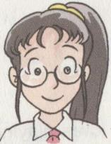
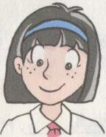
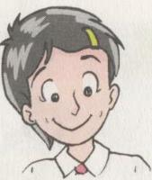
the result of the race
1
2
3
faster
the fastest
fast
Millie came third in the race. She ran fast.
Sandy came second in the race. She ran faster than Millie.
Amy came first in the race. She ran the fastest.

Slide 4
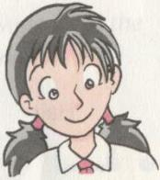
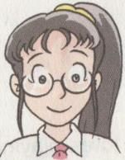
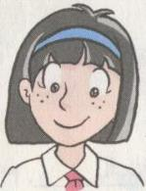
the result of the high jump
the highest
higher
high
1
2
3
Amy jumped high.
Kitty jumped higher than Amy.
Sandy jumped the highest of all.

Slide 5
Do you know comparatives and superlatives of adverbs?
Work out the rules
构成法
原级
比较级
最高级
harder
the hardest
单音节词和少数双音节词,词尾加--er, est
hard
late
later
the latest
early
earlier
the earliest
大部分双音节词和多音节词前加—more , most
more slowly
the most slowly
slowly
more carefully
the most carefully
carefully

Slide 6
不规则变化:
原级
比较级
最高级
well
better
the best
badly
worse
the worst
much
more
the least
the most
little
less
farther
further
far
the farthest
the furthest

Slide 7
Practice
根据句意, 写出括号中所给词的正确形式.
1. She sang even ______ (bad) than usual.
worse
faster
2. Mother asked her son to walk a bit ______ (fast).
3. Of all the novels I like this one _____ (最).
best
highest
4. Who can jump ______ (high) in your class?
more
5. He should speak ____ (little)and listen _____(much).
less
harder
better
6. The ______ (努力) you work, the _____ (好) harvest you'll have.
noisily
7. Please ask them not to play so _______(吵闹).

Slide 8
Competition
Let’s see which group is the best!
Choose your lucky number and do the exercise.
1
2
3
4
5
6

Slide 9
A. Among the four programmes, I watch the first one _______ (regular).
the most regularly
fast
B. He can run as ________(fast) as you .
C. Leo plays basketball ______(well) than
Frank.
better

Slide 10
safely
1 The plane landed _______ (safe) at last.
2 David writes ___________ (careful) than Millie.
3 My mother always gets up ______ (early) in my family.
more carefully
earliest

Slide 11
A. Who jumped the ______ in the high jump ?
A longest B higher
C highest D most high
B. Mrs. Smith was worried about both of her daughters, especially the ______ one.
young B. younger
C. youngest D. oldest

Slide 12
同义句改写
1. John ran faster than any other student in his class.
John in his class.
2. Andy doesn’t draw as well as Millie.
Millie .
ran the fastest
draws better than Andy

Slide 13
1.他学习比我认真，但是他并不是我们班上学习最认真的。
He studies , but he isn’t the one who studies ______________________ in our class.
2. Amy跳得最远，她跳得比其他所有人都远 。
Amy jumped ,
she jumped than all the others
more carefully (harder) than me
the most carefully/hardest
the farthest
farther

Slide 14
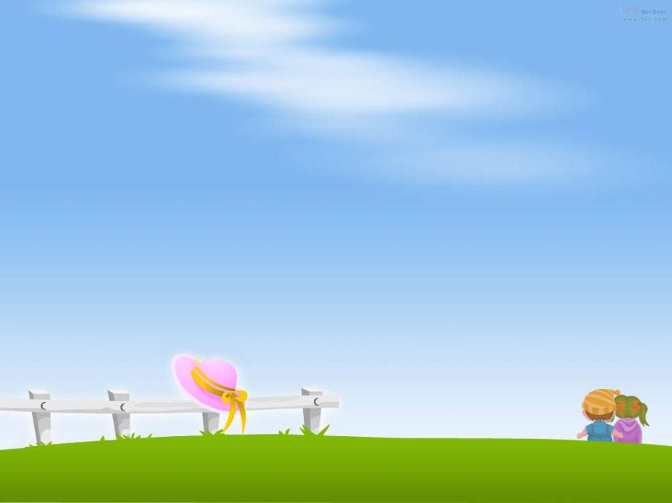
Please find out the mistakes in the following sentences and correct them(改错）
1. If I work more hardly, I will get more points in the exam. __________
2. He did more badly in this exam than in the last one. __________
harder
worse

Slide 15
Practice:
请用adv的比较级和最高级比较一切能比较的东西，与组内成员相互比较(唱歌、跳舞、…)，看谁比的最有水平！行动吧！
E.g. xx jumps high. xx jumps higher than … xxx jumps the highest of /in

Slide 16
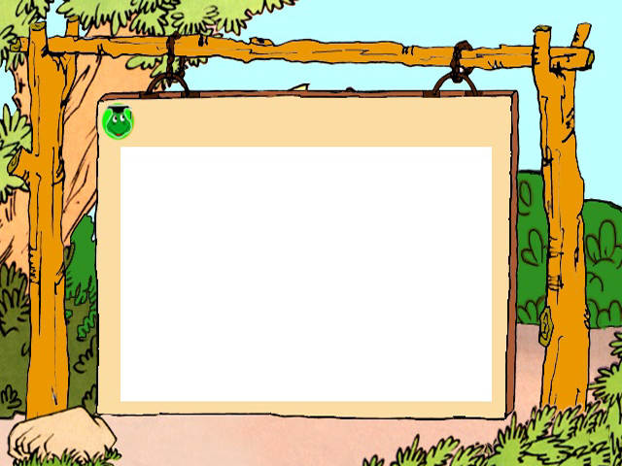
Homework
Finish the exercises on your workbook.
2. Review the grammar.

