Slide 1
Lesson 19
A Story or a Poem?
WWW.PPT818.COM

Slide 2
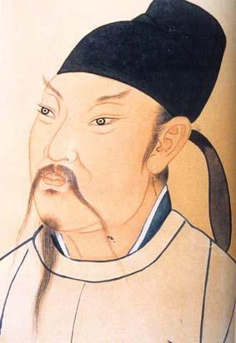
Warming up
Who is this man? Is he famous? Why or why not?

Slide 3
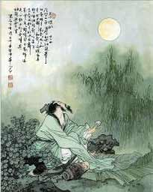
What do you think of the picture? Do you want to write a poem?

Slide 4
Discussing
1.Have you written a poem in Chinese? Is it hard? Why?
2.Do you have a favourite poem or story? What is it?

Slide 5
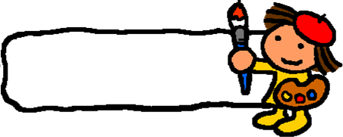
New words
passage n. 章节
although conj. 虽然
fat adj. 胖
aloud adv. 大声地
limit v. 限制
format n. 格式
rhyme n. 韵
compare v. 比较

Slide 6
Listening Task: write it is true or false.
( ) 1. Brian has finished his poem.
( ) 2.Jenny thinks it is easy to write a story.
( ) 3. Danny writes a poem about the donut.
F
T
T

Slide 7
Language Points
1. Have you written your poem yet, Brian? 布赖恩，你写完诗了吗？
此句为现在完成时，与现在完成时连用的副词有：already（已经），yet（仍然），just（刚刚），ever（曾经），never（从不），before（以前）等。
I have already seen the film. 我已看过那部电影了。
My mother hasn’t come back yet. 我妈妈还没有回来。

Slide 8
【注意】
already（已经）通常用于肯定句，表示已经完成某事，可以加在助动词have/has与实义动词的中间，也可以用在句子最后。yet多用于否定句和疑问句，一般放在句尾。
She has already finished her task. =She has finished her task already. 她已经完成了她的任务。
Have they cleaned the room yet? 他们打扫房间了吗？
David hasn’t made his bed yet. 大卫还没有整理床铺。

Slide 9
2. Compared with poems, stories usually have longer passages. 和诗比起来，故事通常有更长的章节。
compared to/with意为“和……比起来”，为过去分词短语做状语。
Compared with many people, I think I am very lucky. 和很多人相比，我觉得我很幸运。
3. I haven’t decided which one to write. 我还没决定写哪个。
decide意为“决定”，常见搭配有：
1）decide to do决定做某事
2）后跟“疑问词+动词不定式（短语）”或疑问词引导的宾语从句。
3）跟that从句。

Slide 10
4. Although a poem has fewer words, it’s not always easier to write. 虽然诗歌用词较少，但写起来不总是容易的。
1）all, both, everybody, always, everything等词和not连用时，为部分否定，不是全部否定。表示全部否定时，应改为对应的否定词none, neither, nobody, never, nothing等。
Both of us don’t know her. 我们俩不是都认识她。
Neither of us knows her. 我们俩都不认识她。
2）although意为“虽然”，为从属连词，不能和并列连词but连用。
Although he is tired, he still works. 虽然他累了，可他仍然工作。

Slide 11
Practice
根据句意及提示补全单词。
1. Can you tell the main idea of the ________ (章节)?
2. I once read a p written by Du Fu, which greatly moved me.
3. C_______ with stories, poems often have fewer words.
4. Our English teacher often asks us to read English a_____ in the morning.
5. A_______ it is winter now, but it is not very cold.
passage
oem
ompared
loud
lthough

