Slide 1
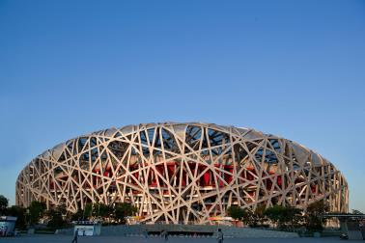
Module 6 Around town
Unit 1 Could you tell me how to get to the
National Stadium?
WWW.PPT818.COM

Slide 2
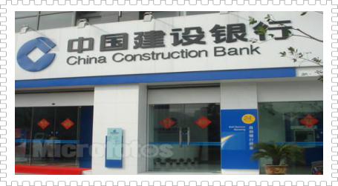
Place Guessing Game
You can get and save money here.
What is it?
bank
[bæŋk]

Slide 3
Place Guessing Game
restaurant
[ˈres trɒnt]
You can have meals when you are hungry.
What is it?

Slide 4
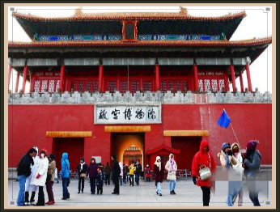
Place Guessing Game
museum
[mjuˈzi: əm]
You can see a lot of artistic(艺术的), cultural, historical or scientific importance and interest.
What is it?

Slide 5
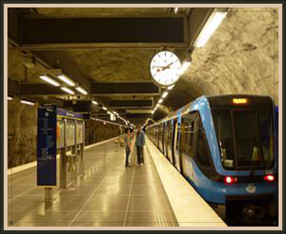
Place Guessing Game
It's a place.
You can get on or get off.
What is it?
station
[ˈsteɪ ʃn]

Slide 6
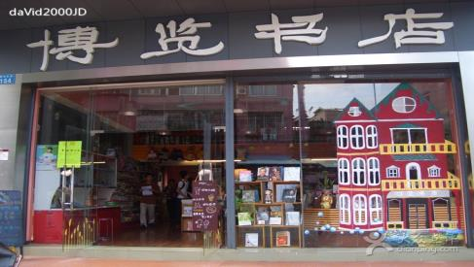
Place Guessing Game
bookshop
You can buy some books here.
What is it?

Slide 7
Bank
go across
[əˈkrɒs]
cross
[krɒs]
Renmin Road
opposite
[ˈɒpə zɪt]
Restaurant
- Excuse me, how can I get to the restaurant?
- Go across/ Cross Renmin Road and it’s opposite the bank.
Notes:
7

Slide 8
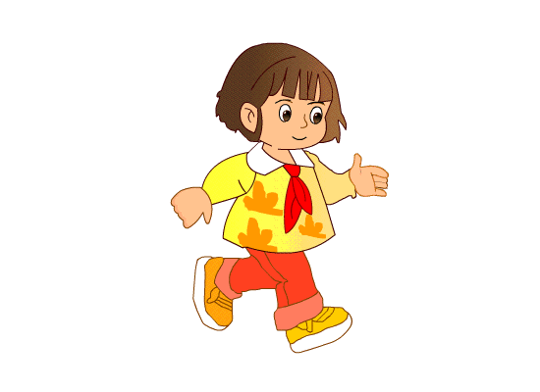
turn
left
Museum
Restaurant
go along
Xinghe Street
Huizhan Road
[əˈlɒŋ]
turn
right
Bookshop
Bank
- Excuse me, is there a museum near here?
- Yes, go along Xinghe Street and turn left. It’s on
the left, opposite the restaurant.
Notes:
8

Slide 9
Jianshe Street
go along
turn
right
Station
Shop
- Excuse me, could you tell me the way to the shop?
Go along Jianshe Street and turn right at the second
street. It’s on the left, opposite the station.

Slide 10
Shop
Station
turn left
Jianshe Street
go along
go across
- Excuse me, could you tell me how to get to the station?
- Go across Jianshe Street, go along the street and turn left at the second street. It’s on the right, opposite the shop.

Slide 11
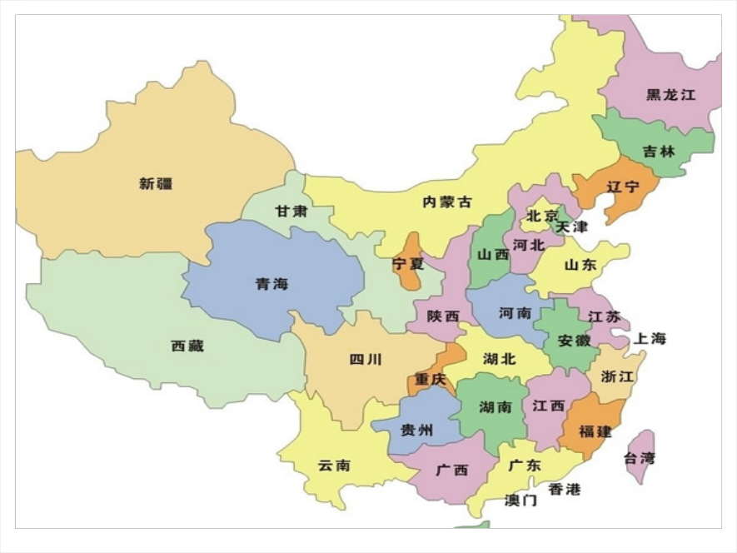

Slide 12
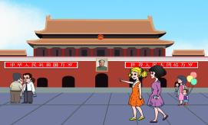
Listening
1.Where does the tourist want to go?
She wants to go to Wangfujing Dajie, bookshop and
the National Stadium.

Slide 13
Xi Chang' an Jie
Dong Chang' an Jie
Tian'an
men
square
Listen and draw the routes(路线) on the map. Try to mark(标记) where Wangfujing Dajie and bookshop are.
Notes:
13

Slide 14
1. Go across Dong Chang'an Jie, go along the street and turn left at the third street on the left.
/
1. Can you tell me the way to Wangfujing Dajie?
way
/
2. Yes, there is a big bookshop over there, just along Xi Chang'an Jie, on the right, opposite the bank.
2. Is there a bookshop
near here?
bookshop
3. Could you tell me how to get to the National Stadium?
/
3. Go along the street and you'll see an underground station.
/
/

Slide 15
Shop
Station
Caishi Street
Changjiang Road
Museum
Cinema
Restaurant
Jianshe Street
Zhongshan Road
Super-
market
Bookshop
Bank

Slide 16
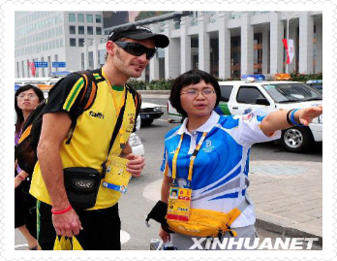
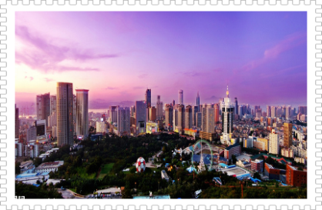
Dalian is a tourist city. Hundreds of people from all over the
world visit it every day. Some foreign tourists may need your
help to get to some places. Would you please help them?

Slide 17
Be polite
Be helpful

Slide 18
Homework
You should do:
Read the text fluently and correctly.
You can choose to do:
Draw a map of where you live. Write a composition to give directions to places on the map.

