Slide 1
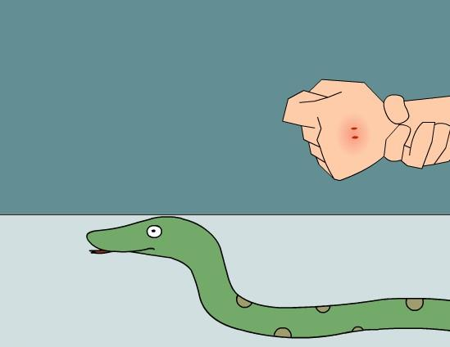
Module 8 Accidents Unit 2
I was trying to pick it up
when it bit me again.
WWW.PPT818.COM

Slide 2
Teaching objectives
1. To learn the vocabulary in unit 2.
2. To learn the past continuous tense.
3. To listen and understand the
text on page 66.

Slide 3
Words and expressions
[baɪt]
[klaɪm]
[haɪd]
[θrəu]
bite
climb
hide
throw
vt.(bit[bit]) 咬；叮
vi. 爬；攀爬
v.(hid[hid]) 躲藏/躲
vt. 投；掷

Slide 4
[frɪdʒ]
[peɪn]
[wə:s]
['medɪsɪn]
fridge
pain
worse
medicine
n. 冰箱
n. 疼痛；痛
a. 更坏的;更坏的
ad.更糟;更坏
n. 药；药物

Slide 5
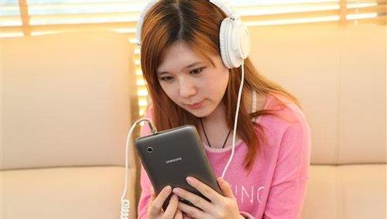
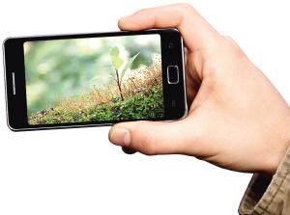
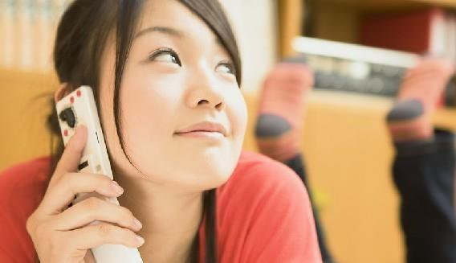
What was
she doing?
What was
he doing?
She was using
a mobile phone
to listen to music.
What was she doing?
He was using a mobile
phone to take photos.
She was calling.

Slide 6
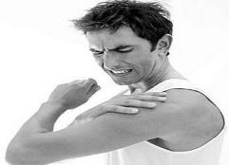
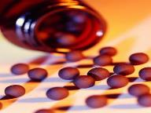
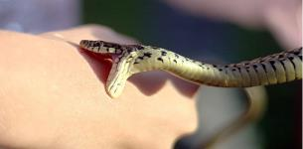
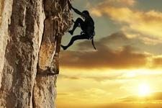
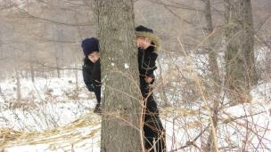
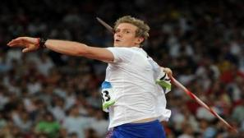
快速说出下面的单词
pain
medicine
bite
climb
hide
throw

Slide 7
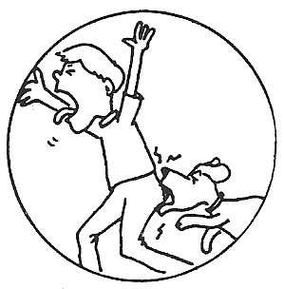
bit by a dog

Slide 8
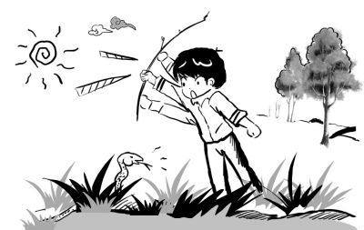
beat it with a stick (木棒)

Slide 9
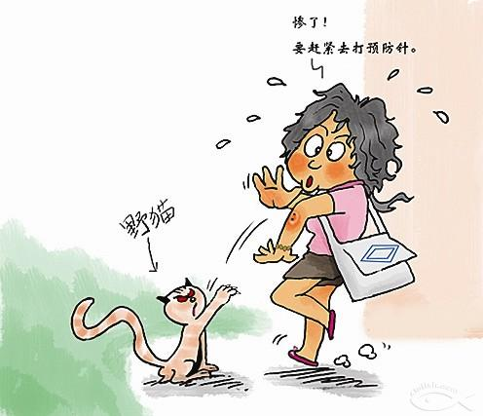
be in danger

Slide 10
3
Listen, read and learn
Smile please
One day, when Henry was working in a
restaurant, a snake suddenly appeared and
bit his hand.
A few days earlier, the snake arrived
from Asia in a box of bananas. It climbed
out and hid somewhere.
注
意
不规则动词

Slide 11
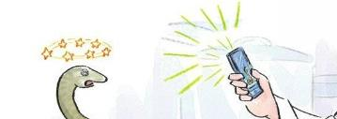
代词在副词前
“I was trying to pick it up when it bit
me again. I threw it across the kitchen, and
it landed on a table.”
While the snake was lying on the table, Henry quickly picked up his mobile phone and took a photo with it . Then the snake
hid behind the fridge.

Slide 12
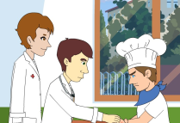
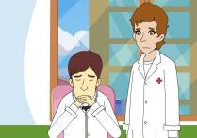
When Henry was trying to find the snake, his
hand began to hurt badly. He hurried to hospital.
As the doctors were checking him, the pain got
worse. But they could not help him because they
did not know what kind of snake bit him,

Slide 13
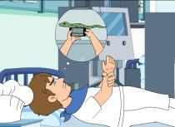
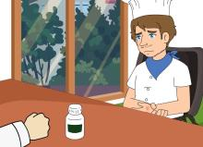
As he was lying there in great pain, Henry
suddenly remembered the photo. The doctors
sent the photo to a zoo. As soon as they learnt
what kind of snake bit him, they gave Henry the
right medicine, and he left hospital the next day.

Slide 14
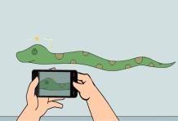
“So if a snake bites you, take out your mobile
phone or camera. Take its photo, and show the
photo to the doctors,” suggests Henry. “But as
you know, the snake won’t smile!”

Slide 15
Read the passage and answer the questions.
1. Where did the snake bite him?
2. When did Henry pick up his mobile
phone?
The snake bit his hand.
While the snake was lying on the table,
he quickly picked up his mobile phone.

Slide 16
3. Why couldn’t the doctor help him
at first?
4. Where did the accident happened?
5. When did he leave hospital?
Because they didn’t know what
kind of snake bit him.
In a restaurant.
The next day.

Slide 17
短语背诵
脸色苍白
你还好吗?
听音乐
过马路
look pale
Are you all right?
listen to music
cross the road

Slide 18
在拐角处
在电话聊天
及时
注意
肩并肩
round the corner
talk on the mobile phone
in time
pay attention
side by side

Slide 19
Language points
climb out 爬出来
climb out of … 从…爬出来
那只猫没法从洞里 爬出来。
The cat couldn’t climb out of the hole.

Slide 20
be doing …when …表示一个动作正在
进行的时候另个动作突然发生了。
他们正在田里干活儿，突然下起雨了。
They were working in the fields when it
began to rain.

Slide 21
pick sth. up 捡起某物，代词要放在中间。
pick sb. up 接某人
他捡起了刀叉。
He picked up his knife and fork.
第二天早上, 妈妈来接我。
The next morning, my mum came to pick
me up.

Slide 22
across prep. 从……的一边到另一边
对面，穿过
他们在我们的汽车前横冲过马路。
They ran across the street in front of
our car.
我最好的朋友住在马路对面。
My best friend lives across the road.

Slide 23
while引导的时间状语从句用进行时。
当主句的时态是现在时，while引导的
从句用现在进行时; 当主句的时态是过
去时, while引导的从句用过去进行时。
男孩读书的时侯，他发现了一个秘密。
While the boy was reading the book he
found a secret.

Slide 24
as 当……的时候
get worse 变得更糟 bad, worse, worst
随着时间的流逝，我的记忆力似乎越来
越差。
As time goes by, my memory seems to get
worse.
in pain 疼痛 in great pain 极其疼痛

Slide 25
5
climb hide hurt medicine pain throw
climbed
A snake 1 _______ out of a box of bananas and 2 _____somewhere. When Henry was working, the snake bit him. He 3 _______ the snake on a table
and took its photo. When he was trying to find the snake, his hand began to 4 ____ badly. At the hospital the 5 ___ got worse. The doctors sent the photo to a zoo. After they found out what kind of snake bit him, they gave him the right 6 _______.
hid
threw
hurt
pain
medicine

Slide 26
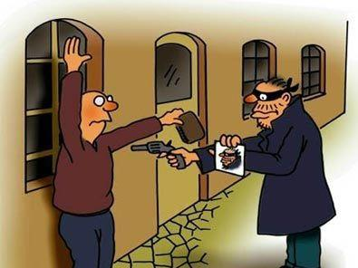
讲故事
found a man robbing (抢劫) Tom, called the police,
saved his life
One day I was walking alone in the city,
late at night, hold on my mobile phone.
Suddenly…

Slide 27
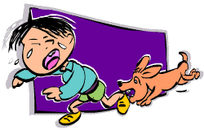
讲故事
found a boy bitten by a dog, called for help, saw the doctor, took some medicine
One day I was walking alone in the city,
late at night, hold on my mobile phone.
Suddenly…

Slide 28
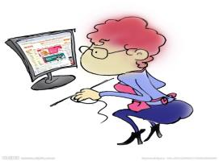
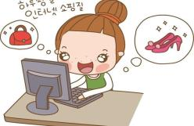
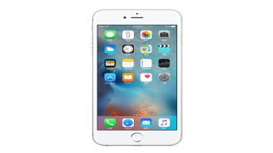
…can use a … to
造句
?
?
…

Slide 29
If I have a mobile phone,
I can use a mobile phone to …
make a phone call call people
play music
listen to music
send messages
send emails
go online
play games
read novels
watch films
video-chat视频聊天
take photos
take videos
pay money…

Slide 30
小结
While, when, as引导的时间状语从句。
重点短语:
bite one’s hand pick up
get worse in great pain
give sb. the right medicine

Slide 31
Homework
1. Recite the text on page 66.
2. Write a passage to tell about your
experience when you were in danger.

Slide 32
