Slide 1
Module
1
Travel
Unit 1 We toured the city by bus and by taxi.
WWW.PPT818.COM

Slide 2


Objectives
1. To understand the conversation with regard to “travel”.
2. To learn some key words and useful expressions
3. To talk about one’s holiday using the structures below:
I most/least like to travel by…
I travel most often/ least often by…
— What did you do during the winter
holiday?
— I went to see my grandparents in Xi’an.

Slide 3


How do you often travel by?

Slide 4
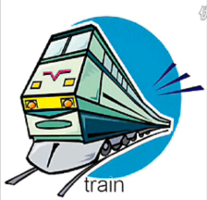



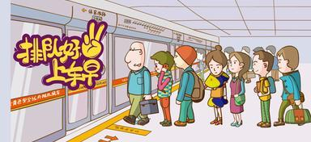

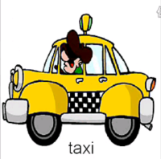

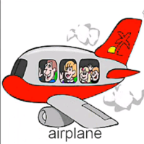
We have talked about the ways of transportation in Grade 8. Can you list some of them now? Let’s review them.
bus
underground
ship
bike
walking
/plane

Slide 5
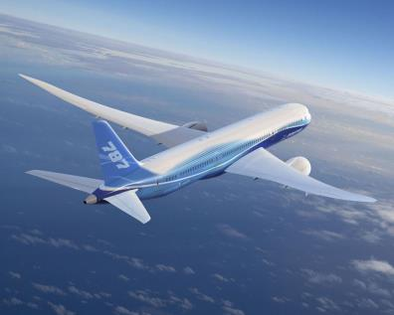
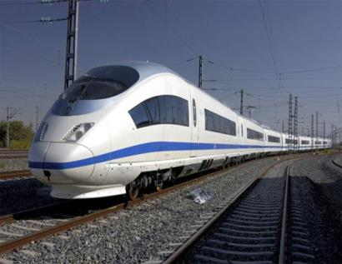
Look at the following pictures and talk about them.
Forms of transport
plane
train

Slide 6
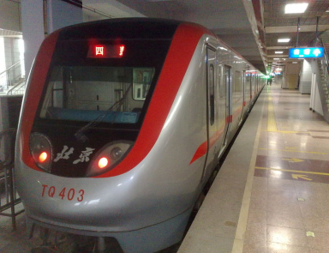
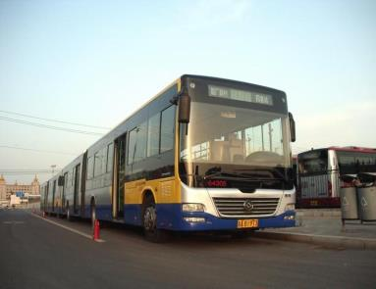
subway
bus

Slide 7
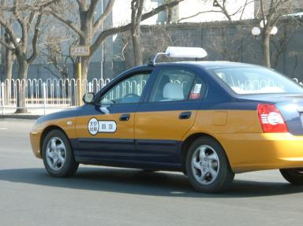
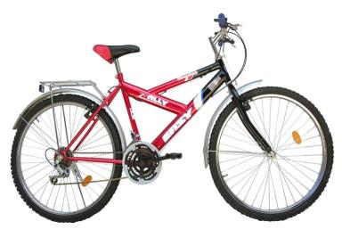
taxi
bike

Slide 8
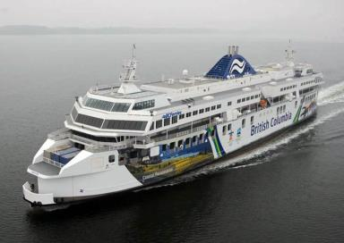
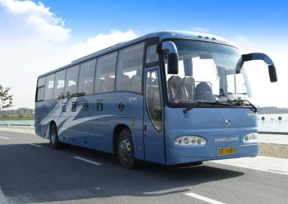
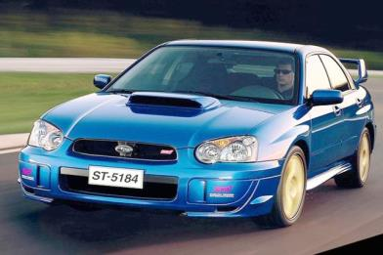
ship
coach
car

Slide 9
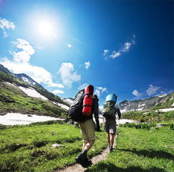
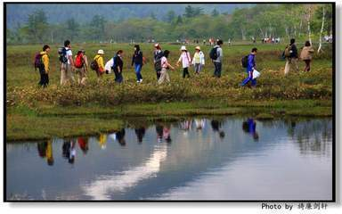
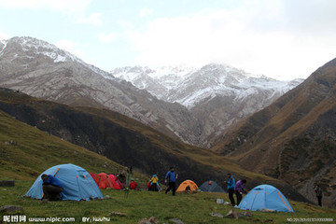
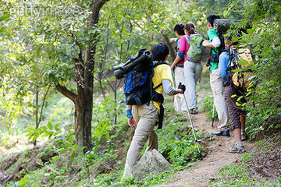

travel on foot
What’s your favourite type of transportation? Why?

Slide 10

For example
I travel least often by taxi, because it’s expensive.
I travel most often by bus, because it’s cheap.
I least like to travel by train, because it’s crowded.
I most like to travel by plane, because it’s fast.

Slide 11


Discussion
airplane
Have you ever taken an airplane?
train
Do you like traveling by train? Why?
ship
Can you describe your feeling of taking a ship?
bus
Do you often go to school by bus?
subway
What’re the advantages of taking a subway?
taxi
When do you choose to take a taxi?

Slide 12
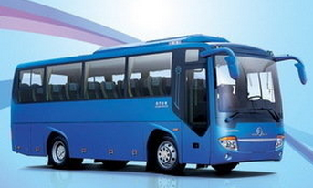
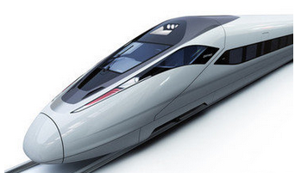
Which of these forms of transport do you
like most?
like least?
use most often?
use least often?
Why do you like travelling by ...?
I like travelling by ... because ...

Slide 13


Talk about these questions and describe your last trip:
Where did you go?
How did you go there?
What did you do there?
How was your trip?
Did you have a good time?

Slide 14

Work in pairs. You may talk like this:
A: Do you like travelling?
B: Yes, I like it a lot.
A: How do you often travel?
B: I often travel by plane.
A: What about you?
C: I often travel by train.
A: We all like travelling. It’s very
exciting and interesting.

Slide 15


Read the words and expressions loudly.

Slide 16
Words review
/flait/
n. 航班；飞行
因为；由于
adv. 径直地；直接地
n. 飞行员
v. 成功；做成
只要
n. 毕业生
adv. 确切地；完全； (表示赞同)确实如此
flight
because of
direct
pilot
succeed
as long as
school-leaver exactly
/dai'rekt/
/'pailət/
/sək'sid/
/iɡ'zæktli/

Slide 17

Focus on
Words:
flight direct pilot succeed school-leaver exactly
Phrases:
be full of because of as long as
succeed in doing… look forward to…
Patterns:
We toured the city by bus and by taxi.
— What did you do during the winter
holiday?
— I went to see my grandparents in
Xi’an.

Slide 18
Listening and vocabulary
1. Complete the sentences so they are true
for you.
1 I most like to travel by ____________.
2 I least like to travel by ____________.
3 I travel most often by _____________.
4 I travel least often by _____________.
taxi
bus
bicycle
ship

Slide 19

2. Listen and complete the notes.
1 The flight takes about ________ hours.
2 Time difference: ________ hours
3 Flight number: ________
ten
eight
CA938
4 From ________ to ________
5 Leave at (new time): ________
6 Arrive at (new time): ___________________
London
Beijing
11:30
5:30 in the afternoon

Slide 20

Watch and read
Learning to learn
When you listen to the recording, try to note down the key information. Your notes will then help you retell the main information.

Slide 21

3. Listen and read
Lingling: Welcome back, everyone!
Betty: Hi, Lingling! How was your holiday?
Lingling: Not bad! I went to see my grandparents in
Henan Province. The train was full of people,
and I had to stand for over three hours!
Betty: Bad luck. Why is travel so difficult in winter?
Lingling: Well, it’s the busiest season in China because of
the Spring Festival. Where’s Tony?
Daming: He went to stay with his family in the UK. He’s
flying back today. But the flight is late.

Slide 22
Betty: Where did you go, Daming?
Daming: We flew direct to Hong Kong and the
plane left a bit late too! But the pilot
succeeded in landing on time. Then we
took a boat to Lantau Island and went
to Disneyland. It was great fun!
Lingling: How about you, Betty?
Betty: We had quite a good time in Beijing.
We toured the city by bus and by taxi.
Last weekend, we took a tour by coach
to the Summer Palace and went for a
long walk around the lake.

Slide 23
Lingling: That sounds great! But now, we’d
better get back to work. We’re going
to have a big exam at the end of the
term.
Betty: There’s nothing to worry about as
long as you work hard.
Daming: And after the exam, there’s the school-
leavers’ party. We’re all looking
forward to it!
Betty: Exactly! We’ll
have a great
time!
Everyday English Not bad!
It was great fun!
How about you?
We’d better get back to work.
We’ll have a great time!

Slide 24
Now complete the table.
 | Holiday activities
Lingling | went to see her grandparents in Henan Province by train
Tony
Daming
Betty
went to stay with his family in the UK
by plane
Flew to Hong Kong and visit Lantau Island and Disneyland
Toured Beijing by bus and by taxi and took a tour by coach to the Summer Palace

Slide 25
Language points
1. The train was full of people, and I had to stand for over three hours!
火车上全是人，我不得不站了三个多小时!
be full of 意为“充满……；装满……”，其后可接可数名词复数或不可数名词。同义短语为be filled with。
箱子里装满了书。
The box is books.
full of/ filled with

Slide 26
2. Well, it’s the busiest season in China
because of the Spring Festival.
由于春节，冬季成了中国交通最繁忙
的季节。
because of意为“因为；由于”，后可接名词、代词或V-ing形式。例如：
We can’t go out for a walk because of the rain.
因为下雨，我们不能出去散步。

Slide 27
because意为“因为；由于”，是连词，后接句子，常用来回答由why引导的特殊疑问句。如：
— Why do you get up so early?
— Because I want to catch the early bus.
选用because of或because填空。
1. She broke the glass __________ her
carelessness.
2. She broke the glass __________ she was careless.
because of
because

Slide 28
3. But the pilot succeeded in landing on
time.
不过飞行员成功地按时着陆了。
succeed in doing… 表示“成功地做……”。例如：
He succeeded in working out the maths problem.
他成功地解出了这道数学题。
We finally succeeded in getting little Johnny up the stairs.
我们最后成功地让小约翰尼上了楼梯。

Slide 29
4. There’s nothing to worry about as long
as you work hard.
只要你努力，没什么好担心的。
as long as在这里引导条件状语从句，表示“只要”，也可以用so long as表达同样的意思。例如：
You can invite your friends as/so long as you tell me two days before the party.
你可以邀请朋友来，只要在聚会前两天告诉我就行。

Slide 30
My parents don’t care what job I do as/ so long as I’m happy.
我父母对我从事什么工作无所谓，只要我开心就好了。
只要你承诺11点以前回来就可以出去。
____________________________________
_____________________________
You can go out as/so long as you promise to be back before 11 o’clock.

Slide 31
4. Answer the questions.
1. When do you think the conversation takes place?
2. According to Lingling, why is travel so difficult in winter?
3. What are Daming and Betty looking forward to at the end of the term?
It takes place in winter.
Travel is difficult because of the Spring Festival.
They are looking forward to the school-leavers’ party.

Slide 32

5. Choose the correct answer.
direct； exactly； pilot； succeed
1.When you fly direct, you __________.
a) arrive without stopping at another place
b) stop at another place before you arrive
2 When you say “Exactly”, it means __________.
a) you do not agree b) you completely agree
3 The pilot of a plane __________.
a) flies it
b) gives you food and drink during the flight
4 If you succeed in doing something, you _______.
a) manage to do it b) nearly do it
√
√
√
√

Slide 33
Pronunciation and speaking
6. Listen and mark the pauses.
Lingling: How about you, Betty?
Betty: We had quite a good time in Beijing. We toured the city by bus and by taxi. Last weekend, we took a tour by coach to the Summer Palace and went for a long walk around the lake.
Lingling: That sounds great! But now, we’d better get back to work. We’re going to have a big exam at the end of the term.
∕
∕
∕
∕
∕
∕
∕
∕
∕
∕
∕
∕

Slide 34


Now listen again and repeat.

Slide 35

Talk
7. Work in groups. Talk about your
winter holiday.
Ask and answer about what you
did during the winter holiday.
-- What did you do during the winter holiday?
-- I went to see my grandparents in Xi’an.
Talk about what happened during the trip.
The train was full of people and I had to stand for three hours.

Slide 36


For example:
The train was full of people and I had to stand for three hours!
What did you do during the winter holiday?
I went to see my grandparents in Xi’an.
How did you get there?
I went there by train.
How was your travel?

Slide 37

总结回顾
本课时主要短语和句型
1. be full of…
2. because of
3. succeed in doing…
4. — What did you do during the winter
holiday?
— I went to see my grandparents in
Henan Province by train.
5. We took a boat to Lantau Island and went to Disneyland.

Slide 38
Important phrases
1. 欢迎回来
2. 充满……的
3. 不得不做
4. 和……呆在一起
5. 乘飞机飞回
6. 最繁忙的季节
7. 乘飞机去香港
8. 乘船去……
9. 玩的非常高兴
welcome back
be full of
have to do
stay with
fly back to
the busiest season
fly to Hong Kong
take a boat to
have quite a good time

Slide 39
13. 最好做某事
14. 最好不做某事
15. 在学期末
17. 学校毕业晚会
18. 去……的参观
had better do sth
had better not do sth
at the end of the term
the school leavers’ party
the visit to

Slide 40


Slide 41
Ⅰ. 用方框内所给单词的恰当形式填空。
coach flight succeed plane school-leaver
plane
The first _________ was flown by the
Wright brothers over 100 years ago.
2. A _______ is a large comfortable bus used for sightseeing or long-distance travel.
3. Will the head teacher attend the ______________ party next Friday?
4. It’s only about forty minutes’ ________ from Taiyuan to Beijing by air.
5. I’m sure you will ______ if you work hard.
coach
school-leavers’
flight
succeed

Slide 42
Ⅱ. 根据上句完成下句，使上下句意思相同或相近。
1. What was your trip to London like?
______ ______ your trip to London?
2. The Blacks enjoyed themselves very
much in Hangzhou last week.
The Blacks ______ _____ ______ _____
in Hangzhou last week.
How was
had a great time

Slide 43
Ⅲ. 根据汉语意思完成下列句子。
1. 你最好早点回来。
You _____ _____ _____ ______ early.
2. 欢迎回来，孩子们！
_________ _______, children!
3. 下课时把作业交上来。
Give in your homework ______ ______ ______ _______ the class.
had better come back
Welcome back
at the
end of

Slide 44
Homework
Have a talk with your parents and get
more information about their holiday.
Then make a short dialogue with your
partner.

Slide 45



