Slide 1
Unit 5 Topic 3
Many things can affect our feelings
Section C
WWW.PPT818.COM

Slide 2
Review
Talk about the story of Michael according to the key words:
speech, upset, sick, not confident, in a bad mood, affect
be proud of, each other, surprise, put on, get ready for

Slide 3
Review
Chain work: Talk about what makes you have the feelings one by one. The following structure may help you.
Things | Feeling | Things | Feeling
 | nervous |  | happy
 | frightened |  | sad
 | angry |  | worried
I feel … when / if …
… makes me feel …

Slide 4
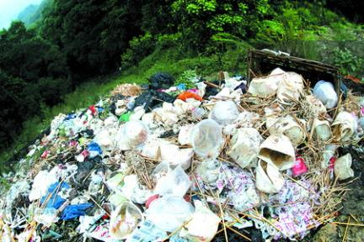
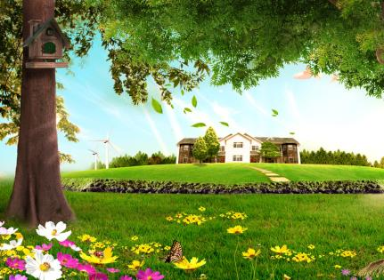
How do you feel at the pictures?
environment环境
The environment can affect our feelings and health.

Slide 5
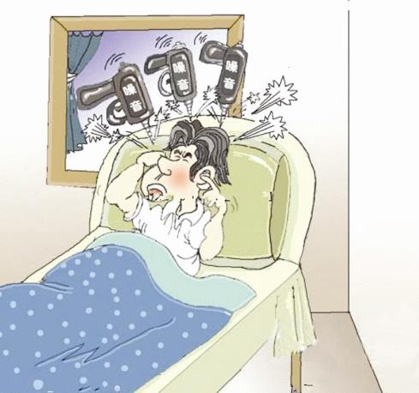
trouble 困难，问题
loud noise
He has trouble sleeping because of the loud noise.

Slide 6
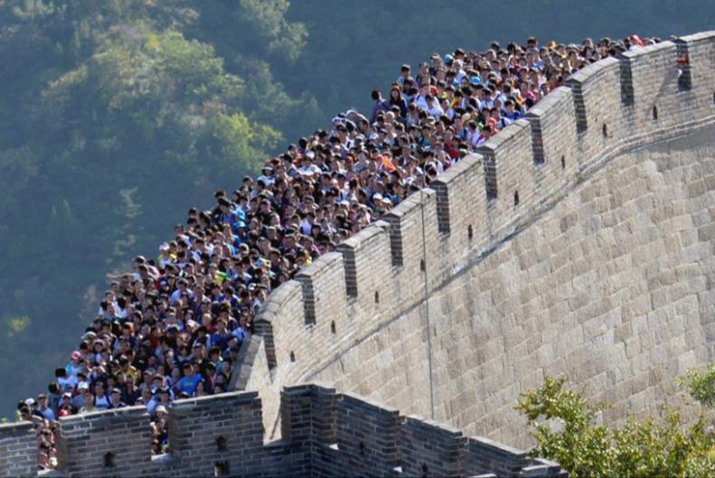
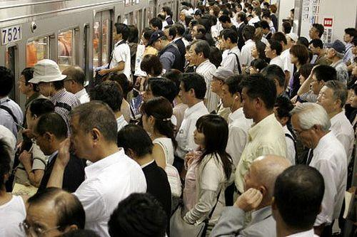
The Great Wall is crowded with people.
crowd v.拥挤；n. 人群
the crowd of people
Does it affect your feelings and moods?

Slide 7
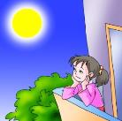
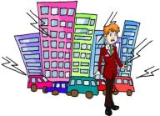
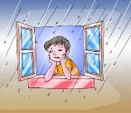
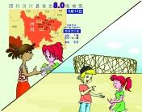
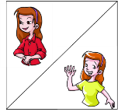
1a Read and understand
Tick the things that can affect your things and moods. Then look at the pictures and predict what will be mentioned in the text. Then add more ideas.
weather books holiday
colors big events homework environment music

Slide 8
Read 1a again and complete the table. Then retell the passage.
1b
Thing | Condition | Feeling
moon | can’t be with the family ____________________the family | ____________ happy
environment | noisy and crowded with people ________________________ | ____________ relaxed
weather | rainy __________ | ____________ happy
color | orange and yellow _________ green _________ | ___________ calm more ______ active
big event | ______________ Beijing 2008 Olympics | sad and worried ___________
lonely
get together with
nervous
clean and quiet
sad
sunny
confident
blue and white
energy
red
Wenchuan earthquake
excited

Slide 9
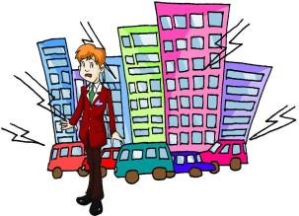
I think the moon can affect my moods, especially when the full moon is high in the sky on the Mid-autumn Festival. The moon is so round and bright. But I can’t get together with my family. I feel very lonely, and my eyes fill with tears.
adv. 特别，尤其
The environment can change my feelings. I live in a big city. It is always noisy and crowded with people. I feel nervous and I have trouble sleeping at night. I hope to live in the countryside some day. It’s clean and quiet there. I think I could relax and sleep well.
v. 装满= are full of

Slide 10
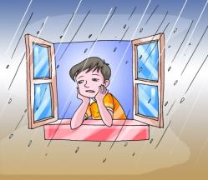
I think the weather can affect my moods. When it rains, I always feel sad. When the sun shines brightly, it makes me happy again.
Colors can affect my feelings and moods. Orange and yellow can make me feel confident. when I am feeling sad, these colors cheer me up. Blue and white can make me feel calm. Green is the color of nature. It can give me more energy. Wearing red often makes me feel active.

Slide 11
Big events can affect me a lot. When I talk about the Wenchuan earthquake with friends, sadness and worries always come to me. But when we talk about Beijing 2008 Olympics, I always feel excited.

Slide 12
Discuss in groups to find more information and give your own opinions.
1c
What else can affect your feelings?
Thing | Feeling
noise | When I’m doing my homework, I hate loud noise.
music | When I am excited, I like rock music. when I’m sad, I don’t like it.
movie | Sad movies often make me unhappy.
… | …

Slide 13
2
Write a passage about how things affect your feelings.
You can begin like this:
Colors can affect my feelings. _______________________________________
______________________________________________________________________________

Slide 14
2
Write a passage about how things affect your feelings.
An example :
Colors can affect my feelings. Different colors can change my feelings. When I feel sad, I usually put on bright-colored clothes, such as light green, red, yellow or orange. They will make me feel happy quickly. But when I want to calm down, I always look at blue things or put on blue clothes, because blue makes me feel quiet and calm. What’s more, brown makes me feel better at learning, and white makes me more helpful. And I remember not to wear dark-colored clothes when I feel sad.

Slide 15
Exercise
1. She was so excited that her eyes _____ _____ (充满)tears.
2. The __________(环境) can affect our feelings and moods. But if we can’t change it, try to change our minds then!
3. Don’t make any ______ ______ (很响的噪声) when the boss is sleeping. He can’t sleep well in _______ (吵闹的)places.
4. You must be careful on the street. _________(尤其) when you go across it.
5. Learn to _____ ______(处理) it by yourself if you have any _______ (麻烦). Of course, you can also ________ (选择) to call me for help.
filled with
environment
loud noise
noisy
Especially
deal with
trouble
choose

Slide 16
Summary ①
We learn
1. New words and phrases:
environment, especially, trouble, fill, fill (sth. ) with…, choose (to do sth.)
2. The structure “make + O + do sth.”
… it makes me feel happy again.
Blue and white can make me feel calm.
Wearing red often makes me feel active.

Slide 17
Summary ②
We can
Words and phrases:
sick, proud, be proud of, anyway, ready, passport, boss, grandson, get along with sb.
To describe personal feelings.
I’m afraid he is going to be sick.
If we’re not confident about ourselves, we may feel upset or nervous.
3. Six sentence structures of simple sentences.
Talk about the influences of different things on our feelings.
I think the weather can affect my moods.
The environment can change my feelings.
Colors can affect my feelings and moods.

Slide 18
Project
Survey your classmates to know about the influence of different things on their feelings.
Name | What things can affect your feelings? | What do you do when you feel bad?

Slide 19
Homework
Review the new words, phrases and useful expressions in Section C.
Write down your passage to talk about how things can affect your feelings and what you do when feeling bad.
Preview Section D.

