Slide 1
Lesson 38
Making School a Better Place
WWW.PPT818.COM

Slide 2
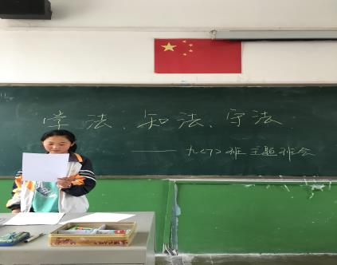
Warming up
Is there a student council in your school? What does it do?

Slide 3
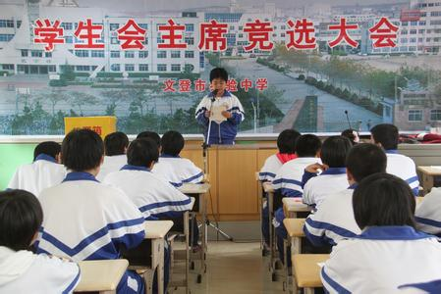
Who do you think can work towards peace? Can you do it too?
work toward(s) “努力达到；设法获得”

Slide 4
Words and expressions
1. Danielle 丹妮尔（人名）
2. president n. 会长；总统；国家主
席；董事长
3. council n. 委员会；议会
student council 学生会
4. organization n. 组织；机构
5. provide v. 提供；供给
provide… for… 为……提供……

Slide 5
6. agreement n. 协议；同意
reach an agreement 达成一致
7. religion n. 宗教
8. dispute n. & v. 争论；辩论
9. take…as… 把……作为……

Slide 6
Listen to the tape and correct your pronunciation and intonation !

Slide 7
Can you read
the text
???

Slide 8
Let's do it!
1. Read the lesson and write true
(T) or false (F).
1. Danielle is president of the student
council at her school. ( )
2. The teacher chooses students as
members of the student council. ( )
T
F

Slide 9
3. The purpose of student councils is to
make schools better places to learn.
( )
4. It is easy for everyone in the student
council to agree with each other.
( )
T
F

Slide 10
1. I’m in Grade 9 this year, and I’m
president of the student council at my
school.
今年我上九年级，担任学校的学生
会主席。
表示独一无二的职务的名词前，通常
不用冠词。但用这些词指代任职的人
时，要用冠词。

Slide 11
e.g. John was elected monitor of the
class.
约翰被选为班长。
The governor visited our village last week.
上周州长参观了我们村。

Slide 12
2. In the council, we share our ideas,
interests and concerns with teachers
and others.
在学生会里，我们与老师们和其他同
学们分享我们的思想兴趣和事务。
(1) share,“分享”。
share...with... 与......分享......
(2) concern用复数形式，意思是“事务”

Slide 13
3. In December, we decided to raise
money for an organization that
provides food for poor people in our
city.
在12月份，我们决定为本市一个给穷
人提供食物的组织集资。
(1) 表示“为某人提供某物”可以用
provide sth. for/ to sb.结构，也可
以用provide sb. with sth.结构。

Slide 14
e.g. This restaurant provides good meals
for these guests.
这家饭店为这些客人供应上好的膳
食。
Mary provides him with money.
玛丽供给他钱。
provide，offer，supply

Slide 15
2. Make sentences with “provide…for”
using the given information.
1. this organization / food / poor people
→_____________________________
______________
2. the hotel / a shoe-cleaning service /
guests
→______________________________
________________________
This organization provides food for poor people.
The hotel provides a shoe-cleaning service for guests.

Slide 16
3. the rich land / enough food / the people
→_______________________________
_____________
The rich land provides enough food for the people.

Slide 17
4. I think we should work together
towards peace in our school and in
the world.
我认为我们应该共同努力让学校氛围
融洽，让世界和平。
work toward(s) 的意思是“努力达
到；设法获得”。

Slide 18
5.并列句是由并列连词 (如and, but, or, so等) 把两个或两个以上的简单句连在一起而构成的句子。
结构：“简单句+并列连词+简单句”
并列连词：and 并列关系
but 转折关系
or 选择关系
so 因果关系

Slide 19
3. Fill in the blanks with “and”,
“but”, “or”, or “so”.
1. The Spring Festival is usually in
January ____ February.
2. I have two new classmates. One is
Sandra ____ the other is Mary.
3. She doesn’t like the colour, ____
she likes the style.
or
and
but

Slide 20
4. Go right now, ___ I will punish you!
5. We have Mother’s Day and Father’s
Day here, _____ no Children’s Day.
6. A tablet has no keyboard ____
mouse, ____ it is easy to carry.
or
but
or
so

Slide 21
Let’s play a game with a conjunction
(and, but, or, so).

Slide 22
Example:
Student A : My name is Danny.
Student B : I am a dinosaur.
All the students :
My name is Danny and I am a dinosaur.

Slide 23
1. Read lesson 38
2. Write down all of the sentences in the lesson that use conjunctions.

