Slide 1
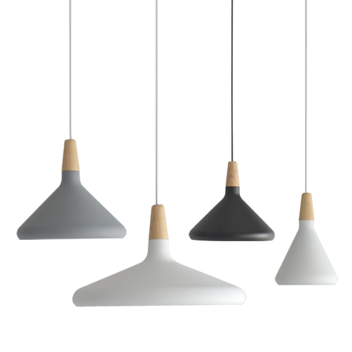
BLESSED
IMPROVEMENT HOME
FASHION
FURNITURE
FASHION
It's true that we don't know what we've got until we lose it, but it's also true that we don't know what we've been losing until it arrives.

Slide 2
CONTENT
01‘LOYAL
02‘OBLIGATION
03‘VALUED
04‘EXCUSE

Slide 3
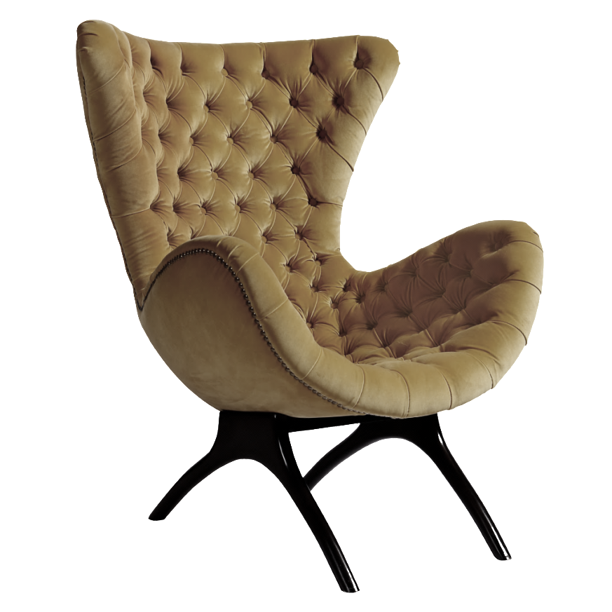
CONTENT
PART.01
LOYAL
FASHION
It's true that we don't know what we've got until we lose it, but it's also true that we don't know what we've been losing until it arrives.

Slide 4
LOYAL
IMPROVEMENT HOME
It's true that we don't know what we've got until we lose it, but it's also true that we don't know what we've been losing until it arrives.

Slide 5
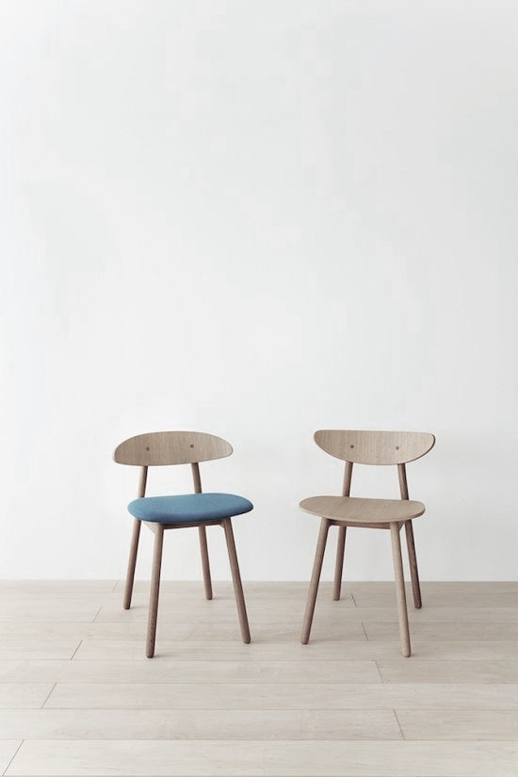
LOYAL
IMPROVEMENT HOME
It's true that we don't know what we've got until we lose it, but it's also true that we don't know what we've been losing until it arrives.

Slide 6
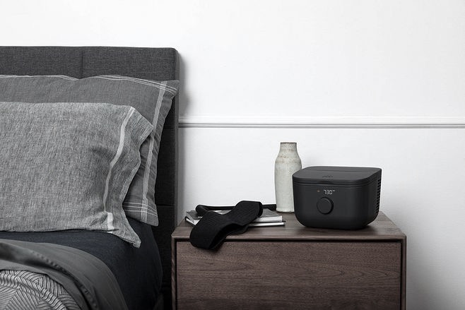
IMPROVEMENT HOME
LOYAL
It's true that we don't know what we've got until we lose it, but it's also true that we don't know what we've been losing until it arrives.

Slide 7
LOYAL
IMPROVEMENT HOME
It's true that we don't know what we've got until we lose it, but it's also true that we don't know what we've been losing until it arrives.

Slide 8
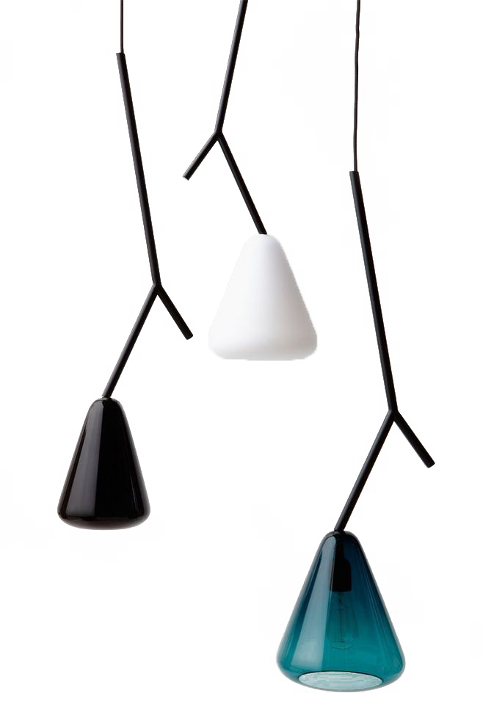
CONTENT
PART.02
OBLIGATION
FASHION
It's true that we don't know what we've got until we lose it, but it's also true that we don't know what we've been losing until it arrives.
行业PPT模板http:// www.PPT818.com/hangye/

Slide 9
OBLIGATION
IMPROVEMENT HOME
It's true that we don't know what we've got until we lose it, but it's also true that we don't know what we've been losing until it arrives.

Slide 10
IMPROVEMENT HOME
It's true that we don't know what we've got until we lose it, but it's also true that we don't know what we've been losing until it arrives.

Slide 11
OBLIGATION
IMPROVEMENT HOME
It's true that we don't know what we've got until we lose it, but it's also true that we don't know what we've been losing until it arrives.

Slide 12
OBLIGATION
IMPROVEMENT HOME
It's true that we don't know what we've got until we lose it, but it's also true that we don't know what we've been losing until it arrives.

Slide 13
CONTENT
PART.03
VALUED
FASHION
It's true that we don't know what we've got until we lose it, but it's also true that we don't know what we've been losing until it arrives.

Slide 14
OBLIGATION
IMPROVEMENT HOME
It's true that we don't know what we've got until we lose it, but it's also true that we don't know what we've been losing until it arrives.
It's true that we don't know what we've got until we lose it, but it's also true that we don't know what we've been losing until it arrives.

Slide 15
OBLIGATION
IMPROVEMENT HOME
It's true that we don't know what we've got until we lose it, but it's also true that we don't know what we've been losing until it arrives.

Slide 16
OBLIGATION
IMPROVEMENT HOME
It's true that we don't know what we've got until we lose it, but it's also true that we don't know what we've been losing until it arrives.

Slide 17
OBLIGATION
IMPROVEMENT HOME
It's true that we don't know what we've got until we lose it, but it's also true that we don't know what we've been losing until it arrives.

Slide 18
CONTENT
PART.04
EXCUSE
FASHION
It's true that we don't know what we've got until we lose it, but it's also true that we don't know what we've been losing until it arrives.

Slide 19
IMPROVEMENT HOME
It's true that we don't know what we've got until we lose it, but it's also true that we don't know what we've been losing until it arrives.
EXCUSE

Slide 20
EXCUSE
IMPROVEMENT HOME
It's true that we don't know what we've got until we lose it, but it's also true that we don't know what we've been losing until it arrives.

Slide 21
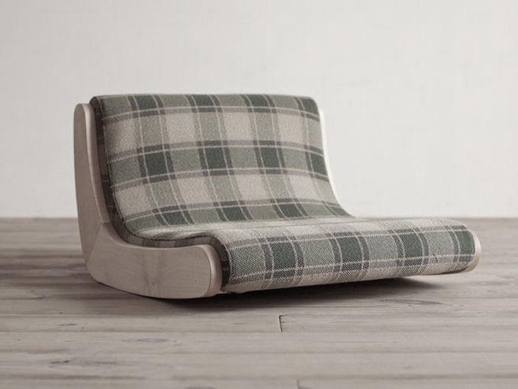
EXCUSE
IMPROVEMENT HOME
It's true that we don't know what we've got until we lose it, but it's also true that we don't know what we've been losing until it arrives.

Slide 22
IMPROVEMENT HOME
EXCUSE
It's true that we don't know what we've got until we lose it, but it's also true that we don't know what we've been losing until it arrives.

Slide 23
BLESSED
THANKS FOR
WATCHING
FASHION
It's true that we don't know what we've got until we lose it, but it's also true that we don't know what we've been losing until it arrives.

