Slide 1
Unit 4
Why don’t you talk to your parents?
R 八年级下册
第1课时
WWW.PPT818.COM

Slide 2
Lead-in
Do you have any problems in your daily life?
How do you solve them? Give some advice.

Slide 3
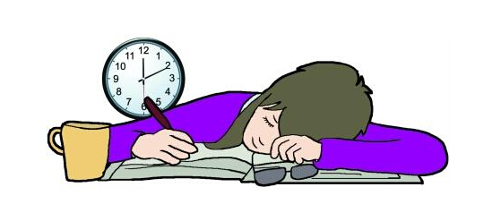
have to study too much

Slide 4
have too much homework

Slide 5
hang out with my friends

Slide 6
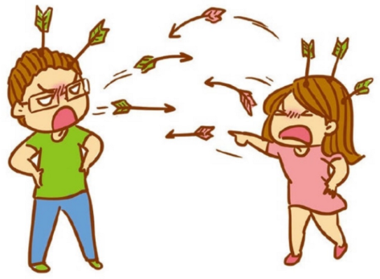
argue with friends

Slide 8
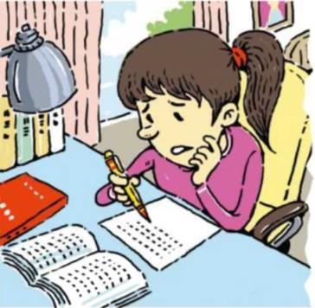

Slide 9
Look at these problems. Do you think they are serious or not? Write them in the appropriate box.
1a
I have to study too much so I don’t get enough sleep.
2. I have too much homework so I don’t have any free time to do things I like.
3. My parents don’t allow me to hang out with my friends.
4. I have too many after-school classes.
5. I got into a fight with my best friend.

Slide 10
Serious | Not serious
1. I have to study too much so I don’t get enough sleep.
2. I have too much homework so I don’t have any free time to do things I like.
4. I have too many after-school classes.
3. My parents don’t allow me to hang out with my friends.
5. I got into a fight with my best friend.

Slide 11
Language points
My parents don’t allow me to hang out ...
allow是动词，意为“允许；准许”，侧重听从，不阻止，
通常用于： allow sb. to do sth. 允许某人做某事
被动形式：sb be allowed to do sth. 某人被允许做某事
构成短语： allow doing sth. 允许做某事
如：You are not allowed to smoke here.
这里不许吸烟。

Slide 12
1b
Listen and circle the problems you hear in 1a.
Serious | Not serious
1. I have to study too much so I don’t get enough sleep.
2. I have too much homework so I don’t have any free time to do things I like.
4. I have too many after-school classes.
3. My parents don’t allow me to hang out with my friends.
5. I got into a fight with my best friend.

Slide 13
Look at the problems in 1a and make conversations.
1c
What’s wrong?
I’m really tired because I studied until midnight
last night.
Why don’t you go to sleep earlier this evening?

Slide 14
Listen. Peter’s friend is giving him advice.
Fill in the blanks with could or should.
2a
Advice
1.You _______ write him a letter. 2.You _______ call him up. 3.You _______ talk to him so that you can say you’re sorry. 4.You _______go to his house. 5.You _______take him to the ball game.
could
should
should
could
could

Slide 15
Listen again. Why doesn’t Peter like his friend’s advice? Write the letters (a-e) next to the advice in 2a.
2b
Why Peter doesn’t like the advice
It’s not easy. I don’t want to wait that long. I don’t want to surprise him. I’m not good at writing letters. I don’t want to talk about it on the phone.

Slide 16
Advice
1.You _______ write him a letter. ( ) 2.You _______ call him up. ( ) 3.You _______ talk to him so that you can say you’re sorry. ( ) 4.You _______go to his house. ( ) 5.You _______take him to the ball game. ( )
could
d
should
e
should
a
could
c
could
b

Slide 17
Role-play a conversation between Peter and his friend.
2c
What’s the
matter, Peter?
I had a fight with my best friend. What should I do?
Well, you should call him so that you can say you’re sorry.

Slide 18
2d
Role-play the conversation.
Dave: You look sad, Kim. What’s wrong?
Kim: Well, I found my sister looking through my things
yesterday. She took some of my new magazines and CDs.
Dave: Hmm... That’s not very nice. Did she give them back to you?
Kim: Yes, but I’m still angry with her. What should I do?

Slide 19
Dave: Well, I guess you could tell her to say sorry. But
why don’t you forget about it so that you can be friends again? Although she’s wrong, it’s not a big deal.
Kim: You’re right. Thanks for your advice.
Dave: No problem. Hope things work out.

Slide 20
Language points
1. I’m really tired because I studied until midnight last night.
until在此作介词，意为“直到……”，相当于till，其后可接名词、副词或介词短语。
他一直工作到半夜。
He continued working until middle night.

Slide 21
until用于肯定句中时，句子的谓语动词必须是延续性动词；若句子谓语动词是非延续性动词，则要用not… until…结构，表示“直到……才……”。
昨晚他直到 12 点才回家。
He didn’t come home until twelve last night.

Slide 22
2. Why don’t you go to sleep earlier this evening?
“Why don’t you…?”句型表示提建议，即提议某人去做某事，后面接动词原形，相当于“Why not…?”
为什么不跟我一起去那儿呢？
Why not go there with me?
Why don’t you go there with me?

Slide 23
提建议的几种方式：
What/How about…？ ……怎么样？
Why not/don’t…？ 为什么不……？
Shall we…？ 我们……好吗？
Please… 请……
You’d better do… 你最好做……
Let’s… 让我们……

Slide 24
3. Well, I found my sister looking through my things yesterday.
find sb. doing sth.意为“发现某人正在做某事”，强调动作正在进行。
清晨你会发现许多人在沿着河边跑步。
You can find many people running along the river in the morning.

Slide 25
【拓展】find sb. do sth.意为“发现某人做了某事”，表示发现某人做事的全过程，即动作全部完成或表示发现某人反复地、多次做某事。
与find用法类似的感官动词或短语动词还有：watch，see，hear，look at，listen to等。

Slide 26
look through意为“浏览；快速查看”，为“动词+介词”短语，后面接物。
与look相关的短语：
look up向上看；查阅 look over检查
look out 小心 look through 浏览
look for 寻找 look after 照顾
look like看起来像 look around向四周看
look down on轻视；看不起

Slide 27
4. Although she’s wrong, it’s not a big deal.
although意为“虽然; 尽管; 即使”,引导让步状语从句。
although/though作连词，意为“虽然；尽管”，这两个词都不能与but连用，即用了although/ though就不能再用but。
尽管他很穷，但他总是乐于助人。
Although he is very poor, he is ready to help others.

Slide 28
Exercise
1. 我父母想让我每天晚上都呆在家里。
My parents ______ me ____ ______ at home every night.
2. 我没有足够的钱。
I ______ have ________ money.
want
to stay
don’t
enough

Slide 29
3. 或许你应该买些新衣服。
Maybe you ______ _____ some new clothes.
4. 你可以给他一张球赛的票。
You ______ give him a ticket ____ a ball game.
should buy
could
to

