Slide 1
陕旅版英语五年级上册
Unit5 Can You Tell Me the Way to the Supermarket?
第2课时
WWW.PPT818.COM

Slide 2
教学目标：
1. 能听懂、会说、会用句型：Is there a ... near here? Can you tell me the way to...? Go along the ... The ... is beside / behind it. / There is a ... between ... and ... 就场所的位置进行问答，并能在日常生活中恰当自如地问路、指路。
2. 能够在对话中正确使用礼貌用语。
3. 能在教师的带领和组织下，完成Part B Look, find and answer部分的活动。

Slide 3
Song: Is This York Street?
听完歌曲，你能猜出本单元的话题了吗？

Slide 4
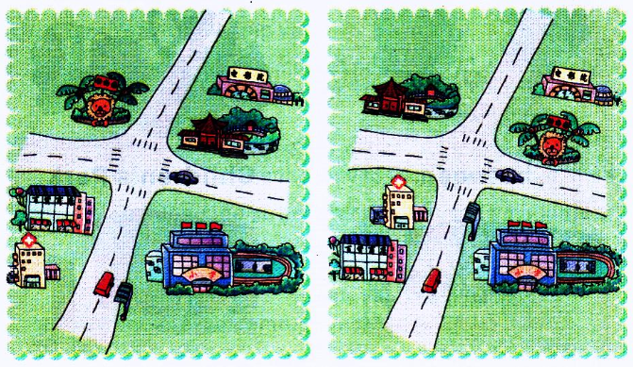
There are two pictures here. Let’s look at them carefully.
Are they the same?
What are the differences?

Slide 5
Where is the Children’s Park in the first picture?
What is behind it?
Can you see the zoo? Where is it?
What is beside the shop?
Picture1
Picture2

Slide 6
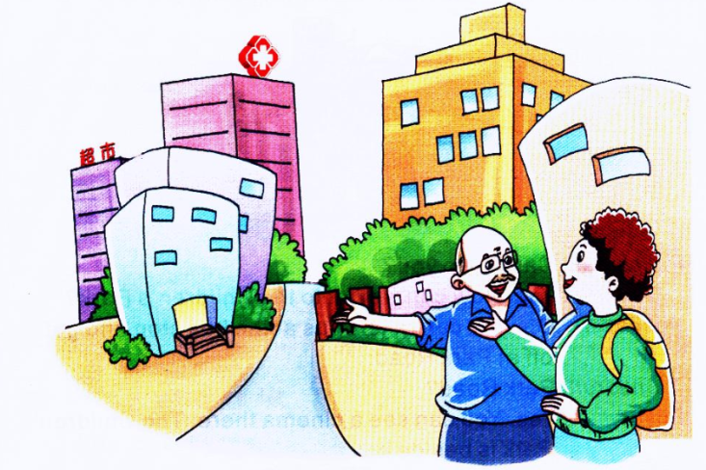
What are they talking? Can you guess?

Slide 7
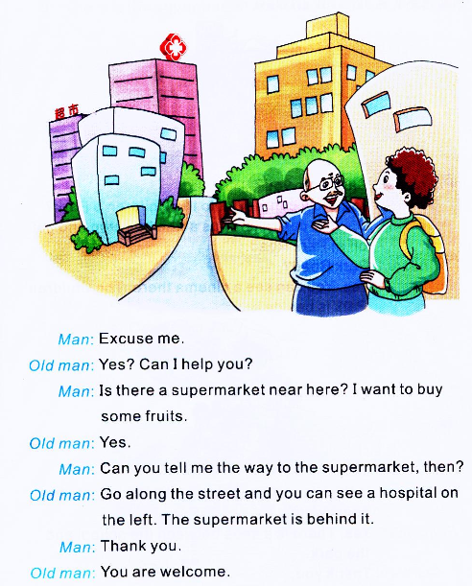

Slide 8
What does the man want to buy?
He wants to buy some fruits.
Can you tell him the way to the supermarket?
Go along the street and you can see a hospital on the left. The supermarket is behind it.

Slide 9
观看动画，并跟读

Slide 10
Summary
问路指路用语:
—Can you tell me the way to the…?
你能告诉我去……的路吗？
—Go along the street and you can see ... on the left / right.
沿着这条街走，你可以在路左/右边看到…...。

Slide 11
Role play
扮演老人的学生在表演时应注意语气及动作要符合身份及年龄特点哦！

Slide 12
Let’s play—传话游戏

Slide 13
Pair work
五人为一组，组员拿出各自设计的街区图， 合作完成对话的内容并进行表演。
会话内容可参考：
A: Excuse me.
B: Yes? Can I help you?
A: I want to…Is there a…near here?
B: Yes.
A: Where is it?
B: Can you see the…there? The…is…it.
A: Thank you.
B: You are welcome.

