Slide 1
Unit 8 Birthdays
五年级
第1课时
WWW.PPT818.COM

Slide 2
Do you like birthdays?
Why?

Slide 3
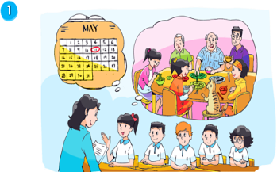
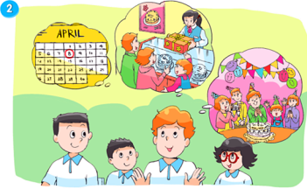
Look and say
Whose birthdays are they talking about?

Slide 4
What do you want to know about their birthdays?

Slide 5
Watch and choose
When’s Su Hai and Su Yang’s birthday?
When’s Mike’s birthday?
A
B
C
D
Su Hai’s birthday
Mike's birthday
Su Yang’s birthday

Slide 6
Watch and choose
When’s Su Hai and Su Yang’s birthday?
When’s Mike’s birthday?

Slide 7
Watch and choose
When’s Su Hai and Su Yang’s birthday?
When’s Mike’s birthday?
A
B
C
D
Su Hai’s birthday
Mike's birthday
Su Yang’s birthday

Slide 8
When’s Su Hai and Su Yang’s birthday?
When’s Mike’s birthday?
the eleventh of May
the eighth of April
A: When’s …’s birthday?
B: It's on...

Slide 9
Read and say
读78页课文，并和搭档进行问答。
A：What do Su Hai and Su Yang do on their birthday?
B：Su Hai and Su Yang usually ______ with their families. They_______. After that, they_______. They have a great time.
have a big dinner
eat noodles
have a party
play with Kitty the cat
eat the birthday cake together
buy a birthday cake
play some games

Slide 10
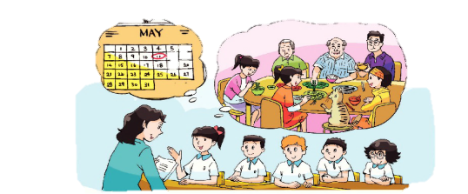
Tip:划出关键句，获取信息
Miss Li: When's your birthday, Su Hai?
Su Hai: It's on the eleventh of May. It's also Su Yang' s birthday.
Miss Li: What do you do on your birthday?
Su Hai: We usually have a big dinner with our parents and grandparents.
Su Yang and I eat some noodles. After that, we play with Kitty
the cat. We have a great time.

Slide 11
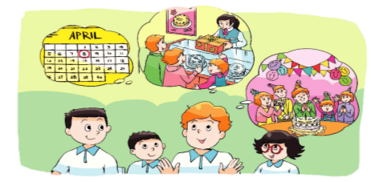
Read, underline and discuss
读79页课文,划出关键句并和搭档讨论，再回答。
Miss Li: When's your birthday, Mike?
Mike: It's on the eighth of April. We always have a party at home. Helen, Tim
and I go to buy a birthday cake in the morning. Then, my friends come
in the afternoon. We eat the birthday cake together and play some games.
We have a lot of fun!
... always … on his birthday .
They … Then , ...
They … and … They have a lot of …

Slide 12
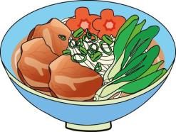
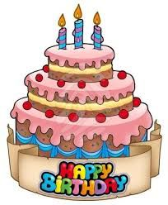
Discuss and say
同桌讨论，生日那天，苏海、苏阳和迈克吃的有什么不同？
What do they eat on their birthdays?
生日时吃面,寓意长寿
生日时吃蛋糕，寓意好运

Slide 13
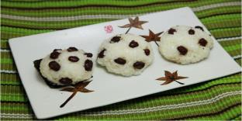
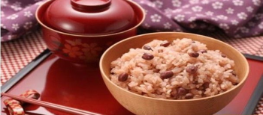
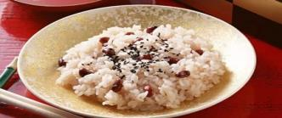
In Japan, people eat red bean rice——lucky
在日本，人们过生日吃红豆饭——吉祥

Slide 14
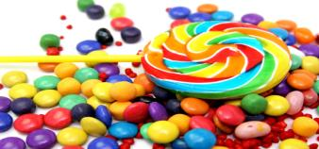
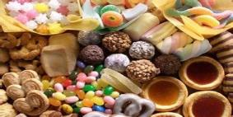
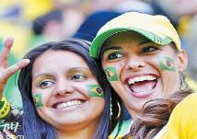
In Brazil, people eat candies——sweet
在巴西，人们过生日吃糖果——甜美

Slide 15
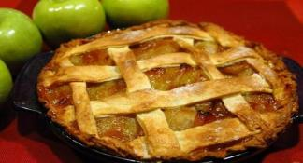
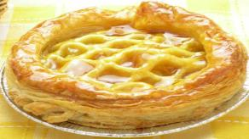
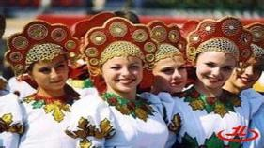
In Russia, people eat birthday pies——healthy
在俄罗斯，人们过生日吃生日馅饼——健康

Slide 16
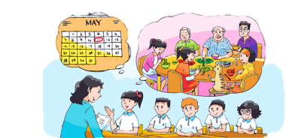
Listen and imitate
Miss Li: When's your birthday, Su Hai?
Su Hai: It's on the eleventh of May. It's also Su Yang's birthday.
Miss Li: What do you do on your birthday?
Su Hai: We usually have a big dinner with our parents and grandparents. Su Yang and I eat some noodles. After that, we play with Kitty the cat. We have a great time.

Slide 17
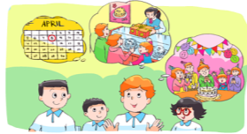
Listen and imitate
Miss Li: When's your birthday, Mike?
Mike: It's on the eighth of April. We always have a party at home. Helen, Tim and I go to buy a birthday cake in the morning. Then, my friends come in the afternoon. We eat the birthday cake together and play some games. We have a lot of fun!

Slide 18
English readers朗读者
以小组为单位，选文中某一人的生日读一读。
Read in roles.
（分角色读）
Read together.
(齐读）
…
Read after one.
（跟一人读）
小组合作完成：
能按主题分工，语言准确流利、语调丰富的可得☆☆☆
能较好完成合作并展示的得☆ ☆
仍然需要好好努力的得☆

Slide 19
Survey and say
在小组内调查采访，调查组员或者他们家人的生日，并汇报。
When’s your/…’s birthday?
It's on....
What do/does… do on … birthday?
I/We/...
…’s birthday is on...
He/She/They usually/often...
Who
When
What
activities
什么活动

Slide 20
Homework
1. Read the story time 3 times .
2.Talk with your friends about your parents’
birthdays.
3.Enjoy the birthday cake together and be
happy every day.

