Slide 1
外研（新标准）版-七年级上册
Module 1 Unit 2
I'm Wang Lingling and I'm thirteen years old.
教学课件
WWW.PPT818.COM

Slide 2
Warm-up
Let's play a game!
I will divide you into 6 groups and each group will have a picture of a famous person. Work in groups and introduce the person. Let’s see which team is the best. Are you clear? Ready!

Slide 3
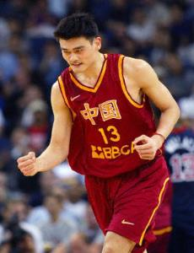
Name: Yao Ming
Age: 33
Birth place: Shanghai
Hobby: Basketball
Job: Basketball player
1980年生于上海。
NBA及世界巨星。
篮球史上里程碑式人物。曾效力于中国国家篮球队, NBA火箭队。2011年7月20日退役。被美国《时代》列入“世界最具影响力100人”。

Slide 4
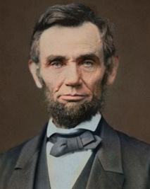
Name:Abraham Lincoln
Age: 56
Birth place: America
Hobby: Reading
Job: President
林肯1809-1865，美国第16任总统。林肯废除了奴隶制度，维护了国家的统一。他是第一位遭到刺杀的总统，更是一位出身贫寒的伟大总统。为影响美国的100位人物第1名。5美元纸币正面为其头像。

Slide 5
Name: Liu Yang
Age: 35
Birth place: He Nan
Hobby: Music
Job: Astronaut
刘洋，河南省人，党员。1978年10月6日出生，1997年8月入伍，2001年5月入党，现为中国人民解放军航天员大队四级航天员。2012年6月16日神舟九号顺利升空，成为第一位飞天的中国女航天员。

Slide 6
中国最具社会影响力和传奇性的著名流行女歌手、唱作人，中国首位民选超级偶像，电影演员, 公益先锋，时尚引领者，有“舞台皇后” 美誉，被美国《时代周刊》评为“亚洲英雄”。
Name: Li Yuchun
English Name: Chris Lee
Age: 29
Birth place: Si Chuan
Job: Singer

Slide 7
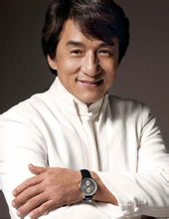
English Name: Jackie Chan
Age: 59
Birth place: Hong Kong
Hobby: Kongfu
Job: Actor
成龙，生于香港，影坛巨星和国际功夫电影巨星，在华人世界享有极高的声望。为香港电影票房保证。多次获得香港金像奖的最佳动作设计奖，台湾金马奖最佳男主角奖。

Slide 8
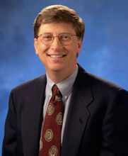
Name: William Henry Gates
Age: 58
Birth place: Seattle, America
Job: Founder of Microsoft
Hobby: Table tennis
比尔·盖茨(Bill Gates), 生于1955年10月28日，美国微软公司的董事长。与保罗·艾伦一起创建了微软公司，曾任微软CEO和首席软件设计师，是公司最大的个人股东。

Slide 9
Reading
Put the sentences in the correct order.
Nice to meet you too. Where are you from?
b) Hello, my name is ... What’s your name?
c) I’m from ... too.
d) Nice to meet you... My name is ...
e) I’m from...
b – d – a – e – c

Slide 10
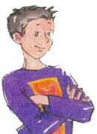
Read and check the true sentences.
Hello, everyone. My name is Li Daming and my English name is David. I’m twelve years old and I’m from Beijing. Beijing is the capital of China. This is Lingling andher English name is Lucy. She’s my friend. She’s from Beijing too.

Slide 11
Hello, I’m Wang Lingling and I’m thirteenyears old. Good to see you. Wang Hui is my friend, but he is not in my class. His English name is Henry. He’s from Shanghai. Shanghai is a very big city.

Slide 12
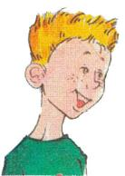
Hi, my name is Tony Smith, I’m from Cambridge. It’s a small city in England. Tony is my first name and Smith is my last name. I’m thirteen years old. It’s nice to meet you all.

Slide 13
Henry is Daming’s English name.
Lingling’s English name is Linda.
Daming is twelve years old.
Wang Hui is from Beijing.
Tony is twelve years old.
Tony is from the capital of England.

Slide 14
Underline the correct words.
Smith is Tony’s first / last name, and
Tony is his first / last name. He’s from
Cambridge. In Tony’s class, Tony and
Lingling are thirteen years old and
everyone / Daming is twelve / thirteen
years old. Lingling is Daming’s student /
friend.

Slide 15
Read and complete the table.
What’s his / her name? | Daming |  |  | Tony
How old is he / she? |  | 13 | /
Where is he / she from? |  |  | Shang hai
Lingling
Wang Hui
12
13
Beijing
Beijing
Cambridge

Slide 16
New words
1. Is e_______ here today?
2. Beijing is the c_____ of China.
veryone
everyone 每人，人人；单数，意指全体；后加动词第三人称单数形式。
apital
capital 首都，也可以当“首府”讲；
Eg. Jinan is the capital of Shan Dong Province.

Slide 17
3. Tom likes singing, b___ I don’t like it.
but 但是；表转折的并列连词，在句
中作用是话题的转移。
4. Thank you v___ much.
very 很, 非常; 副词; 常和much连用,
表示程度; 修饰形容词置前;
Eg. It is very cold.
ut
ery

Slide 18
5. Shanghai is a very big city, but
Suzhou is a s____ city.
mall
small 小的; 形容词; 修饰名词置前, 也可以用在be动词后做表语；和big 是反义词。
Eg. This isn’t a big car, it’s very small.

Slide 19
6. I am Tony Smith. Tony is my f____ name and Smith is my l___ name.
7. We are a__ here today.
irst
ast
first name 名字，last name 姓，也可以说成 family name.
ll
句中all为代词，意思“每个，全体”；作主语时，be动词用are。

Slide 20
Language points
1. This is Lingling and her English name is Lucy.
这位是玲玲，她的英文名叫露西。
This is ...向别人介绍某人时说“This is ...”不用 “That is ...”。
Eg. This is Tom. Tom, this is Jack.
这是汤姆。汤姆，这是杰克。

Slide 21
注意：this is不能缩写，而 that is可以缩写成that’s。
打电话时, 介绍自己用this, 询问对方用that。
Eg. This is Lucy speaking.
Is that Lucy speaking?

Slide 22
2. Good to see you. 很高兴见到你！
熟人之间见面常用问候语, 还可以说：Nice to see you. / Glad to see you. / Pleased to see you.
Eg. It’s nice to see you all. 很高兴见到你们所有人！

Slide 23
句中all为代词，意思“每个，全体”；作主语时, be动词用are。
Eg. All the students are here today.
所有的学生都到齐了。

Slide 24
3. I’m Wang Lingling and I’m thirteen
years old.
我叫王玲玲，我今年十三岁了。
介绍自己的时候可以用“I’m”、“I am”或“My name is ...”，此句还可以说：
My name is Wang Lingling.

Slide 25
这里的“...years old”，表示……几岁, 这里的数字可以省略，直接说成：I am thirteen.
对它提问用：How old ...?
Eg. How old is Lingling? She is thirteen years old.

Slide 26
4. Tony is my first name and Smith is my last name.
托尼是我的名, 史密斯是我的姓。
family name 姓 = last name 教名

Slide 27
大多数英语姓名有三个名字：教名，中间名和姓。他们的姓放在最后。（中间名一般很少用）如果你要称呼别人为“……先生，夫人，小姐” 时，只能在family name也就是last name前加上Mr, Mrs, Miss，如上面的这个名字，你只能称他为Mr. Green，而不能称他为Mr. James。

Slide 28
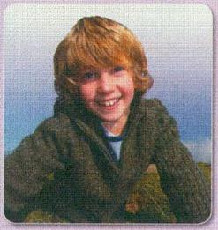
Writing
Look at the pictures and write sentences.
Tom, England, English, fourteen, Class 3
1. His name is Tom.
2. He’s from England.
3. He’s English.
4. He’s fourteen years old.
5. He’s in Class 3.
He’s = He is

Slide 29
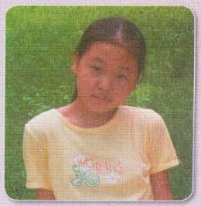
Zihan, China, Chinese, twelve, Class 1
1. Her name is Zihan.
2. She’s from China.
3. She’s Chinese.
4. She’s twelve years old.
5. She’s in Class 1.
She’s = She is

Slide 30
Write sentences about yourself and join them with and.
Modle: My name is Li Ping.
I’m from China.
I’m Chinese.
I’m fifteen years old.
I’m in Class One, Grade Seven.

Slide 31
My name is Li Ping and I’m from China.
I’m Chinese and I’m fifteen years old.
I’m in Class One, Grade Seven.

Slide 32
Module task
Task: Ask your partners about their personal information and make cards for them. The more, the better.
Name: _______ Age: ________ School: __________
Date of birth: ___________ Birth place: __________
Telephone number: ___________
Hobbies:___________ Favorite color: ____________

Slide 33
Homework
采访两个你的新同学，问他们几个问题：What’s your name?
Where are you from?
How old are you?
What’s your favourite subject?
将你的采访记录整理成一篇为My new classmates的短文。（可适当增加问题，全文不少于50词。）

