Slide 1
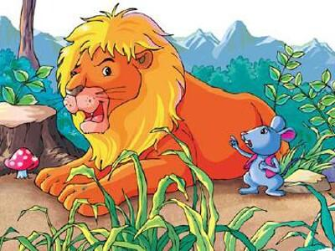
Unit 1
The lion and a mouse
第二课时
WWW.PPT818.COM

Slide 2
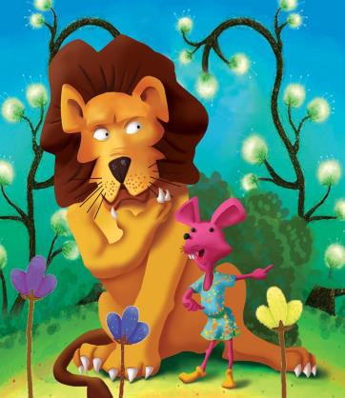
Introduce
Lion: I’m…and…
Animals: Here comes the lion. Run!
Lion: What are you doing here, Little Mouse?
I’m going to…!
Mouse: Please don’t…, Lion. I can …some day.
Lion: Ha! Ha! You’re so…How can you help me?
Lion: Help! Help! Please help me.
Mouse: Don’t be…, Lion. I can help you!
Lion: …, Little Mouse!

Slide 3
Words
excited [ɪkˈsaɪtɪd]
作形容词，意为“兴奋的”。
eg：He played football excitedly after school. 放学后他很兴奋地踢足球。
小练习：用所给词的适当形式填空:
He is very ________ （excite）.
拓展：exciting 形容词，修饰物；excited形容词，修饰人。
eg：(1)I've got an exciting piece of work. 我得到了一份令人兴奋的工作。
(2)He is watching an exciting game. 他正在观看一场令人兴奋的比赛。
excited

Slide 4
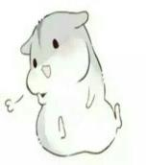
Words
laugh [lɑ:f]
作动词，意为“大笑”
固定搭配：laugh at sb./ sth. 因某人或者某事而发笑
eg：The children laughed at the clown. 孩子们被小丑逗笑了。
小练习：汉译英：我嘲笑他 ____________
拓展：（1）作名词，意为“笑声，笑”
eg：Her jokes got lots of laughs. 她的笑话引起了阵阵笑声。
I laugh at him.

Slide 5
Words
happy [ˈhæpi]
作形容词，意为“快乐的，高兴的”。
固定搭配：be happy to do sth.意为“高兴做某事”。
eg: He is happy to see us again.
小练习：单项选择：（ ）I’m happy ______ have a birthday party.
A. to B. for
拓展：（1）表示祝愿某人快乐。
eg：Happy Birthday to you.祝你生日快乐。
A

Slide 6
Expressions
I’m going to …
将来时句型结构为：be going to do sth. 表示将要干某事。将来时强调的是将来发生的事情，它的时间状语有：tomorrow, soon, 等。
eg：I’m going to Beijing. 我即将去北京。
小练习：单项选择：
（ ）He is going to______ football after class.
A: play B: plays
【点译】A be going to后接动词原形。
A

Slide 7
Expressions
The lion asked sadly.狮子很伤心的问。
作动词，意为“问”。
eg：He asked me sadly. 他伤心的问我。
小练习：所给词的适当形式填空：He is ______(ask) me some questions.
拓展：ask sb. for sth. 向某人要某物
eg：He came and asked me for his bike.他来向我要他的自行车。
ask sb. to do sth. 要求某人做某事。
eg：He is asking me to go with.他要求我和他一起去。
asking

Slide 8
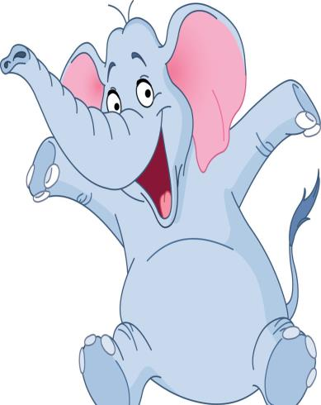
Dialogue
The lion asked sadly.
狮子很伤心的问。
The lion laughed loudly.
狮子大声的笑。
The mouse said quietly.
老鼠安静的说。
The mouse said happily.
老鼠开心的说。

Slide 9
Dialogue
He’s a happy boy.
他是一个开心的男孩。
He laughs happily.
他开心的笑着。
Here comes the lion.
狮子来了。
What are you doing here, Little Mouse?
你正在这儿干什么，小老鼠？
How can you help me?
你能怎么样帮我？

Slide 10
Summary
excited
laugh
happy
I’m going to …
The lion asked sadly.

Slide 11
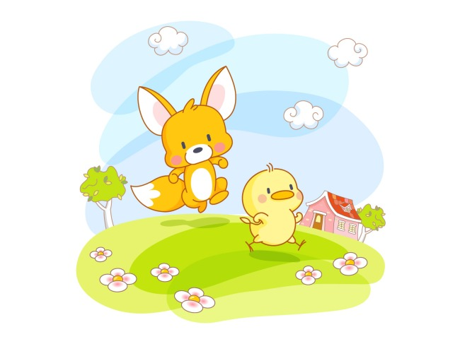
Exercise
看音标写单词
1.／ lɑ:dʒ／__________
2.／ʃɑ:p／__________
3.／strɒŋ／__________
4.／wi:k／__________
large
sharp
strong
weak

Slide 12
Exercise
用所给词的适当形式填空
1.The boy is running__________ (quick).
2.Ｔhe girl is shouting__________ (happy).
3.The children are talking__________ (excited).
4.The people are laughing __________ (loud).
5.The man is reading __________ (quiet).
6.The woman is crying __________ (sad).
7.Last Sunday , I _________（go）to a shopping centre.
quickly
happily
excitedly
loudly
quietly
sadly
went

Slide 13
Exercise
1. 在森林里有一只狮子。
__________________________________
2. 狮子很生气，想要吃掉老鼠。
_____________________________________
3. 你太幼小和懦弱了。
_________________________________
4. 我可以帮助你。
_________________________________
5.从哪以后，狮子和老鼠成了好朋友。
_____________________________________
There was a lion in forest.
The lion was angry and wanted to eat the mouse.
You are so small and weak.
I can help you .
From then on, the lion and the mouse became good friends.

Slide 14
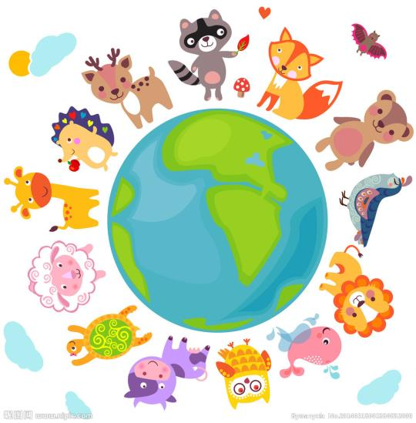
Homework
Know the animals

