Slide 1
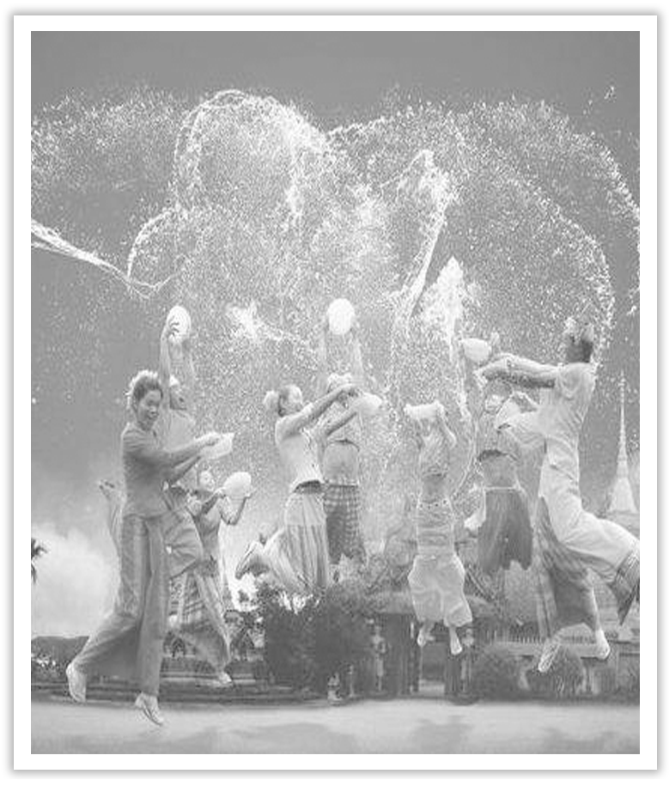
Unit 3 Diverse Cultures
Section Ⅷ Assessing Your Progress
WWW.PPT818.COM

Slide 2
Ⅰ.单词拼写
1.The company was in deep ____________(财政的) difficulties.
2.At school we had to learn a lot of ____________(诗歌) by heart.
3.A woman in blue __________(牛仔裤) walked into the store.
4.My hands，____________(靴) and trousers were covered with mud.
5.Some ____________(蘑菇) are good to eat; some are poisonous.
6.The explosion of the chemical plant has ____________(毒死) many local residents.
7.I ____________(折叠) the letter and then put it into the envelope.
8.He has been ____________(格外) understanding and kind.
financial
poetry
jeans
boots
mushrooms
poisoned
folded
super

Slide 3
Ⅱ.单句语法填空
1.This medicine is ____________(poison) if taken in large quantities.
2.The ____________(collect) is housed in a fine building.
3.Television attracts a large ____________(percent) of the people.
4.Children must learn to write ____________(neat).
5.The exhibition is designed to reflect the ____________(diverse) of the nation and its regions.
6.I have to avoid food ____________(contain) too much fat.
7.Major changes will have to be brought ____________ in British industry.
8.Apart ____________ the hair，he looked extraordinarily unchanged.
poisonous
collection
percentage
neatly
diversity
containing
about
from

Slide 4
Ⅲ.用省略结构补全句子
1.Some of you may have finished Unit 1.______________(如果是这样的话)，you can go on to Unit 2.
2.—My mother is preparing my favorite dishes.Go with me and have a taste，okay?
—________________(我愿意去).And I’ll be glad to meet your parents.
3.—Have you finished your first paper?
—________________(还没有).Just half of it.How about you?
If so
I’d love to
Not yet

Slide 5
4.—Have you got any particular plans for the coming holiday?
—Yes，________________(如果可能的话)，I’m going to visit some homes for the old in the city.
5.—Would you like to join us in the game?
—________________(恐怕不行)，for I have something important to attend to.
if possible
I’m afraid not

