Slide 1
Lesson 39
Danny’s Hobby
WWW.PPT818.COM

Slide 2
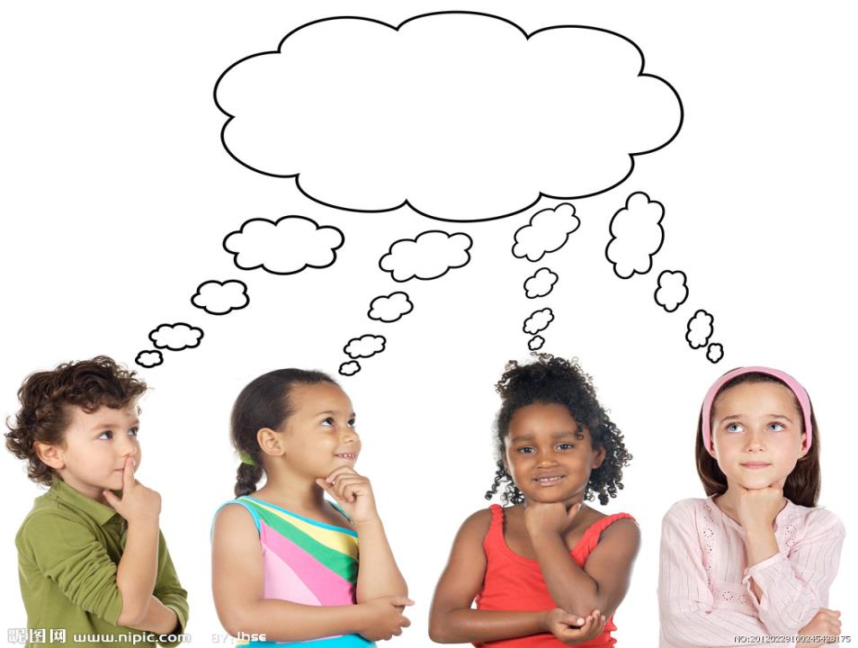
THINK ABOUT IT

Slide 3
How many people are there in your family?
What hobbies do they have?
Do you know any interesting facts about
your family history?

Slide 4
Dear Grandma,
Thank you very much for your letter about
Great Great Grandpa Rex. I like collecting
facts about our family history. It’s a great
hobby! It’s fun and it makes me feel proud.
I like your name for Great Great Grandpa
Rex: Grandpa Giant! He was very tall and
very strong! When he visited you, did you
have a huge chair for him?

Slide 5
You told me many interesting facts about
him. He came from Africa and learned English
in Canada. He built his own African-style house.
He got his eggs from his own hens and milk from
his own cows. That is very interesting. Most
people don’t have cows or chickens anymore.
They buy their milk and eggs at the store.

Slide 6
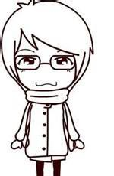
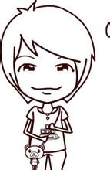
Can you help me some more? I am doing a
report for one of my classes. I need to
show and talk about my hobby, so I would
like a photo of Great Great Grandpa Rex. Do
you have one?

Slide 7
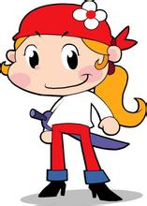
I have an idea! Let’s trade photos! Here’s a
photo of me from school. You keep this photo
and send me a photo of Great Great Grandpa
Rex. Would that be OK?
I’ll write again soon.
Love,
Danny

Slide 8
Read the lesson and write true (T) or false (F).
1. Danny likes collecting facts about his family. （ ）
2. Grandpa Giant is another name for Danny’s great
great grandpa. （ ）
3. Rex came from Africa, and he learned English in the
U.S. （ ）
4. Rex always goes to the store to buy milk and eggs. （ ）
5. Danny wants to trade photos with his grandma. （ ）
T
T
F
F
T

Slide 9
1.
thank sb. for sth.
因为某事感谢某人
thank sb. for doing sth.
因为某人做了某事
而感谢某人
Thank you for your help.
感谢你的帮助。
I must thank you for telling me the news.
我必须感谢你告诉我这个消息。

Slide 10
2.
make sb. do sth.
让(使)某人做某事
句型结构：动词 + 宾语 + 宾语补足语
The boss makes him work ten hours a day.
老板让他一天工作十小时。
feel proud
感到骄傲
句型结构：系动词 + 形容词表语
feel hungry 感到饥饿 feel sad 感到伤心

Slide 11
类似结构：look well 看起来气色好；
smell delicious 闻起来很香；
sound reasonable 听起来很有道理；
taste terrible 尝起来难吃

Slide 12
3.
get… from…
从……获得……
We can get knowledge from books.
我们可以从书本中获得知识。
We can always get help from our parents when we are in trouble.
当我们遇到麻烦时，经常能从父母那里获得帮助。

Slide 13
Most people don’t have cows or chickens anymore.
大部分人们已经不再养牛和鸡了。
4.
在这里是形容词，大多数的，大部分的
Most of the teachers in our school are men
teachers.
我们学校大部分是男教师。
Most of the students have passed the exam.
大部分学生都已经通过了考试。

Slide 14
most
还可以用做much的最高级
表示“最，最多（大）；非常，很”
most与多音节或部分双音节形容词
放在一起，构成这个形容词的最高级
表示“最……”

Slide 15
Of all the subjects, I like math most.
在所有科目中，我最喜欢数学。
It is one of the most wonderful films that I have
ever seen.
这是我看过的最精彩的电影之一。
much的最高级
wonderfuf的最高级

Slide 16
not… anymore
美式用法
意为“不再…….”
not… any more
英式用法
not… anymore
可以和no more替换
not… any more
I don’t like this pair of shoes anymore.
我不再喜欢这双鞋了。
Most people don’t have cows or chickens anymore.
= Most people have no more cows or chickens.

Slide 17
Danny’s grandma is telling him more facts about
Grandpa Giant Listen to the dialogue and circle
for correct and for false.
He enjoyed playing basketball.
He didn’t like gardening.
He enjoyed eating donuts.
He liked collecting stamps.
He was not interested in painting.

Slide 18
Complete the passage with the phrases in the box.
sends a letter doing a report feel proud
collect facts trade photos
Shirley is a journalist. She travels around the
world and interviews many people. Her job
requires her to ask people questions and ________
________about them. Right now she is __________
________about Africa. She is there to write about
the lives of the poor.
collect
facts
doing
a
report

Slide 19
She likes to take photos with them and they like to
____________ with one another. Shirley never
forgets to stay in touch with her family.
She____________to them once a week and always
includes a photo. Shirley’s family and friends
___________of her.
trade photos
sends a letter
feel proud

