Slide 1
Section A (1a—2b)
Unit 8
How do you make a banana milk shake?
WWW.PPT818.COM

Slide 2
学习目标：
1. New words:
shake，milk shake, blender, turn on, peel, pour, yogurt, honey, watermelon, spoon, finally
2. Sentences:
How do you make a banana milk shake?
First…, Then…, Next…, Finally…

Slide 3
New words
shake/ʃeɪk/
milk shake
blender/'blendə/
turn on
peel/pi:l/
pour/pɔ:/
yogurt/'jəʊgət/
honey/'hʌnɪ/
watermelon
/'wɔ:təmelən/
spoon/spu:n/
finally/'faɪnəlɪ/
摇动；抖动
奶昔
食物搅拌器
接通；打开
剥皮；去皮
倒出；倾倒
酸奶
蜂蜜
西瓜
勺子
最后

Slide 4
基数词/a/an+计量单位+of+不可数名词
2、英汉互译：
milk shake_______ turn on __________ cut up ________ how many_________ how much_________________
两杯酸奶__________________
剥皮，去皮_________
西瓜_____________ 蜂蜜 _______
奶昔
打开
切碎
多少
多少；多少钱
two cups of yogurt
peel
watermelon
honey

Slide 5
3.区分可数名词与不可数名词，填表： banana yogurt watermelon apple milk honey spoon blender bread tomato beef noodle
可数名词【C】 | 不可数名词【U】
banana, watermelon, apple,spoon,blender tomato noodle
yogurt milk honey bread beef

Slide 6
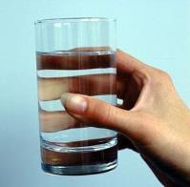
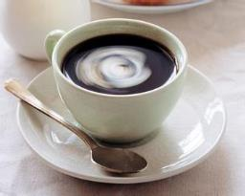
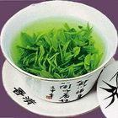
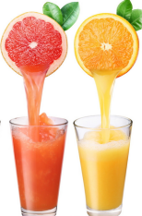
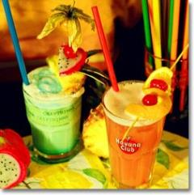
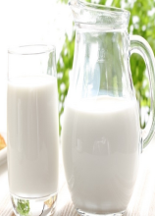
Do you know these drinks?
water
tea
coffee
奶昔(由牛奶和冰淇淋等搅制而成的混合饮料)
milk
juice
milk shake

Slide 7
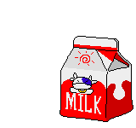
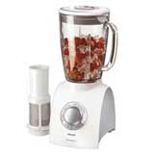
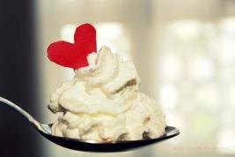
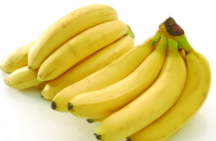
What do we need?
blender
milk
ice-cream
bananas
knife

Slide 8
How do you make a banana milk shake?
Step 1
Peel the bananas.

Slide 9
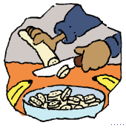
Step 2
Cut up the bananas.

Slide 10
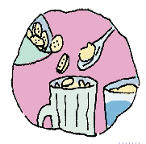
Step 3
Put the bananas and ice-cream
in the blender.

Slide 11
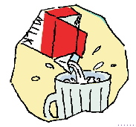
Step 4
Pour the milk into the blender.

Slide 12
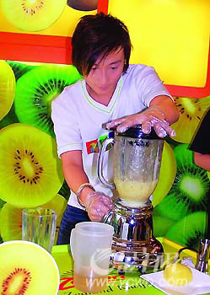
Step 5
Turn on the blender.

Slide 13
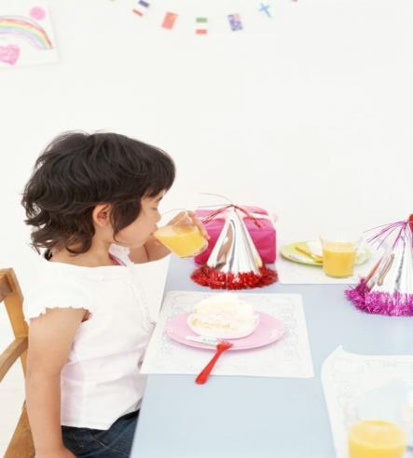
Step 6
Drink the milk shake.

Slide 14
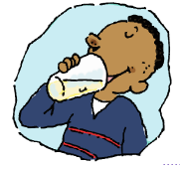
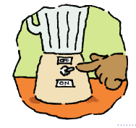
Game
Tell me what you see.

Slide 15
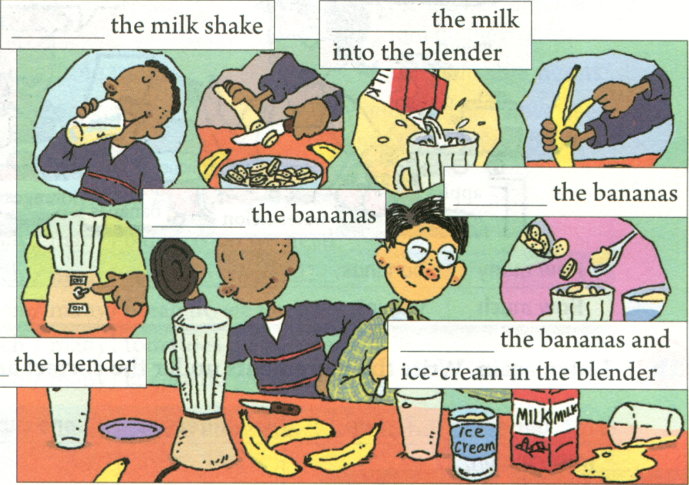
1a. Write these words in the blanks.
Drink
Pour
Peel
Cut up
Turn on
Put

Slide 16
1b
Listen and put the instructions in order.
____ Turn on the blender.
____ Cut up the bananas.
____ Drink the milk shake.
____ Pour the milk into the blender.
____ Put the bananas and ice-cream into
the blender.
____ Peel three bananas.
5
2
6
4
3
1

Slide 17
1b
Listen and fill in the blanks.
A: I’m hungry! Let’s make a banana milk shake.
B: How do you make a banana milk shake?
A: Well, ________ peel three bananas.
B: Three bananas?
A: Yes. Then cut up the bananas.
B: OK, I’m finished.
A: Now put the bananas and ice-cream in the blender.
______ pour the milk into the blender.
B: Is this enough milk?
A: I guess so.________, turn on the blender.________, pour the milk shake into a glass and drink it.
first
Then
Next
Finally

Slide 18
Translation
首先…
并且…
然后…
接下来…
最后…
First,…
And…
Then,…
Next,…
Finally,…

Slide 19
宾语是代词时，放在短语中间
拓展
turn on 打开，接通(电流、煤气、水等)
turn off 关掉, 截断(电流、煤气、水等)
turn up 开大, 调高(音量、热量等)
turn down 调低, 关小(音量、热量等)

Slide 20
1c. Pair work
A: How do you make a banana milk shake?
B: First, peel the bananas.
Then, cut up the bananas.
Next, put the bananas and ice-cream in
the blender.
And pour the milk into the blender.
Next turn on the blender.
Finally, drink the milk shake.

Slide 21
A: How do you make a banana milk shake?
B: First, peel the bananas…
cut up
put … in …
peel
pour …into ...
turn on
drink

Slide 22
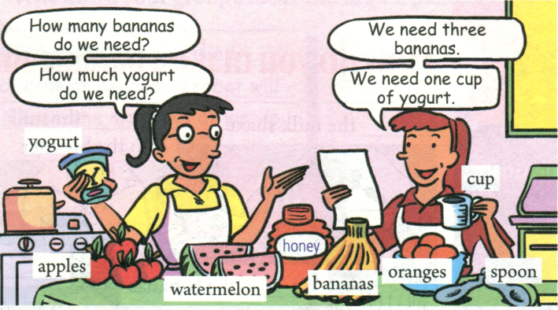
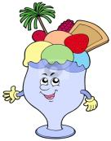
2a
Listen and complete the chart.
+可数名词复数【C】
+不可数名词【U】
How much | How many
yogurt | bananas
honey
watermelons
apples
oranges

Slide 23
2b
Listen again. Write the ingredients(材料） under the correct amount in the chart.
one | two | three | one cup | two spoons
watermelon,
apples
bananas
yogurt
honey
orange

Slide 24
Summary
How to make ______?
Words and phrases:
first, then, next… finally
peel, cut up, put…in, pour…into, turn on, need, watermelon, yogurt, honey
how many / much, spoon, cup

Slide 25
四、当堂检测、拓展延伸
1.— How many ______do you want?
A. bananas B. orange C. apple D. honey
2.How much _____ do we need to make the salad?
A. pear B. yogurt C apple D. banana
3. Please ___ the light. It’s too dark(黑暗的） in the room.
A. turn down B. turn on
C. turn off D turn down
4.Peel the apple, then ______.
A. cut up them B. cut them up
C. cut it up D. cut up it

Slide 26
Fill in the blanks.
A: I am hungry. Let’s make an orange milk shake.
B: OK. What do we need?
A: We need some oranges and milk.
B: How m___ oranges do we need?
A: We need three.
B: OK. How m____ milk do we need?
A: One cup.
B: Now how to make it?
any
uch

Slide 27
A: First, p____ the oranges . Next, c___ up the oranges and then put them in the b______. P_____ the milk into the blender, too. Then t____ on the blender. Finally, d______ the orange milk shake.
B: That must be much more delicious.
eel
ut
lender
our
urn
rink

Slide 28
Homework
1.完成课堂作业中Section A 部分
2.做自己喜欢的水果奶昔，并简要说明过程。可以用下列表示过程的词汇来让你描述更加清晰明了。
first, then, next, … finally…

Slide 29
Thank you for your listening!

