Slide 1
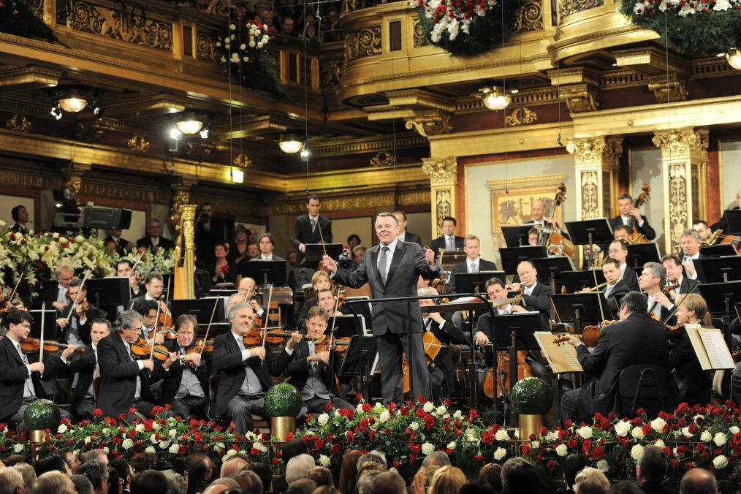
Module 12 Western music
Unit 2 Vienna is the centre of European classical music.
WWW.PPT818.COM

Slide 2
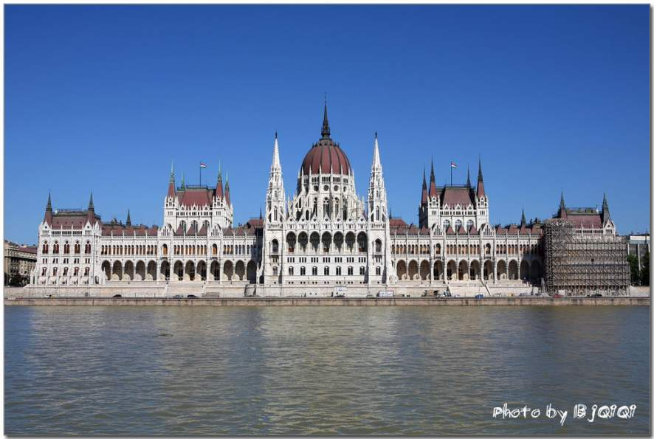
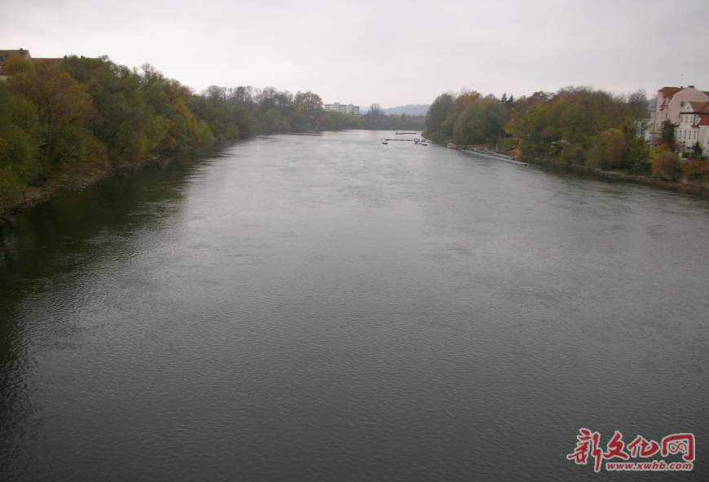
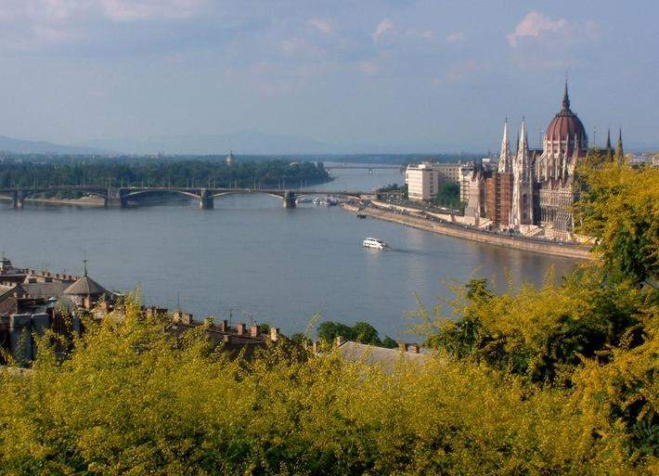
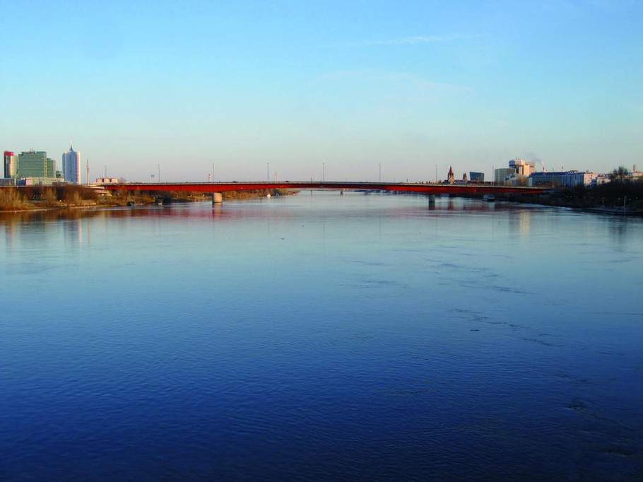
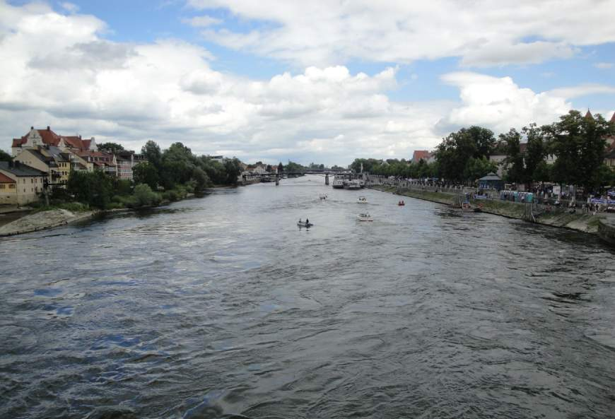
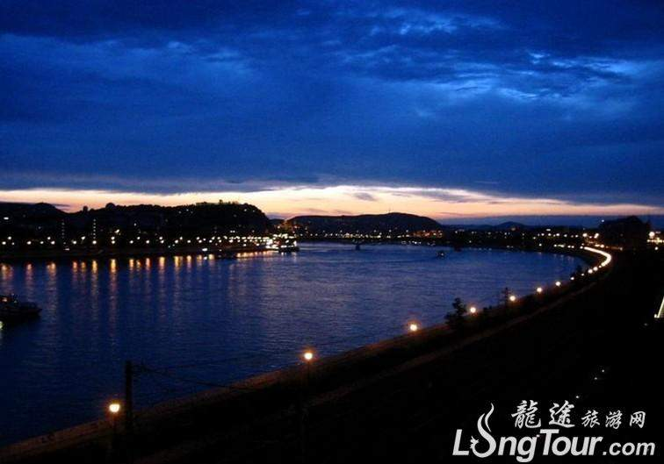
the river Danube
Vienna is a beautiful old city
on the river Danube.
维也纳是多瑙河畔一座美丽而古老的城市。

Slide 3
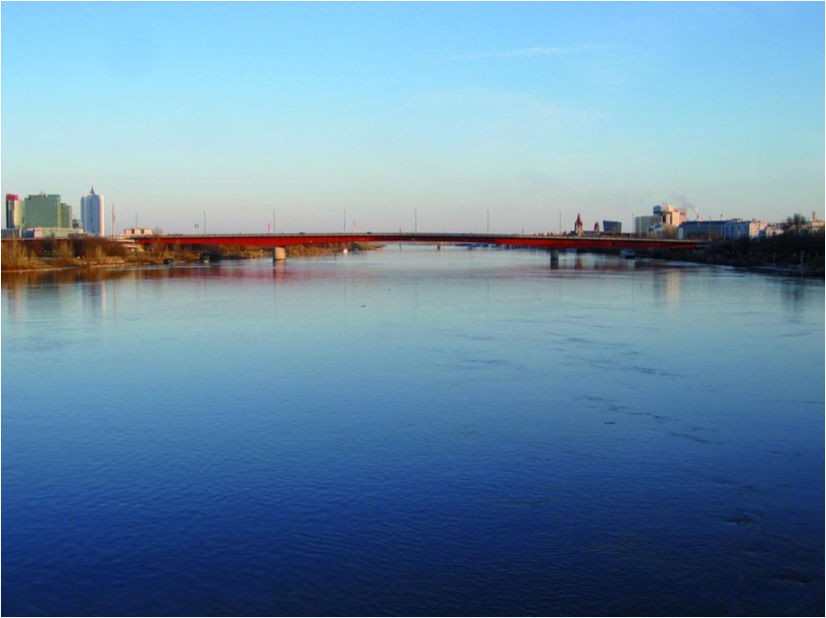
It's the capital city of Austria and
the center of European classical music.
它是奥地利的首都，也是欧洲古典音乐的中心。

Slide 4
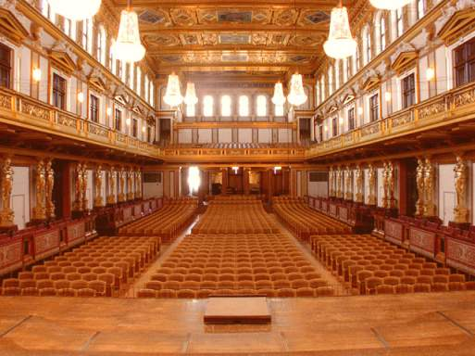
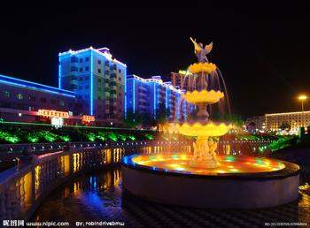
Vienna------ the centre of European classical music.

Slide 5
Some instruments (乐器)
piano
drum
violin
guitar
钢琴
鼓
小提琴
吉他
play the

Slide 6
Read quichly and match
Para.1 A.the Strauss family
Para.2 B. Mozart
Para.3 C. Vienna

Slide 7
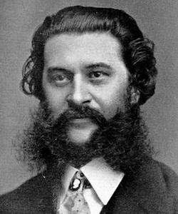
He wrote and played music for a classical dance--a waltz.
他创作并演奏了古典舞曲-华尔兹。
Johann Strauss--
the elder

Slide 8
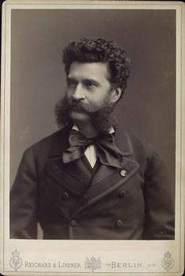
约翰·小施特劳斯甚至比他的父亲更成功和受欢迎。
Johann Strauss--the younger is even more successful and popular than his father.
他写了四百多首华尔兹，最著名的是《蓝色多瑙河》。
He wrote more than 400 waltzes and the most famous one is The Blue Danube.
Johann Strauss--
the younger

Slide 9
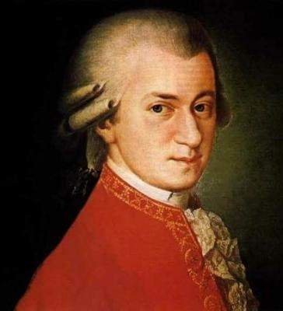
莫扎特与1756年出生于奥地利。
Mozart was born in Austria in1756.
他十二岁的时候写了第一部歌剧。
He wrote his first opera at the age of 12.
他在1791年去世，当时他只有35岁。
He died in 1791when he was only 35.
Mozart

Slide 10
Read carefully
★阅读技巧：
抓关键词，首先确定任务所在的段落。

Slide 11
Read Para.1
beautiful
It’s a ____________ old city on the river Danube.
capital
Vienna
It’s the__________ city of Austria.
musicians
In the 18th a lot of ___________ came here.

Slide 12
Read Para2
What made Johann Strauss the elder famous
all over Europe?
2. Johann Strauss the younger was also successful, wasn’t he?
3.How many waltzes did he write?
His dance music did.
Yes, he was.
He wrote over 150 waltzes.
more than

Slide 13
Read Para.3
Time | What happened to Mozart？
In1756 | He was_________.
Before he was six | He played the _______and violin .
In__________ | He died.
born
piano
1791

Slide 14


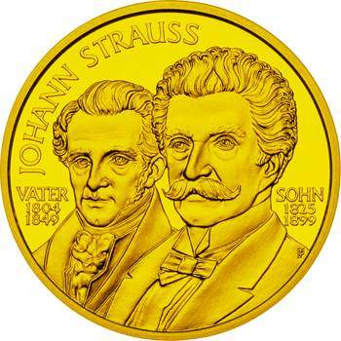
Listen to the passage and fill in the blank.
Vienna is the centre of ________ ________ _____.
European classical
music

Slide 15
Read and check ( ) the true sentences.
√
1. Many musicians came to study and
work in Vienna.
2. Strauss the younger played the piano,
the violin and thedrums at the age of
six.
3. Mozart’s family took him around Europe.
4. The father, Johann Strauss, died in 1791.
5. Mozart wrote The Blue Danube.
√
×
√
×
×

Slide 16
Answer the questions.
Where is Vienna?
Vienna is on the River Danube in the
centre of Europe.
2. What music did Johann Strauss the
elder write?
Johanna Strauss the elder wrote and
played music for traditional dances,
called the waltz.

Slide 17
3. How many waltzes did Johann Strauss
the younger write?
He wrote over 150 waltzes.
4. When was Mozart born?
He was born in Austria.
5. How old was Mozart when he died?
He died in 1791 when he was only 35.

Slide 18
Complete the passage with the correct form of the words from the box.
another, elder, European
perfect, poor, popular
Both Strauss the _______ and Strauss the younger wrote some very ________ music. _________ successful composer from Vienna was Mozart, but he became very
elder
popular
Another

Slide 19
_______ and died at the age of 35. many people think Mozart’s music is _________. All three were great __________ musicians.
poor
perfect
European

Slide 20

Language Points
1. His dance music made him famous all over Europe.
他的舞曲使他享誉全欧洲。
make 的常见用法：
(1) make sb. do sth. 使某人做某事
make sb. not do sth. 使某人不做某事
Parents always make their children learn many things.
父母总是使他们的孩子学习很多东西。

Slide 21
(2) make sb./sth. +adj. 使某人/物……
The bad news made him very sad.
这个坏消息使他很伤心。
all over 遍及
all over the world 全世界
all over the country 全国
all over China 全中国
We have friends all over the world.
我们的朋友遍天下。

Slide 22
2. …he played not only the piano, but also
the violin.
…他不但能弹钢琴，而且还会拉
小提琴。
not only…but also…是一个表并列关系的
连词，用来连接两个并列关系的句子成
分。
I can speak not only English, but also
French.
我不但会讲英语，而且还会讲法语。

Slide 23
Writing
When you write, choose your tenses carefully. Think about whether you are writing about something that is still true now or happened in the past.

Slide 24
Use the notes to write a passage about the Chinese composer Xian Xinghai.
◆ Xian Xinghai
◆ famous for the song The Yellow River
◆ wrote it in 1939 in only six days
◆ one of the great composers of classical
and traditional music
◆ born in Macao, China, 1905

Slide 25
◆ died young, 1945
◆ called the “People’s Musician”
◆ used traditional Chinese music
◆ studied in Paris
◆ songs are still popular today
Xian Xinghai is one of the great
composers of classical and traditional
music. He was born in…

Slide 26
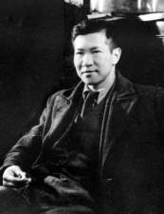
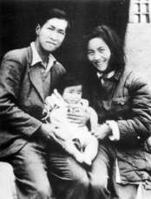
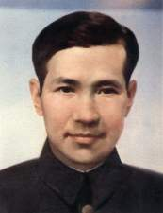
Xian Xinghai
Xian Xinghai is one of the great composers of classical and traditional music. He was born in Macao, China in 1905 and studied in Paris. He was famous for his song The Yellow River. He used traditional music, and the music describes China to the rest of the world. Unfortunately, Xian Xinghai died young, in 1945. But he
is called the “People’s Musician” and his music is loved by every one.

Slide 27


Individual activity
Exercise

Slide 28
I. 根据课文内容填空。
Vienna is a beautiful old city on the river Danube. It’s the _______ city of Austria and the ______ of European classical music.
There were two __________ called Johann Strauss: a ______ and a ____. The father wrote and played music for a classical dance — _____. His waltzes made him famous all over _______.
capital
centre
composers
father son
waltz
Europe

Slide 29
Johann Strauss the younger, was even more __________ and ________ than his father. He wrote ________ 150 waltzes and his most _______ one was The Blue Danube. He wrote it in 1867. Strauss and Mozart were two of the most __________ composers.
successful
popular
over
famous
important

Slide 30
II. 用所给动词的适当形式填空。
doesn’t like
1. Tony ___________ (not like) pop music,
does he?
2. I like pop. It’s lively and good ________ (dance) to.
3. There were two composers _____ (call)
Johann Strauss.
4. Mozart _______ (die) in 1791 when he
was only 35.
5. He _____ (be) a teacher in 1992.
to dance
called
died
was

Slide 31
III. 按要求转换下列句子。
1. At the age of 20, he joined the army.
(改为同义句)
_____ ___ ____ 20, he joined the army.
2. Your father was born in 1948,
__________? (完成反意疑问句)
3. Strauss was famous for his waltzes.
(改为同义句)
Strauss’ waltzes _____ ____ _______.
When
he
was
wasn’t he
made
him
famous

Slide 32
4. I can play the violin. Tom can play the
violin, too. (改写为同义句）
____ ____ I ____ ____ Tom can play the violin.
5. Many people went to Qingdao to enjoy
the beautiful sea. (就划线部分提问）
______ ___ many people____ to enjoy
the beautiful sea?
Not
only
but
also
Where
did
go

Slide 33
IV. 完成下面的反意疑问句。
don’t you
1. You like rock music, ________?
2. They sing well, _________?
3. He has written ten new songs this year,
________?
4. He wrote traditional music, ________?
5. She was a musician, _________?
6. We can practise after school, ________?
don’t they
hasn’t he
didn’t he
wasn’t she
can’t we
do you
7. You don’t like this song, ______?
8. They have never been to any concert,
________?
9. This music isn’t very popular, _____?
10. He has a lot of CDs, _________?
have they
is it
doesn’t he

Slide 34
Homework
Write a passage about your favourite singer.

