Slide 1
Unit1 I go to school at 8:00.
人教精通版六年级上册
WWW.PPT818.COM

Slide 2
>>Review
Let’s retell
Lucy’s Daily Life
Activities | Time
get up | 7:30 in the morning
have breakfast
go to school
School begins.
have lunch
School is over.
go home
have dinner
go to bed
8:00
8:30
9:00
11:45
3:30 in the afternoon
4:00
7:00 in the evening
About 9:30 in the evening

Slide 3
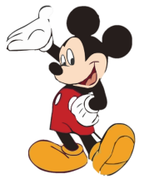
>>Lead-in
Free talk
Talk about your daily life
1
When do you go to school every day?
1
How do you go to school?
1
What do you usually do at school?
1
Do you like English?
1
What do you do in English class?

Slide 4
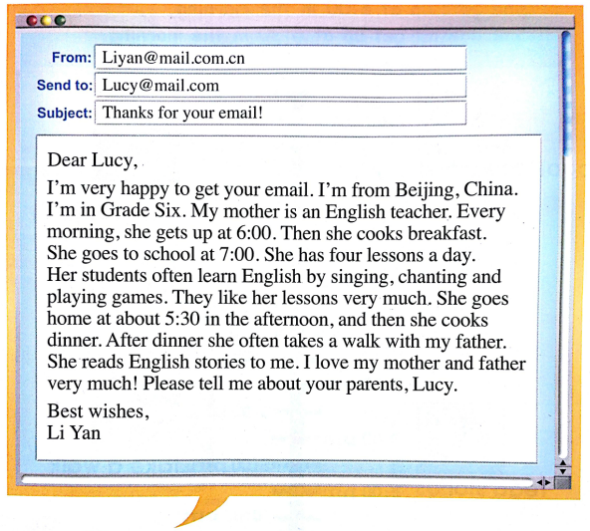
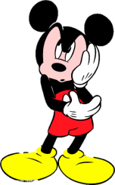
>>Presentation
This is a letter from Li Yan to Lucy.
Who is the letter sent to?
Who is it from?

Slide 5
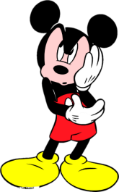
>>Presentation
Just read and talk
Task1: Listen and say
What’s Li Yan’s e-mail about?
It’s about Li Yan’s mother’s daily life.

Slide 6
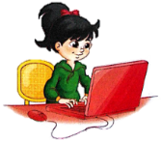
>>Presentation
Just read and talk
Task2: Read and judge
1. Li Yan is from Beijing, China.
2. Li Yan is in Grade Five.
Six
3. Li Yan’s mother teaches Chinese.
English

Slide 7
>>Presentation
Just read and talk
Task3: Read and circle
What activities do you know about Li Yan’s mother?
Every morning, she gets up at 6:00. Then she cooks breakfast. She goes to school at 7:00. She has four lessons a day. Her students often learn English by singing, chanting and playing games. They like her lessons very much. She goes home at about 5:30 in the afternoon, and then she cooks dinner. After dinner she often takes a walk with my father. She reads English stories to me. I love my mother and father very much! Please tell me about your parents, Lucy.
gets up
cooks breakfast
goes to school
has four lessons
goes home
cooks dinner
takes a walk
reads English
stories

Slide 8
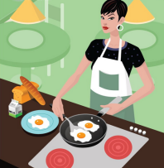
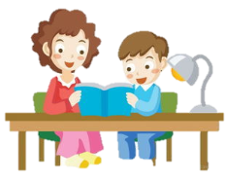
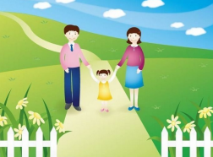
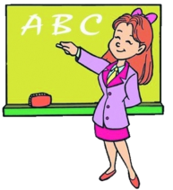
>>Presentation
cook breakfast
read stories
take a walk
teach English

Slide 9
>>Presentation
Just read and talk
Task4: Read and answer
1. What does Li Yan’s mother do every morning?
She gets up at 6:00. Then she cooks breakfast. She go to school at 7:00.
2. How many lessons does Li Yan’s mother have every
day?
She has four lessons every day.
3. Do her students like her lessons?
Yes, they do.

Slide 10
>>Presentation
Just read and talk
Task4: Read and say
4. How do the students learn English?
They often learn English by singing, chanting and playing games.
5. After dinner, what does her mother do?
She often takes a walk and reads English stories.

Slide 11
>>Practice
Just read and talk
Listen and imitate

Slide 12
>>Practice
Read it by yourselffor one minute .
自读文章一分钟。
一分钟倒计时
60
Learning tip :
10
10
50
当你自己朗读时，遇到不会读或不明白意思的单词或句子，可以把它圈起来，请教同学或老师！
20
20
40
30
30
开始

Slide 13
>>Practice
Show time
Good: 朗读有感情，语音语调正确地道。
Great: 可以脱离课本，适当改动其中部分，语音地道。
Excellent: 添加适当内容，意思完整有创新，表演生动。

Slide 14
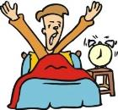
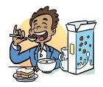
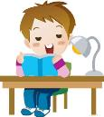
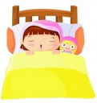
>>Practice
Pair work
Fill in the blanks and introduce your mom and dad’s daily life.
Activity
Time
People
Two
Mom
Dad
My mother gets up at six o’clock. She has breakfast at ….

Slide 15
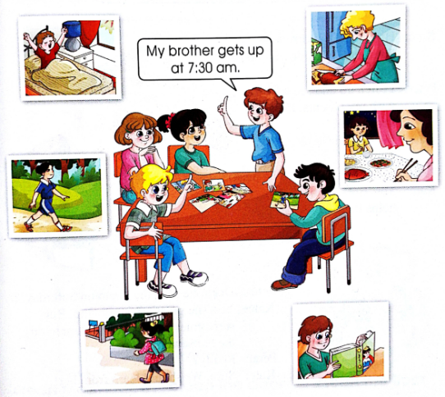
>>Practice
Group work
Bring a few photos of your family or your friends. Talk about them in groups.

Slide 16
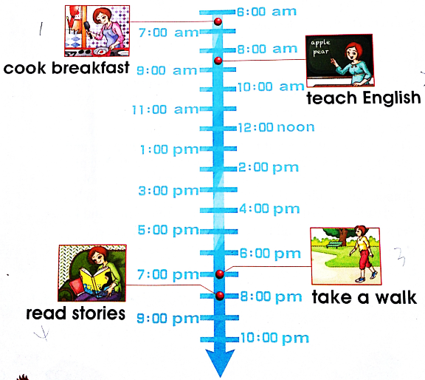
>>Consolidation
Retell the passage
cook breakfast
get up
go to school
teach English
go home
cook dinner
take a walk
read stories

Slide 17
>>Summary
如何介绍别人的日常生活及作息时间呢？
My mother gets up at 6:00.
She cooks breakfast at …
She goes to school at ….

Slide 18
>>Homework
1.观看课文动画，按照正确的语音、语调朗读课文对话。 2.运用本课学习知识，用英文介绍一下自己的家人或朋友的日常生活和作息时间。
3.预习 Lesson 4。

