Slide 1
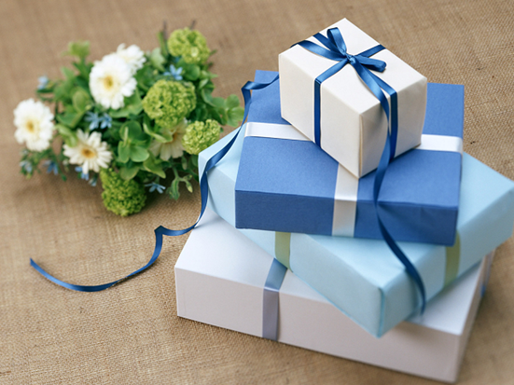
Unit 1
In China, we open a gift later.
WWW.PPT818.COM

Slide 2
a: chess set 国际象棋
b: video game 电子游戏
c: toy 玩具
d: dictionary
e: chocolate
f: chopsticks 筷子
g: baseball cap 棒球帽

Slide 3
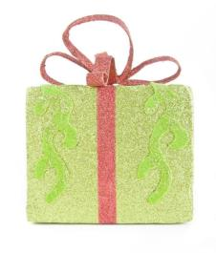
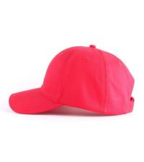
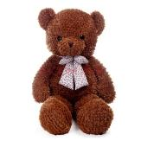
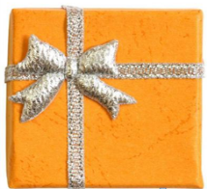
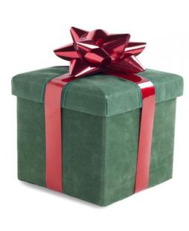
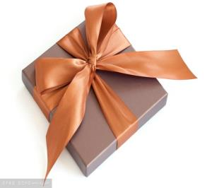
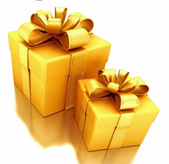
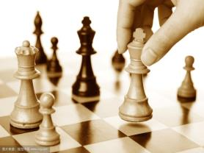
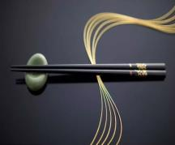
Game
toy
cap
chess set
video game
chopsticks

Slide 4
Match the words and expressions in
Activity 1 with the pictures.
a
baseball cap chess set
chocolate chopsticks
dictionary toy
video game
g
e
f
d
c
b

Slide 5
Listen and answer the question.
What present do they want to buy for Lingling?
toy
chess set
dictionary
√

Slide 6
Who’s birthday?

Slide 7
Question:
In China, do people open a gift immediately
or later?
A: Later.
2. Where do people open the gift
immediately?
A: In the US.

Slide 8
Now check (√) what you usually do in China.
1. Open a present immediately when you receive it.
2. Accept a present with both hands.
3. Use red paper for hongbao.

Slide 9
4. Do cleaning on the first day of the Spring Festival.
5. Break something during the Spring Festival.
6. Have your hair cut during the Spring Festival month.

Slide 10
Now check (√) what you usually do in China.
1. Open a present immediately when you receive it.
2. Accept a present with both hands.
3. Use red paper for hongbao.
√
√

Slide 11
4. Do cleaning on the first day of the Spring Festival.
5. Break something during the Spring Festival.
6. Have your hair cut during the Spring Festival month.

Slide 12
3. Listen and read
Betty: Happy birthday, Lingling.
Daming: Here's your gift.
Lingling: Oh, you remember! What a surprise!
Tony: You can open it.
Lingling: I don't think I should open it now. In China, we open a gift later.
Betty: But back in the US, we open a gift immediately.

Slide 13
Lingling: So what do I do?
Betty: You needn't wait!
(Lingling opens her present and finds a dictionary.)
Lingling: Oh, thank you. I really wanted one.
Betty: We're happy you like it.
Tony: I noticed another difference. In China, you accept a gift with both hands. But in the west, we usually don't pay much attention to that.

Slide 14
Daming: You must only use red paper for hongbao because red means luck. And you'd better not cut your hair during the Spring Festival month.
Betty: That's interesting! I'm interested to know all the Chinese traditions. Tell me more.

Slide 15
Lingling: There are a lot. For example, in my home town, people say you mustn't do any cleaning on the first day of the Spring Festival. And you mustn't break anything. It's bad luck.
Tony: You can't be serious!
Daming: And in the north of China, people eat lots of jiaozi!
Betty: Perfect! They taste great.

Slide 16
Tony: I like eating jiaozi too. Anyway, the Spring Festival is still over a month away. Let's celebrate Lingling's birthday first!

Slide 17
Homework
Finish off the exercise in Activity 4 on Page 89.
Copy the new words.

