Slide 1
Unit1 How are you feeling now?
第4课时
WWW.PPT818.COM

Slide 2
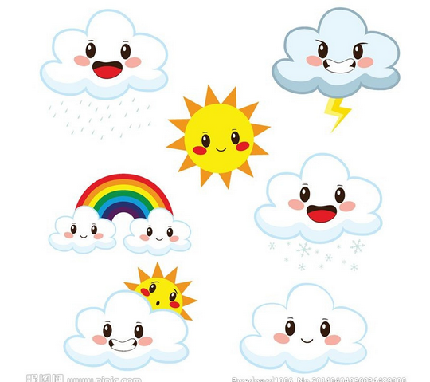
>>Lead-in
Free talk
It’s … today. It makes me …

Slide 3
>>Presentation
Read the words
ar
farm park party garden
er
her hers herself
ruler driver
worker teacher
er

Slide 4
>>Presentation
你发现什么规律了吗？
ar - /a:/
farm
park
party
garden
er - /ə/
her
hers
herself

Slide 5
>>Presentation
你发现什么规律了吗？
er - /ə/
ruler
driver
worker
teacher

Slide 6
>>Presentation
Try to read more
star dark smart market
term serves person German
river dinner letter answer

Slide 7
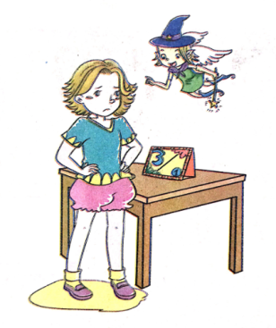
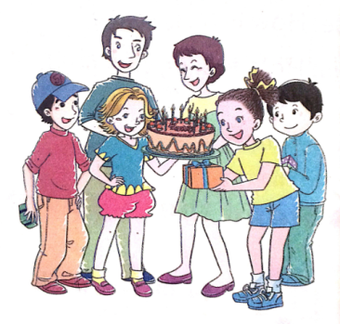
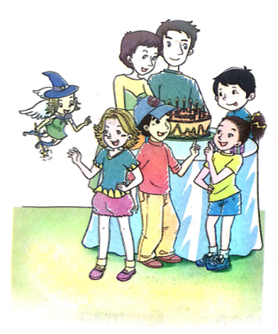
>>Presentation
Look and say
How is Alice feeling
in these pictures?

Slide 8
>>Presentation
Listen and answer
Why is Alice feeling a little sad at the beginning?
Because today is her birthday.
But nobody is in.
(2) Are Alice’s mom and dad at home?
Yes, they’re.

Slide 9
>>Presentation
Listen and answer
(3) Does Kitty send a gift to Alice?
Yes, she does.
(4) How is Alice feeling finally?
She is feeling very happy.
(5) Why is Alice happy?

Slide 10
>>Practice
Try to retell

Slide 11
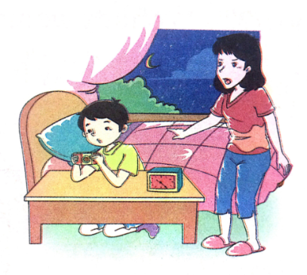
>>Practice
Look and write
Mom ______________.
is feeling angry

Slide 12
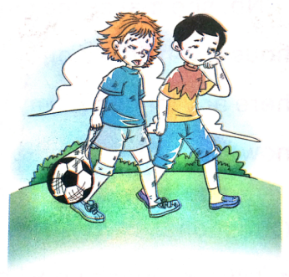
>>Practice
Look and write
The boys _______________.
are feeling tired

Slide 13
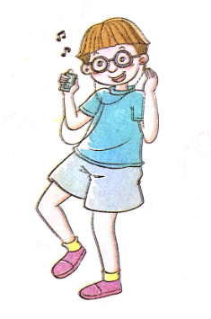
>>Practice
Look and write
The music _____________________.
makes Kevin/him happy

Slide 14
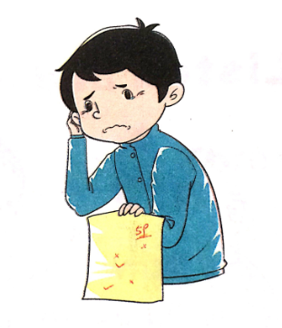
>>Practice
Look and write
The boy ____________.
is feeling sad

Slide 15
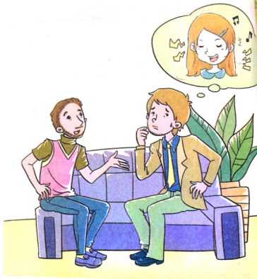
>>Practice
Read and answer
1. Why is James very happy?
Because his child is learning music.
2. Does his child play very
beautiful music?
No, she doesn’t.

Slide 16
>>Summary
语音：
字母组合ar在单词中的发音为/a:/； 字母组合er在单词中通常读长元音
/ə:/；而词尾的er通常读短元音/ə/。

Slide 17
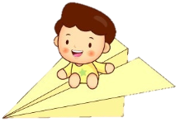
>>Homework
1.观看课文动画，按照正确的语音、语调朗读课文对话。
2.熟读“Let’s learn more” 。
3.预习“Unit2 Let’s learn”。
close

