Slide 1

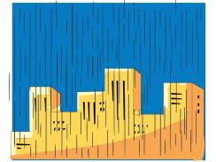


Unit 2 What a day!
WWW.PPT818.COM

Slide 2
Brain Storm
I say 'go', you say 'went'
fly
flew
lose
lost
bring
brought
find
found
can
could

Slide 3
Brain Storm
I say 'went', you say 'go'
went fishing
go fishing
swept the floor
sweep the floor
ate moon cakes
eat moon cakes
made a cake
make a cake
bought some new clothes
buy some new clothes

Slide 4

Sing the song
Johnny's
unhappy rainy day

Slide 5
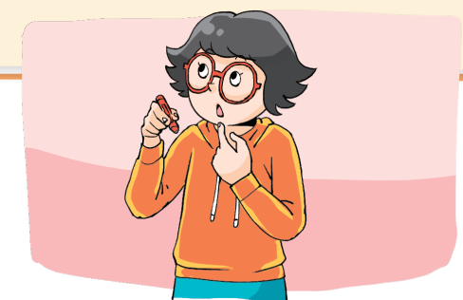
Retell Story time
Try to retell Yang Ling's Sunday

Slide 6

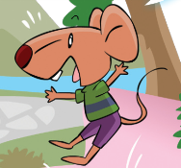

Retell Cartoon time
What happened?
at first
at last
Why?

Slide 7
Bobby's diary
Sunday, 20th September ________
This morning, Tina and I ______ my new kite in the park, but it wasn't______ in the park. Then we ______ ______ the hill. It was windy there.
Then the kite flew too high, we couldn't ______ ______ it. I ______ my new kite. I was sad. I cried in the park.
Then, Sam came, he ______ my kite near the hill.
_________________________________________
________________________________________
wind/sunny
flew
windy
climbed up
hold
onto
lost
found
What happened then?

Slide 8
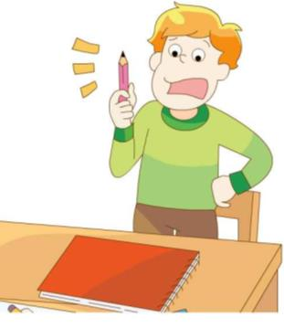
Mike's diary
Guess, was Mike happy?

Slide 9

Listen and choose

Slide 10


Mike's diary
Monday, 21st September cloudy
It was cloudy in the morning. I got up late. It was seven thirty. I couldn’t eat my breakfast. I went to school by bike. I got to school at eight o'clock.
Miss Li was in the classroom. It was her English lesson. I was late again. I was very sorry for Miss Li. I opened my school bag. Oh, no, I couldn’t find my English book.
Mike's
________ Monday

Slide 11
Mike's diary
Monday, 21st September cloudy
It was cloudy in the morning. I got up late. It was seven thirty. I couldn’t eat my breakfast. I went to school by bike. I got to school at eight o'clock.
Miss Li was in the classroom. It was her English lesson. I was late again. I was very sorry for Miss Li. I opened my school bag. Oh, no, I couldn’t find my English book.
What can we write in the diary?
我们可以写些什么？

Slide 12
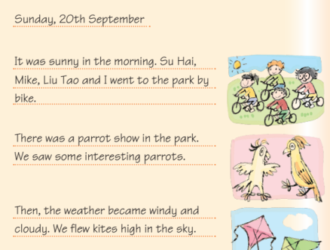
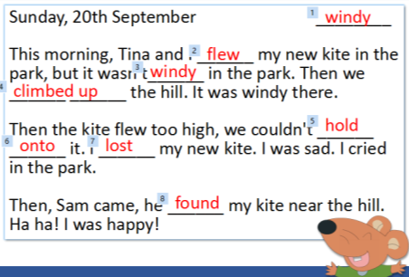
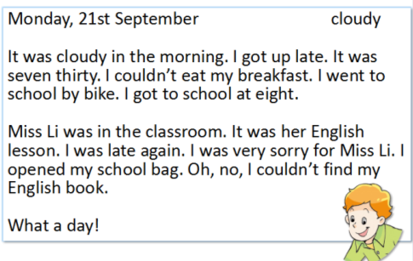
Diary Format
观察这些日记，你能说一说日记的格式吗？

Slide 13

Diary Format
左上角写日期（星期几，日，月），右上角写天气情况。英式日期写法是日，月，年。美式日期写法是月，日，年。
在日期和天气的下一行中间可以写上自己的小标题，也可以不写。
正文是关于一天生活的记载。要选择当天感受最深刻的事件来描述，不要写成流水账。
正文书写时，可以开头不空格，段与段之间空一行。也可以开头空四个字母的位子，段落之间不用空行。
英语日记格式
1.左上角写日期（星期几，日，月），右上角写天气情况。
2.在日期和天气的下一行中间可以写上自己的小标题，也可以不写。
3.正文是关于一天生活的记载。要选择当天感受最深刻的事件来描述，不要写成流水账。
4.正文书写时，可以开头不空格，段与段之间空一行。也可以开头空四个字母的位子，段落之间不用空行。

Slide 14
Your Saturday
What did you do with your family or friends last Saturday?
went fishing
watched a film
had a picnic/big dinner
did the housework for mum

Slide 15
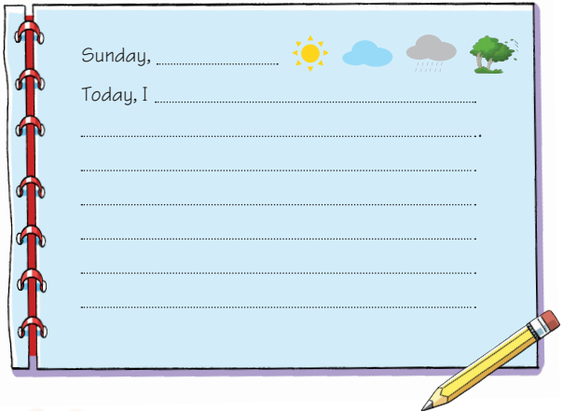
Writing time
Saturday

Slide 16
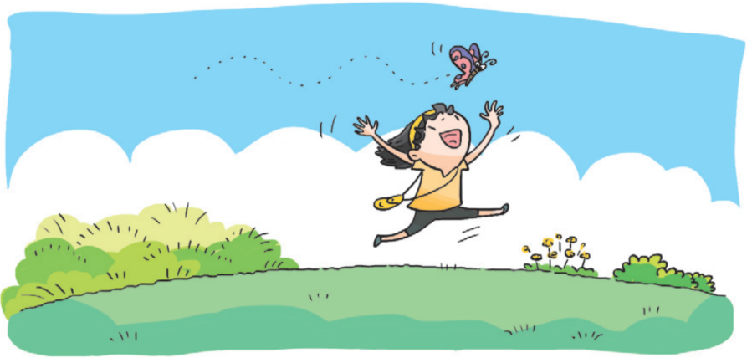
See you!

