Slide 1
Lesson 3
We Read in the Library.
WWW.PPT818.COM

Slide 2
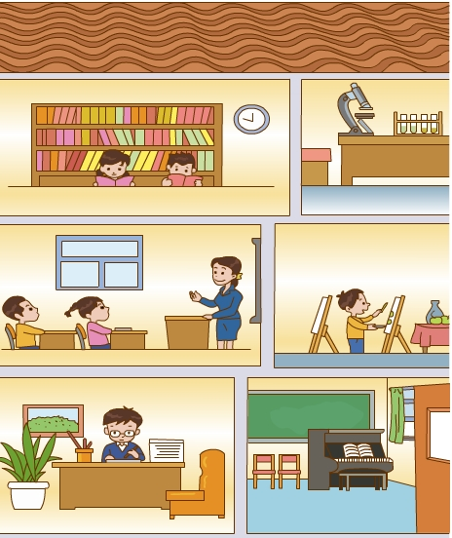
the third floor
the second floor
the first floor

Slide 3
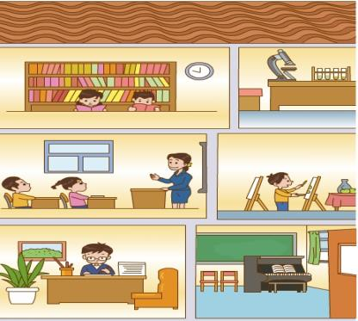
Where’s the ___？
It’s on the ___ floor.

Slide 4
sing
sing
sing
唱歌

Slide 5
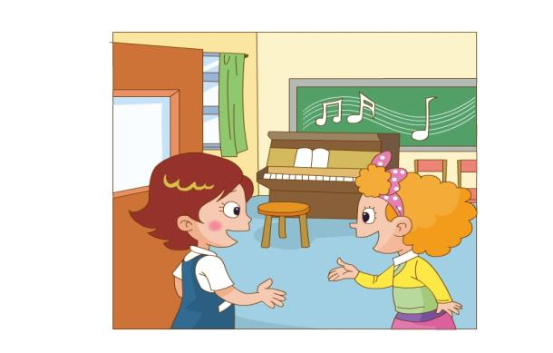
Is this your
music room?
Yes. we sing here.

Slide 6
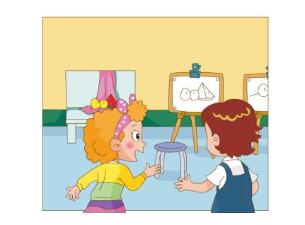
画画
draw
We in
the art room.
How beautiful !

Slide 7
Is this your
library?
图书馆
Yes ,it is.

Slide 8
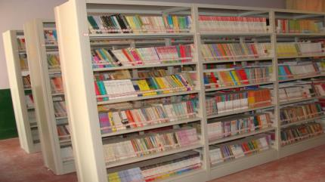
We read in the
library.

Slide 9
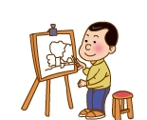
Let's chant.
Sing, sing, sing
Sing in the music room;
Draw, draw, draw
Draw in the art room;
Read, read, read
Read in the library.

Slide 10
Listen and point .
Listen and repeat .

Slide 11
Read and choose.
1、We in the art room.
A. sing B. draw C.read
2、We read in the .
A.classroom B.music room C.library

Slide 12
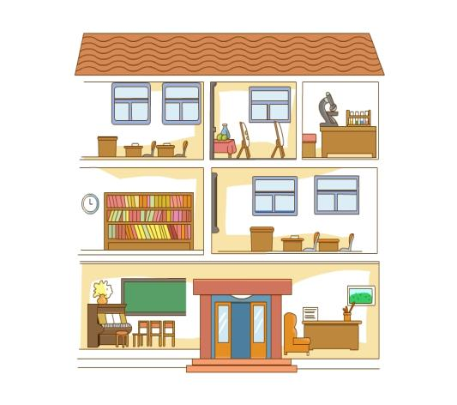
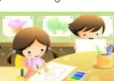
We … in the …

Slide 13
art room
music room
classroom
playground
bedroom
living room
dinning room
We … in the …

Slide 14
Let's find.
Ii
Oo
Uu
Yy
Qq
Ll
Ss
Ww
Xx
Ff
Rr
Nn
Mm
Zz

Slide 15
Let's copy .

