Slide 1
Unit 3
He's my grandpa.
WWW.PPT818.COM

Slide 2
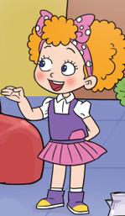

Slide 3
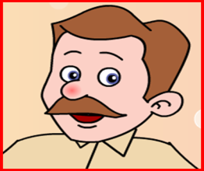

Slide 4
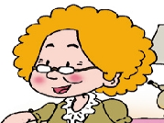
Listen and choose.
He’s my __________.
A. grandpa B. grandma
2. She’s my __________.
A. grandpa B. grandma

Slide 5
Listen and choose.

Slide 6
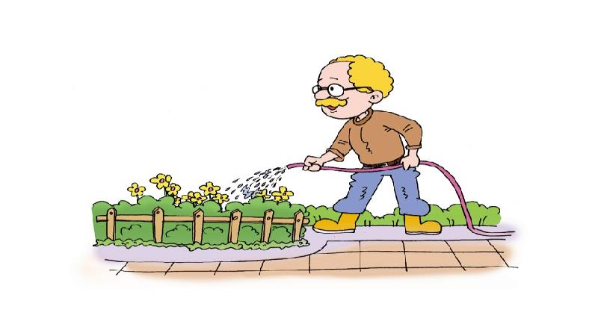
1. He’s my __________.
He
A.
grandpa
B. grandma

Slide 7
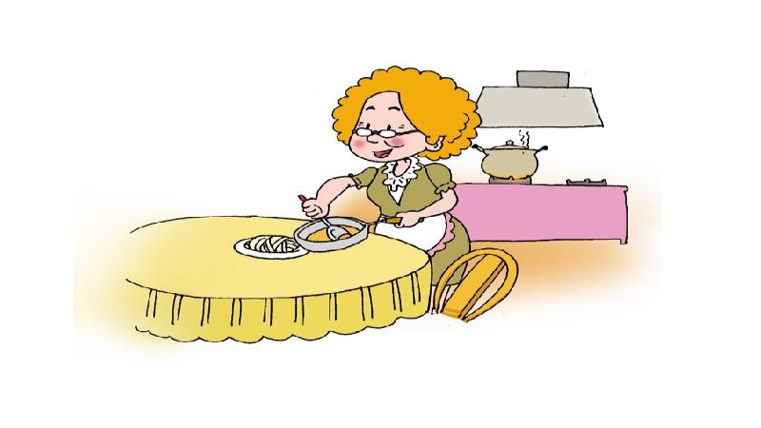
2. She’s my __________.
She
A. grandpa
B.
grandma

Slide 8
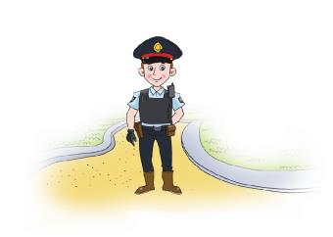
Listen and fill.
brother
He’s my __________.
sister
She’s my __________.

Slide 9
Listen，point and read.

Slide 10
Read by yourselves.
自读课文。

Slide 11
Draw and say.
1.Draw your grandpa/grandma.
2.Introduce them to us.

