Slide 1
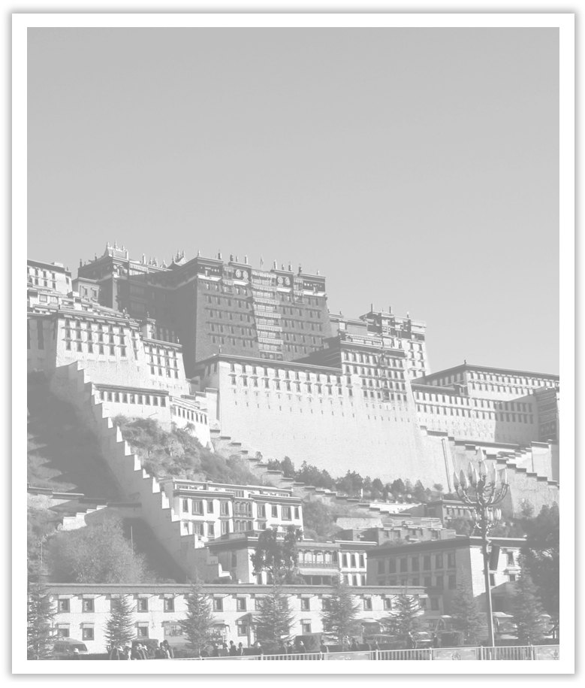
Unit 1 Cultural Heritage
Section Ⅳ Discovering Useful Structures——限制性定语从句(3)
WWW.PPT818.COM

Slide 2
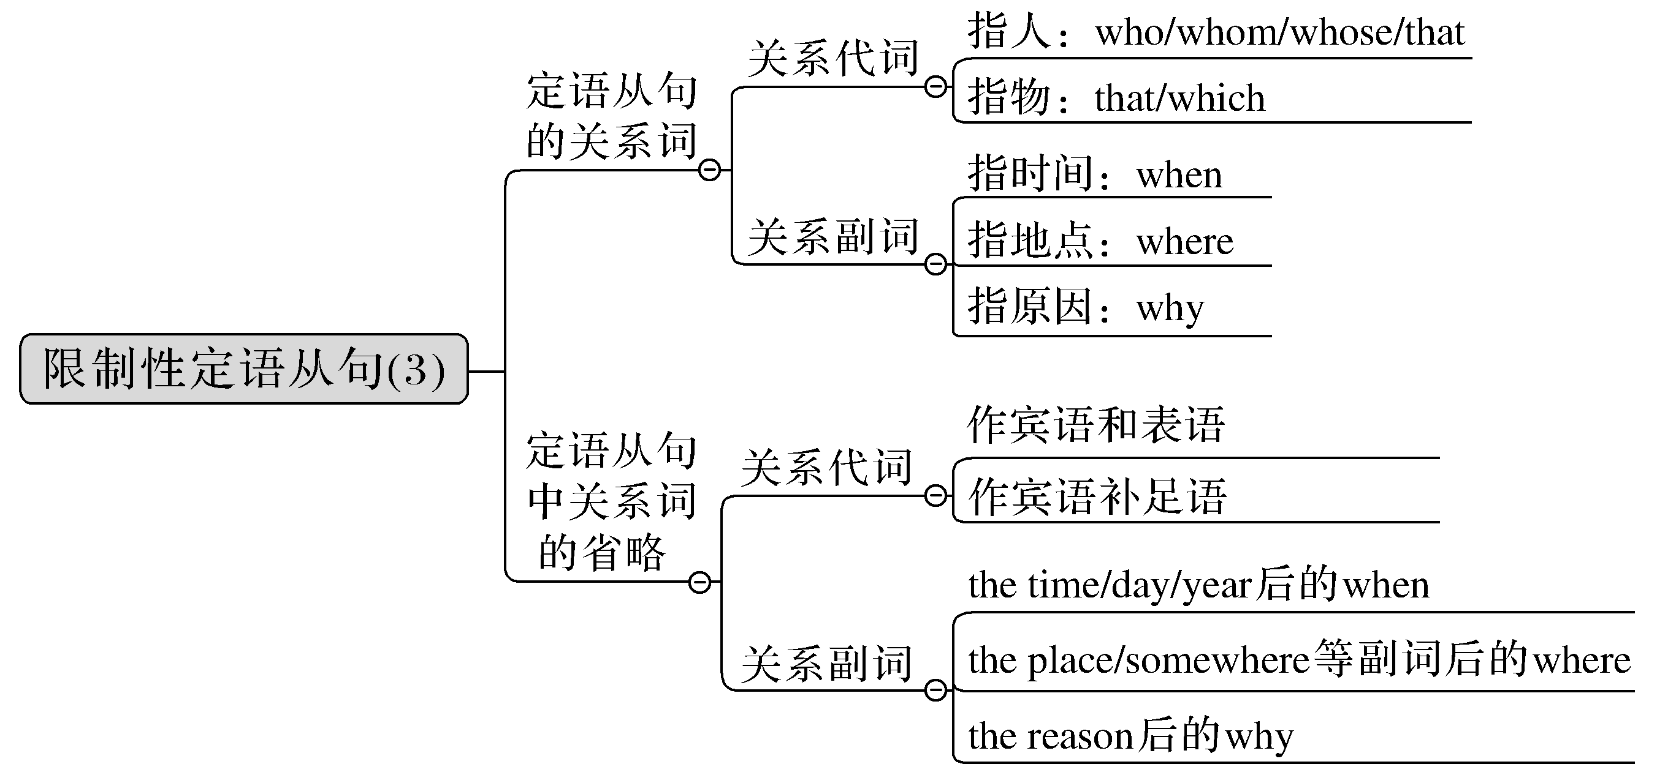

Slide 3
定语从句是一种形容词性从句，它是跟在一个名词、代词或句子后对其进行修饰限定的句子。因该从句在整个句子中作定语，故被称作定语从句。被修饰的词叫先行词。定语从句通常只能放在被修饰的词之后。

Slide 4
一、定语从句的关系词
[合作探究]
After listening to the scientists who had studied the problem and citizens who lived near the dam, the government turned to the United Nations for help in 1959.在听取了研究这个问题的科学家和住在大坝附近的居民的意见后，政府于1959年向联合国寻求帮助。
Temples and other cultural sites were taken down piece by piece, and then moved and put back together again in a place where they were safe from the water.寺庙和其他文化遗址被一块一块地拆下来，然后搬到一个安全的不会遭受水患的地方重新组装起来。

Slide 5
[自主发现1] 当被定语从句修饰的先行词指人且在定语从句中充当主语时，引导定语从句的关系词用____________； 当被定语从句修饰的先行词指地点且在定语从句中作地点状语时用关系词____________。
who/that
where

Slide 6
二、关系词的基本用法
[合作探究]
You may have chances to meet new people who will become your lifelong friends.
你可能有机会结识将成为你一生的朋友的新人。
In the dark street, there wasn’t a single person whom she could turn to for help.
在黑暗的街道上，没有一个她可以求助的人。
Ms Wang is the teacher whose son was admitted to Beijing University.
王女士就是那位儿子被北京大学录取的老师。
I can well remember the accident that happened on a rainy Sunday afternoon.
我清楚地记得在一个下雨的星期天下午发生的那场事故。

Slide 7
Our class is a big family which is made up of 28 girls and 32 boys.
我们班是一个由28个女孩和32个男孩组成的大家庭。
The company whose name is Huawei is based in Guangdong Province, China.
那个叫华为的公司总部在中国广东省。
I always miss the days when we were on the summer camp last year.
我总是怀念去年我们参加夏令营的日子。
The reason why we have to grow trees is that they supply us fresh air.
我们必须种树的原因是它们能为我们提供新鲜的空气。
Literature is the place where the past meets the present to think about the future.
在文学作品里，过去与现实交汇，以思考未来。

Slide 8
It’s time to recall those beautiful days(that/which) we spent together.
是时候回忆我们一起度过的那些美好的日子了。
We are looking for the person to whom the book belongs.
我们正在寻找这本书的主人。

Slide 9
[自主发现2]
(1)定语从句关系词的具体用法是：
who/that
whom/who/that
whose
that/which
that/which
whose

Slide 10
when
where
why
(2)当表示时间、地点或原因的先行词在其后面的定语从句中作宾语或表语时，引导定语从句的关系词必须使用关系____________。
(3)当关系词前有介词时，该关系词多用关系____________。
代词
代词

Slide 11
三、定语从句中关系副词与“介词＋关系代词”的转化
[合作探究]
I still remember the day when (＝on which) I first came to Beijing.
我还记得第一次来北京的那一天。
This is the house where (＝in which) Mo Yan once lived.
这是莫言曾住过的房子。
The reason why (＝for which) he failed in the exam was that he didn’t study hard.
他考试失败的原因是他学习不努力。

Slide 12
The gentleman about whom you told me yesterday is a friend of my father.
你昨天告诉我的那个绅士是我爸爸的一个朋友。
The woman to whom he is married is a famous actress.
他要娶的是一位著名的女演员。

Slide 13
[自主发现3]
(1)关系副词when, where引导的定语从句可以转化为“____________”引导的定语从句；而why引导的定语从句可以转换为“____________”引导的定语从句。
(2)在使用“介词＋关系代词”引导定语从句时，介词的选择要考虑以下三个方面：
①介词和定语从句中____________的习惯搭配；
②介词与定语从句中的____________的习惯搭配；
③介词与定语从句中的____________________同时搭配并符合句意逻辑。
介词＋which
for which
先行词
谓语动词
谓语动词和先行词

Slide 14
四、定语从句中关系词的省略
1.关系词可以省略的几种情况
[合作探究]
I have taken with me the two books(that/which) you asked me to return to the City Library.我把你要我送还给市图书馆的那两本书带走了。
Here is the man (whom) you’ve been looking for.
这就是你一直在找的那个人。
The way (that/in which) you look at the problem is wrong.
你看待问题的方式是错误的。

Slide 15
The reason(why/that) he wanted to sell his house was that he needed a lot of money for his operation.他想卖掉房子的原因是他的手术需要很多钱。
The second time (when) I saw him was in 1980.
我第二次见到他是在1980年。
This is the place (where) we met yesterday.这就是我们昨天见面的地方。
This is the book (which) I read yesterday and which I found very interesting.
这就是我昨天读的那本书，我发现它很有趣。
Our village is not the one (that) it used to be.
我们的村庄已不是过去那个样子了。

Slide 16
[自主发现4]
(1)当定语从句的先行词在定语从句中作____________时，关系词通常省略。
(2)当先行词是way, reason, time, place等且它们在定语从句中分别作方式、原因、时间和地点状语时，它们后面的定语从句的相应的关系词____________， ____________， ____________， ____________等可以省略。
(3)当由and，but，or等并列连词连接两个或两个以上的定语从句修饰同一个先行词时，第____________个关系代词可以省略，但第二个及以后的关系词一般不可以省略。
宾语
that/in which
why
when
where
一

Slide 17
2.关系词不可省略的几种情况
[合作探究]
Do you know any shops nearby in which I can buy flowers?
你知道附近有卖花的商店吗？
That’s the headmaster with whom my father was talking just now.
那就是刚才和我父亲谈话的校长。
Mr.Green, whom you know，is the tallest in our school.
你认识的格林先生是我们学校最高的。

Slide 18
[自主发现5]
(1)关系代词前有____________时，该关系代词不能省略。
(2)____________定语从句中，无论关系词作何成分，都不能省略。
介词
非限制性

Slide 19
[巩固内化1]
选择适当的关系词
①The scientist ____________ (who/whom) discovers a cure for cancer will be great.
②Mr.Liu wants to talk to the students ____________ (who/whose) homework hasn’t been handed in.
③Yesterday Li Ming went to the village ____________ (which/where) his family lived ten years ago.
④I still remember the night ____________ (when/that) I came to the strange city.
⑤We visited a factory ____________ (who/that) makes toys for children.
who
whose
where
when
that

Slide 20
[巩固内化2]
(1)用适当的关系词填空
①The girl ____________ is playing the piano upstairs is my elder sister.
②That is a country ____________ culture is quite different from that of China.
③Please tell me the reason ____________ you were late for the train.
④The man (______________) you saw yesterday is a doctor from Beijing.
⑤There are stars (____________) we still don’t know in space.
⑥Do you still remember the day on ____________ he joined the army?
⑦He has lost the key to the desk _______________ the papers are kept.
⑧The girl to ____________ I lent my bike works in a hospital.
who
whose
why
whom/who/that
that/which
which
where/in which
whom

Slide 21
(2)补全或翻译句子(用定语从句)
①中秋节是一个全家团圆、 赏月和吃月饼的传统节日。
The Mid-autumn Festival is a traditional festival ________________________________
_______________________________________.
②谁笑到最后，谁笑得最好。
________________________________________________________________________
③我的叔叔李明要去你居住的城市参加一个会议。
________________________________________________________________________
when families get together to enjoy the moon and eat moon cakes
He who laughs last laughs best.
My uncle Li Ming is going to the city where you live to attend a meeting.

Slide 22
[巩固内化3]
(1)用“介词＋关系代词”填空
①The tower ____________ people can have a good view is on the hill.
②We live in an age ____________ everyone values time very much.
③Gun control is a subject ____________ Americans argued for a long time.
④I wanted to find someone ____________ I could discuss books and music.
⑤The reason ____________ she did it is that she wouldn’t let her parents disappointed.
on which
in which
about which
with whom
for which

Slide 23
(2)翻译句子(用“介词＋关系代词”)
①我永远也忘不了我在农村度过的我的孩童时代。
________________________________________________________________________
②那个小女孩正在读一本书，书中有很多图画。
________________________________________________________________________
③这个就是我用来拍照的相机。
________________________________________________________________________
I will never forget the time during which I spent my childhood in the countryside.
The little girl is reading a book in which there are many pictures.
This is the camera with which I take pictures.

Slide 24
[巩固内化4]
补全省略的关系词
①I don’t know the exact time (____________) the sports meet will take place.
②The exact year (____________) Angela and her family spent together in China is 2008.
③That was the way (____________) she worked the problem out.
④The man (____________) you spoke to just now is our English teacher.
⑤I believe the reason (____________) Mary gave for her absence from the school.
when
which/that
in which/that
whom
that/which

