Slide 1
人教精通版四年级下册
Unit1
Welcome to my new home !
WWW.PPT818.COM

Slide 2
目录
CONTENT
01
词汇连连看
02
句型对对碰
03
日积月累
04
开动脑筋

Slide 3
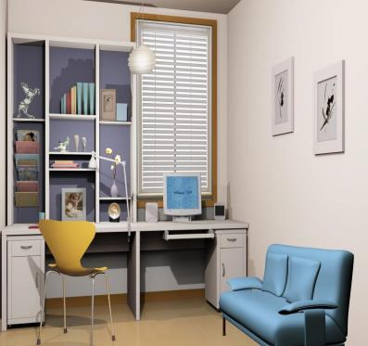
词汇连连看
Look at the study.
What's in the study?
study
[ˈstʌdi]
书房
介词短语：in the study
在书房里

Slide 4
词汇连连看
computer
[kəmˈpjuːtə]
电脑
I want to buya new computer.
我想买一台新电脑
短语:play computer games
玩电脑游戏

Slide 5
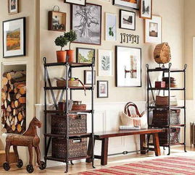
词汇连连看
picture
[ ˈpiktʃə ]
照片
There are fifteen pictures on the wall. 有15张图片在墙上
短语：take a picture
take pictures 照相

Slide 6
句型对对碰
Welcome to my home!
Thank you.

Slide 7
句型对对碰
What's in the study ?
什么
在ˑˑˑˑˑˑ里面
ˑ
书房里有什么？
There is a new computer in the study .有一台新的电脑在书房里。

Slide 8
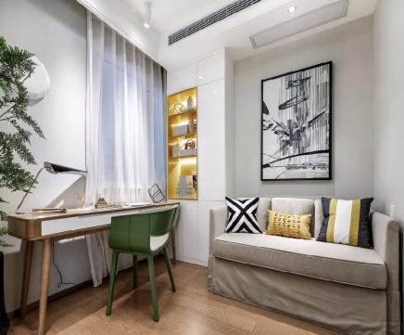
句型对对碰
What's in the study ?
书房里有什么？
There is a new picture in the study.
有一张新的图片在书房里。

Slide 9
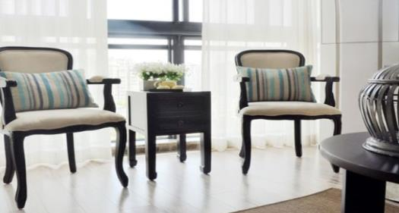
句型对对碰
What's in the living room ?
起居室里有什么？
There are two chairs in the living room.
有两把椅子在起居室里。

Slide 10
句型对对碰
There be 句型
There be 句型主要表达“某处有某人（某物）。其中be 动词有时态和单复数的变化。
单数用is. 不可数名词也要用is。
复数用are.

Slide 11
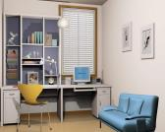
日积月累
 | 单词 | 例句
study
What's in the study?
computer
I want to buy a new computer .
There are fifteen pictures on the wall.
picture

Slide 12
日积月累
重 点 句 型
问句： What's in the study?
句型结构： What's+介词+某处？
答语： There is ...
There are...
句型结构：
There is/are (a/an/some/基数词）+物品 +地点）

Slide 13
开动脑筋
1、你想问书房里有什么，应该说_______
A. What’s in the study? B. Who’s in the study?
2、当朋友来到你家，你应热情地说_______
A. This is my home. B. Welcome to my home.
3、There is a______ in the study.
A. bowls B. TV C. computer
A
B
C

Slide 14
开动脑筋
4、There ____ four new chairs.
A. am B. are C. is
5、______ in the living room?
A. What B. What’s C. What are
B
B

Slide 15
Thanks for watching

