Slide 1
七年级上册
Unit 6 Let’s Go!
Let’s Go to the Movie Theatre!
WWW.PPT818.COM

Slide 2
学习目标
1.) Grasp main words: movie,theatre,price,hero,save,airport,magic,fight
2. ) Understand important sentences.

Slide 3
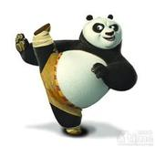
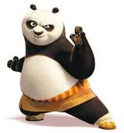
新课导入
Do you like watching movies?
Men in Black
黑衣人
Transformers
变形金刚

Slide 4
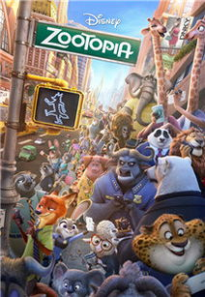
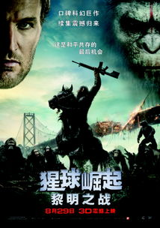
新课导入

Slide 5
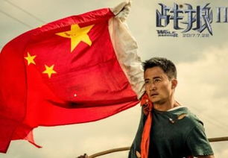
新课导入

Slide 6
自主反馈
(一) 单词(Word）：
1.电影院n_____________
2.价格;价值n__________
3.英雄n__________
4.飞机场n_________
theatre
price
hero
airport

Slide 7
自主反馈
（二）短语 ： 阅读课文找出下列短语
1.这部电影是关于.....____________________________
2.它住在.....___________________
3.它去…_________
4.搭乘火车________________________
5.功夫恐龙与坏人战斗_______________________________
6.看电影_________________________
This movie is about ........
He lives in....
He gets to …
Take the train
Kung Fu Dinosaur fights the bad man
Watch the movie

Slide 8
自主反馈
试着把以下句子译成汉语并想一想这些句型的用法。
1.His name is Kung Fu Dinosaur.
____________________
2. A bad man wants to hurt Panpan the Panda!
_______________
3.He takes a taxi to Wangfujing Street.
____________________
4.But can he save Panpan?
___________________
它的名字叫功夫恐龙。
一个坏人想伤害盼盼熊猫！
它坐的士去了王府井街。
但是它能够就出盼盼吗？

Slide 9
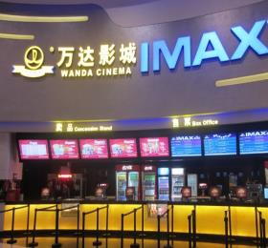
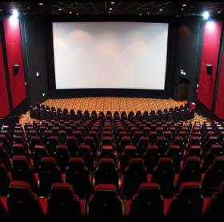
新课学习
Talking:
Do you like going to the movie theatre?

Slide 10
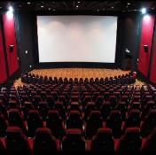
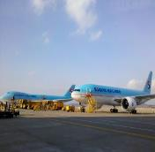
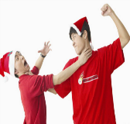
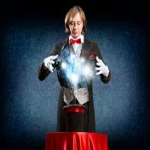
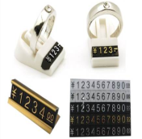
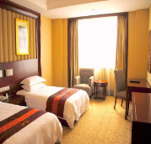
新课学习
PPT模板：www.1ppt.com/moban/ PPT素材：www.1ppt.com/sucai/
PPT背景：www.1ppt.com/beijing/ PPT图表：www.1ppt.com/tubiao/
PPT下载：www.1ppt.com/xiazai/ PPT教程： www.1ppt.com/powerpoint/
资料下载：www.1ppt.com/ziliao/ 范文下载：www.1ppt.com/fanwen/
试卷下载：www.1ppt.com/shiti/ 教案下载：www.1ppt.com/jiaoan/
PPT论坛：www.1ppt.cn PPT课件：www.1ppt.com/kejian/
语文课件：www.1ppt.com/kejian/yuwen/ 数学课件：www.1ppt.com/kejian/shuxue/
英语课件：www.1ppt.com/kejian/yingyu/ 美术课件：www.1ppt.com/kejian/meishu/
科学课件：www.1ppt.com/kejian/kexue/ 物理课件：www.1ppt.com/kejian/wuli/
化学课件：www.1ppt.com/kejian/huaxue/ 生物课件：www.1ppt.com/kejian/shengwu/
地理课件：www.1ppt.com/kejian/dili/ 历史课件：www.1ppt.com/kejian/lishi/
theatre
airport
fight
magic
price
hotel

Slide 11
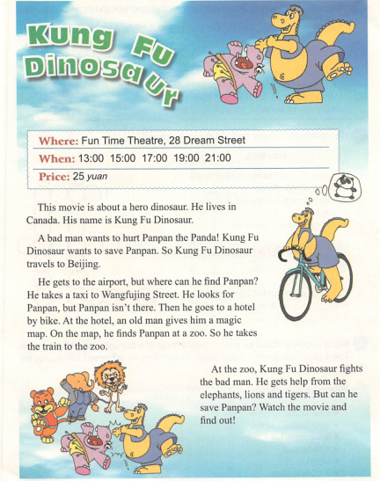
新课学习
Listen and read

Slide 12
知识探究
知识探究（一）
1. price 名词 意为价格。常用the price of …… 表示……的价值或价格。表示价格高低应用________, 而不用________ .
Price 做主语时谓语动词用_______
举例： .
对price 提问要用 而不用 .
举例：What's the price of your watch？

Slide 13
知识探究
知识探究 (二). 辨析get , arrive 和reach
(1) get在表示"到达"时是不及物动词，应与to搭配使用。
We often get to school on foot.
我们经常步行到学校。
They got to the top of the hill at noon.
他们于中午到达了山顶。

Slide 14
知识探究
(2) arrive后不能直接接地点，是一个不及物动词。若表示到达一个相对大的地点，用arrive in ; 若表示相对小的地点，用arrive at .
The delegation will arrive in China at 5:00 p.m.代表团将于下午5:00到达北京。
It was dark when they arrived at the railway station.当他们到达火车站的时候，天已经黑了。
When did she arrive here last time? 她上次是什么时候到这儿的？（副词前省略介词）

Slide 15
知识探究
(3) reach能直接接所到达的地点，是一个及物动词。例如：They reached London on Friday. 他们星期五到达了伦敦。
The news only reached me yesterday.
我于昨天才接到这个消息。
reach还有"伸手去取，伸手触及，联络"等意思。
Can you reach that apple on the tree? 你能够到树上的哪个苹果吗？

Slide 16
分组活动
.
Let’s do it
How does KungFu Dinosaur Travel?Listen to the passage and circle the correct pictures.

Slide 17
分组活动
Read the lesson and put the sentences in the correct order.
1.He gets to the airport.
2.Kung Fu Dinosaur wants to save Panpan.
3. A bad man wants to hurt Panpan.
4. Kung Fu Dinosaur travels to Beijing.
5. He takes a taxi to Wangfujing Street.
6. Then he goes to a hotel by bike.
7. At the zoo, Kung Fu Dinosaur fights the bad man.
8. He takes the train to the zoo.
3.2.4.1.5.6.8.7.
The correct order is: ________________

Slide 18
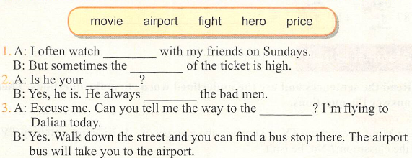
分组活动
Fill in the blanks with the correct forms of the word in the boxs.
1. movies
price
2. hero
fights
3. airport

Slide 19
随堂检测
单项选择
1. Tom, my car is broken. You need to _______ a bus to school.
A. bring B. take C. give D. get
2. My tape recorder is lost. I must _______ it.
A. found B. find C. close D. ask
3. I don’t have breakfast, _______ I feel hungry(感觉饥饿).
A. so B. because C. but
4. How do you go to the zoo, _______ bus or _______ foot?
A. by; by B. on; in C. on; to D. by; on
5. I like the shoes, _______ I have no money for them.
A. and B. but C. or D. so
B
B
A
D
B

Slide 20
作业布置
1.Finish your poster and write a short passage about your favourite movie.
2. Retell the article by your own words.
3.下载Lesson 37导学案，根据导学案完成预习任务。

Slide 21
Have a good time!

