Slide 1
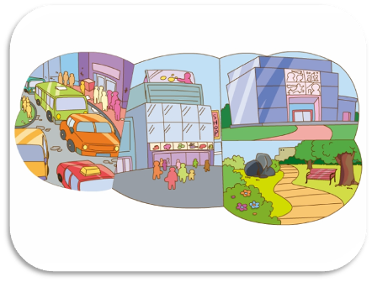
Unit 4 I like the city very much
WWW.PPT818.COM

Slide 2
让学生复习句型：Where are you from?
Children. I want to know where are you from?
A：Where are you from?
B: I’m from……..
A:Do you like your city?
B:……..
A:Why?
B:Because ………
For example：Dalian, Sichuan, Hunan, Guangzhou
noisy,comfortable,heavy,slow,quiet

Slide 3
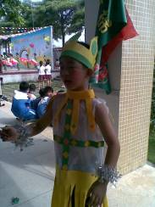
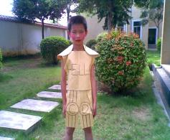
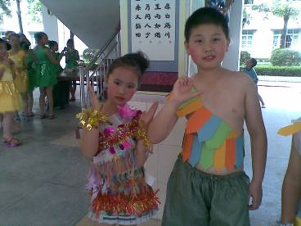
We are all live in the city!
What’s our city life like?
Guangzhou is a big and modern city. But it’s noisy.
Jieyang is a small city. It’s quiet and clean.
Sichuan is a good city. The people are nice.
回顾何芷晴、李盛权、谢耀帅三位同学的城市生活，并且与他们交流。
Sichuan
Jieyang
Guangzhou
He Zhiqing
Li Shengquan
Xie Yaoshuai

Slide 4
Do you like city life?
Why?
Yes,I do.
Do you like city life?
Why?
Xie Yaoshuai
Li Shengquan
Because the people are nice, and Guangzhou is a big and modern city.

Slide 5
A:Do you like city life?
B:Yes,I do.（必须是喜欢）
A:Why?
B:Because……..
1.介绍，My 拍档 is …..
2.开始提问。
Xie Yaoshuai

Slide 6
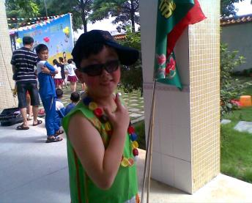
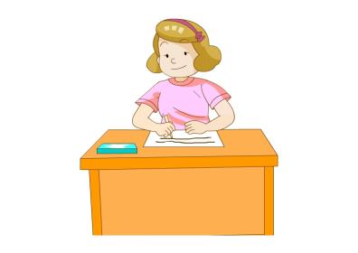
Country kid and city kid
Let’s go, visit the city.
OK.
Do you like this building?
country kid
city kid
Wow! I like it! It’s tall and new!

Slide 7
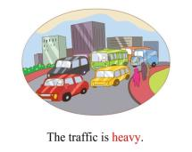
Country kid and city kid
I don’t like the traffic. It’s heavy.
country kid
city kid
But I think it is OK.I like the city.
It’s big and modern. There are many supermarkets and parks. I can play all day.

Slide 8
Country kid and city kid
Goodbye! Next time
meet in Guangzhou.
city kid
OK! Next time meet!
country kid

Slide 9
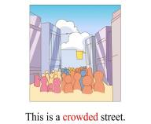
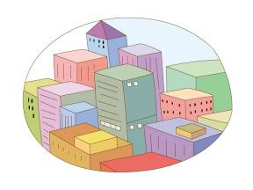
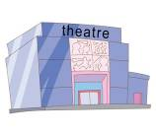
Let’s talk
What can you see in the city?
quiet park
crowded streets
large supermaket
heavy and slow traffic
modern theatres
意思：剧院 注意：cinema是电影院只能播放电影，剧院还可以演出话剧！

Slide 10
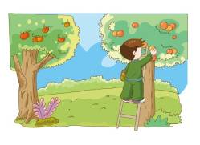
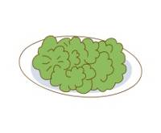
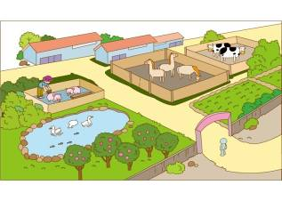
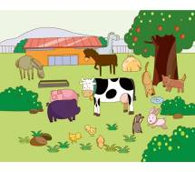
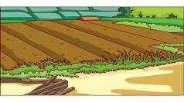
Let’s talk
fruits
What can you see in the countryside?
vegetables
animals
field

Slide 11
Let’s talk
What can you do in the city?
What can you do in the countryside?
几个人讨论，讨论能做什么。
并记录在书本第21页空白处。

Slide 12
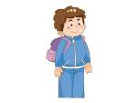
in the city
in the countryside
grow vegetables
go shopping
feed the animals
go to the KTVs
plant trees
….
play in the park
visit the museum
There is much more to do in the city than in the countryside.
go to the KFCs
visit the flower show
…….

Slide 13
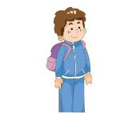
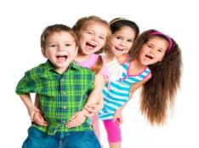
These people are enjoy city life.

Slide 14
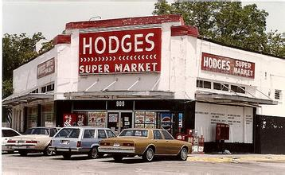
I like the city life.
There are many supermarkets here.
I can go shopping day and night.
all day
Ms White

Slide 15
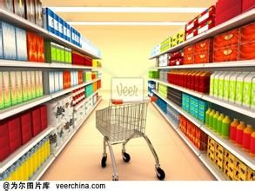
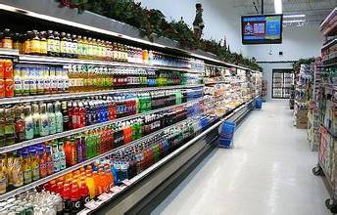
sell
buy
The supermarkets sell lots of different things.
I can buy many different things.
sell 新单词，意思是出售。 反义词是buy。
Ms White

Slide 16
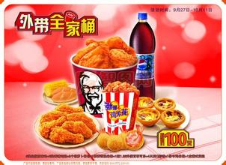
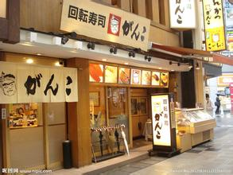
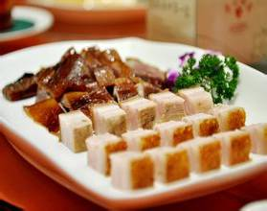
I like the city life.
There are many restaurants here.
I can eat many delicious food.
Janet

Slide 17
Guangzhou museum
广东省博物馆
I like the city life.
There are many museums here.
I can visit the museum.
Peter

Slide 18
many places here in the city
We like the city life.
There are many places here.
We can play all day.

Slide 19
But sometimes………

Slide 20
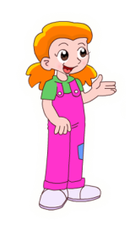
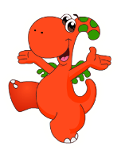
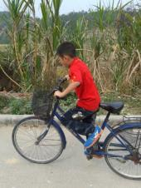
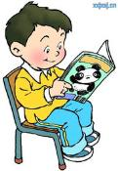
These people don’t like the city life.

Slide 21
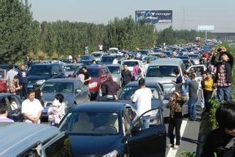
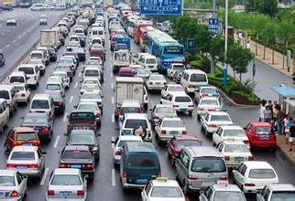
afraid害怕
be afraid to 害怕
I don’t like the city life.
There are too many cars.
I am ______ to go outside.
afraid
Ann

Slide 22
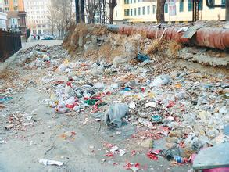
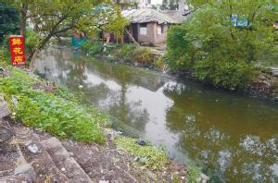
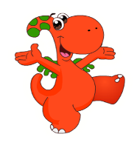
dirty脏的 形近单词：thirty
not health for me对我不健康
I don’t like the city life.
The streets are very ______.
It’s not ______ for me.
dirty
health
Tom

Slide 23
can’t go to sleep at night
晚上不能睡觉
I don’t like the city life.
There are too many cars.
It’s too_______.
I ____________________.
Peter
noisy
can’t go to sleep at night

Slide 24
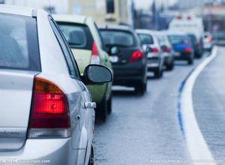
too heavy 太拥挤
Sam
I don’t like the city life.
The traffic is _________.
The streets are _______.
too heavy
crowded

Slide 25
Do you like the city life now?
We all like the city life.
I don’t like.

Slide 26
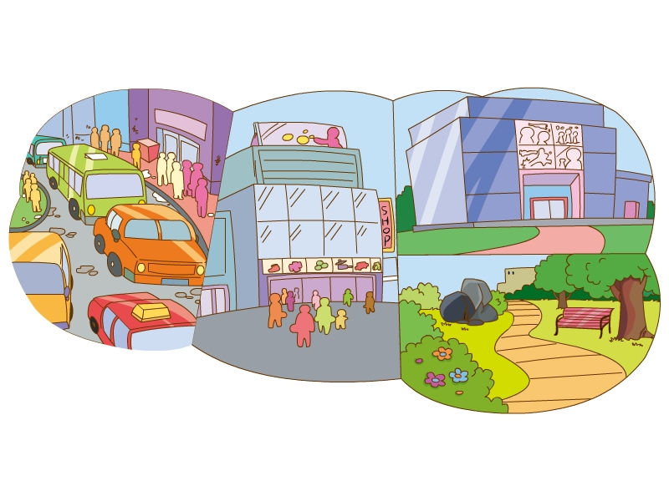
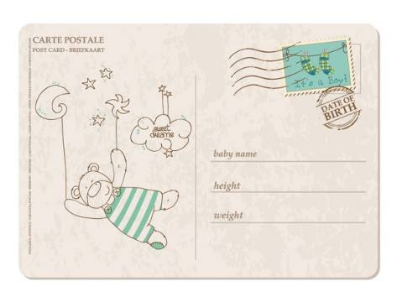
postcard

Slide 27
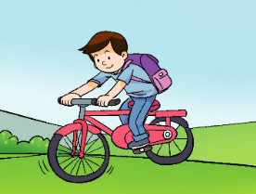
Hi, I’m Liwei. I’m going to the city this holiday. I like the city very much! But I really miss my friends.

Slide 28
Task1 Listen and answer true(T) or false(F).
T
Liwei goes to the city this holiday. ( )
Liwei likes some things in the city.( )
There are many cars in the city.( )
Liwei doesn't miss the country life.( )
This postcard is for Lucy.( )
This postcard isn’t for Lily. ( )
T
T
F
Lily
F
F

Slide 29
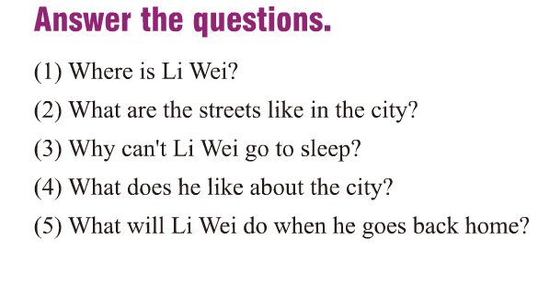
Task2 Read and answer the questions.
(1)问题意思：李伟在哪里？
He is in the city. 答案意思：他在城市里。
(2)问题意思：在城市里，街道是什么样子的？
The streets are crowded and dirty.
答案意思：在城市里，街道都很拥挤，并且很脏。

Slide 30
Task2 Read and answer the questions.
(3)问题意思：为什么李伟不能睡觉？
Because it’s very noisy.答案意思：因为外面很嘈杂。
Because there are too many cars.答案意思：因为外面有很多车。
(4)问题意思：他认为城市怎样？
There are many nice things in the city.答案意思：城市里有很多好的东西。

Slide 31
Task2 Read and answer the questions.
(5)问题意思：当李伟回家的时候将会做什么？
He will see all his friends when he goes back home.答案意思：当他回家的时候他会去看望他所有的朋友。

Slide 32
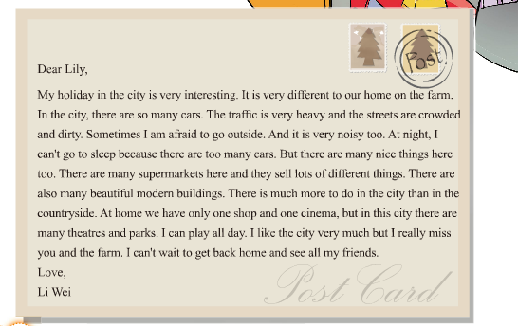
Task3 Let’s read.

Slide 33
Task4 Let’s recite.

Slide 34
Task5 Let’s discuss.
讨论：城市生活是不是好过农村生活？
假如：Yes,it is.
No,it isn’t.
你think so吗？
1.I think so. Because………..(Yes,No)
2.I don’t think so. Because ………..(Yes,No)

