Slide 1
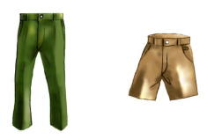
Unit2 Can I help you?
人教精通版五年级下册
WWW.PPT818.COM

Slide 2
>>Warm-up
Let’s sing

Slide 3
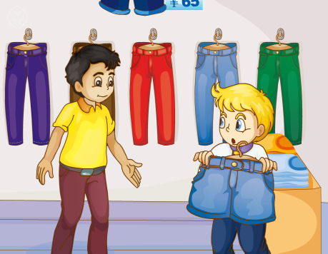
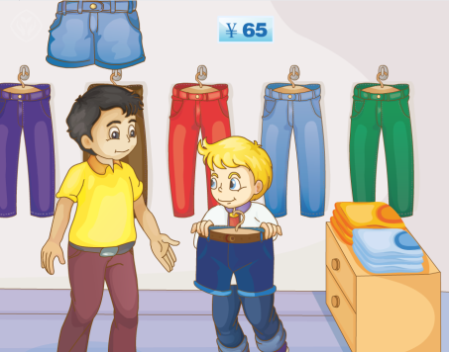
>>Review
Think and say
What does Peter want to buy?
How much are these short pants?

Slide 4
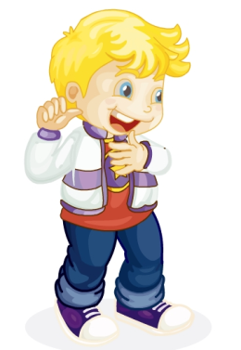
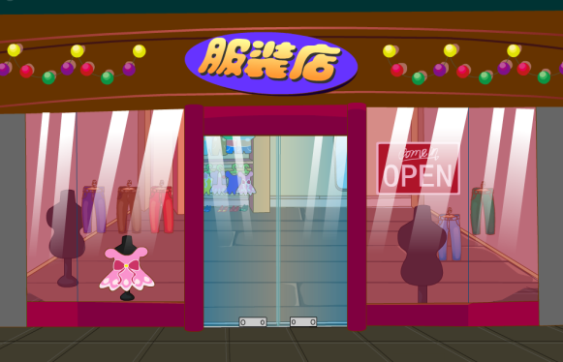
>>Lead-in
Look and think
Today is Peter’s birthday. He wants to buy some clothes for himself.

Slide 5
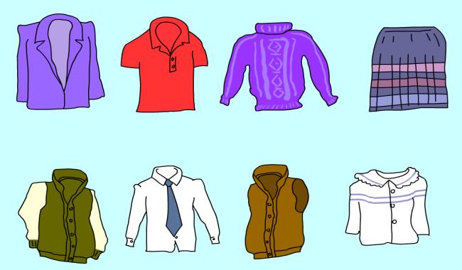
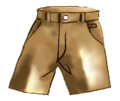
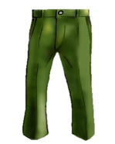
>>Presentation
Look and say
Look! There are so many clothes in the store.
Do you know them?

Slide 6
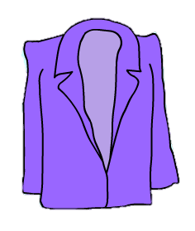
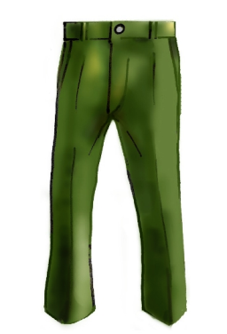
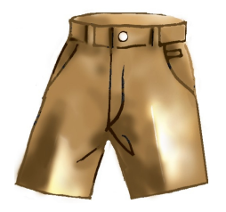
>>Presentation
Look and say
coat
trousers
short pants

Slide 7
>>Presentation
Look and say
Would you show me that coat?
Sure. Here you are.
￥99
How much is it?
They’re ninety-nine yuan.

Slide 8
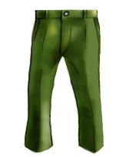
>>Presentation
Look and say
Would you show me …?
that pair of trousers?
Sure. Here you are.
￥75
How much are these?
They’re seventy-five yuan.

Slide 9
>>Presentation
Look and say
Would you show me …?
that pair of short
pants?
Sure. Here you are.
￥65
How much are these?
They’re sixty-five yuan.

Slide 10
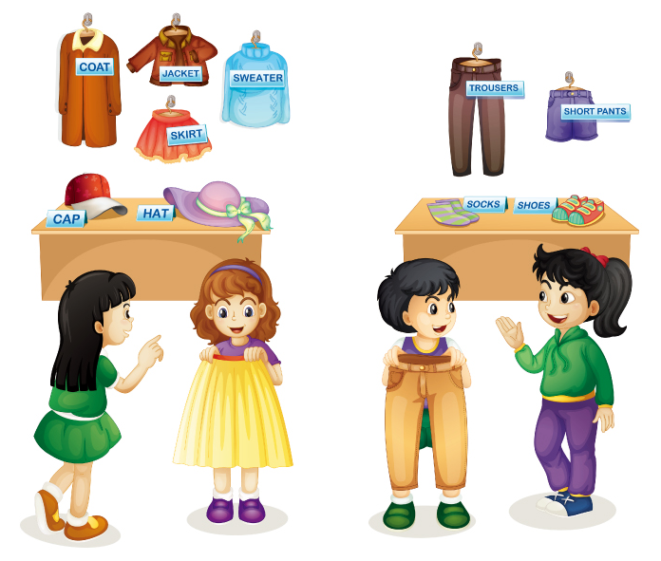
>>Practice
Let’s act
They are ninety-four yuan.
1
I want a skirt.
2
7
Here you are.
Can I try it on?
Sure.
3
4
Oh, it’s too big for me.
How much are these trousers?
5
6

Slide 11
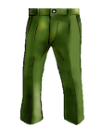
>>Practice
Game
大转盘
￥45
￥65
￥75
￥99
A: How much is/are …?
B: It’s/They’re …
￥58

Slide 12
>>Practice
Let’s chant

Slide 13
>>Summary
1.本课的重点单词：
trousers
short pants
2.本课的重点句型：
—How much are …?
—They’re …
—Would you show me …?
—Sure. Here you are.

Slide 14
>>Homework
1.观看课文动画，按照正确的语音、语调朗读课文对话。 2.在四线三格中正确抄写本课的新单词，不少于5遍。
3.预习 Lesson13。

