Slide 1
Starter Module1
My teacher and my friends
Unit 3 This is my friend.
WWW.PPT818.COM

Slide 2
学习目标
1.掌握以下重点句型：
This is my friend. Her name’s Betty. Nice to meet you.
It’s time to go now.
2. Students can understand others’ introduction by listening.
3. Students can introduce their friends and family members to others.

Slide 3
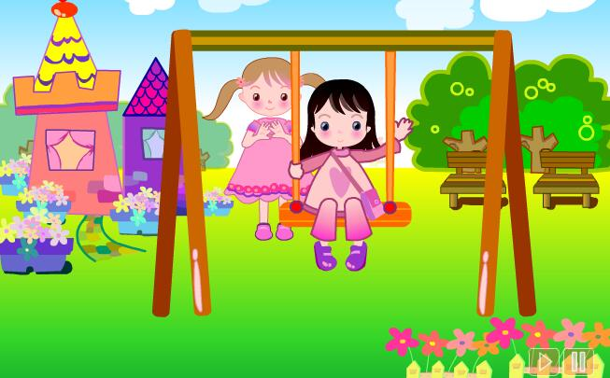
Warming-up

Slide 4
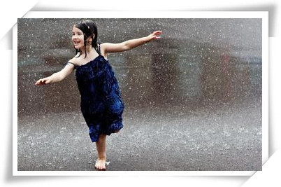
Enjoy a photo

Slide 5
Who are they?
my friends
my teacher

Slide 6
Presentation
How to introduce friends and family members to others?

Slide 7
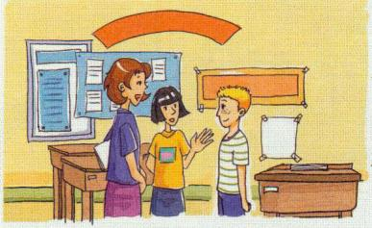
Listen and read
Lingling: This is Miss Zhou. She’s my teacher.
Hello, Miss Zhou.
Miss Zhou: Hello, Lingling.
Lingling: Miss Zhou, this is my friend,
Tony.
Miss Zhou: Hello, Tony.
Tony: Hello, Miss Zhou.

Slide 8
Lingling: This is my friend. Her name’s Betty.
Tony: Hello, Betty.
Lingling: This is my friend. His name’s Tony.
Betty: Hello, Tony. Nice to meet you.
Lingling: It’s time to go now. Goodbye, Tony.
Tony: Bye. See you tomorrow.

Slide 9
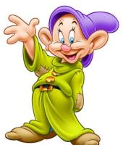
Language points
This is ...“这是……”，介绍某人的基本句型。
【注】this is不能缩写 。
Nice to meet you. “见到你很高兴。”是双方初次见面使用的问候语；答语为Nice to meet you, too.
It’s time to go now.“现在该走了。”It’s time to do sth.意为“该做某事了，到做某事的时间了”。
英语中表达“再见”含义的句子：
Goodbye./Bye./Bye-bye./See you(later/then/again).

Slide 10
Introduce people
This is…
She is…
He is…
Her name is…
His name is…

Slide 11
Fill in blanks
完全形式 | 缩略形式
I am
she is
he is
name is
 | what’s
I’m
she’s
he’s
name’s
what is

Slide 12
Pair work
Draw a family tree, and introduce your family. Use the sentences “This is …”.
Family tree

Slide 13
Match and listen.
1. This is my friend.
2. She is my friend.
3. Hello.
4. It’s time to go now.
a
a) His name’s Tony.
b) Goodbye.
c) Nice to meet you.
d) Her name’s Betty.
d
c
b

Slide 14
Listen and number.
a. Goodbye. See you tomorrow.
b. Hello, Daming. This is my friend, Amy.
c. It’s time to go now. Goodbye.
d. Hello, Amy, nice to meet you.
e. Hello, Daming, nice to meet you too.
5
1
4
2
3

Slide 15
Write and listen.
1. This is my friend. name’s Tony.
2. This is my .Her Betty.
3. Nice to you.
4. It’s time to go now.
5. Goodbye. see you
His
friend
name’s
meet
Goodbye.
Tomorrow.

Slide 16
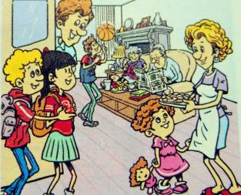
Group work
If you bring your friend to your home, How do you introduce your friend to your family members? Work in groups of 3 and make the conversation.
A: Hello, ... This is my friend. Her name is ...
B: Hello, ....
A: …, this is my ….
C: Hello, .... Nice to meet you.
B: Nice to meet you, too.
…

Slide 17
Summary
介绍别人的句型：
This is…
他的/她的名字叫做……的句型：
His/Her name is…(He/She is…)
Unit3
双方初次见面时的句型：
Nice to meet you.
该做某事的句型：
It’s time to do sth.

Slide 18
Exercise
单项选择。
（1）介绍别人认识时，使用的句型 _______.
A. It is “Tony”. B. He is “Tony”. C. This is “Tony”.
（2）_______ name is Ann Read. What’s _____ name?
A. I; you B. My; your C. My; you D. I; your
（3）—This is Victor, Wendy.
—____, Victor.
A. Goodbye B. Thank you
C. Good D. Nice to meet you

Slide 19
连词成句。
1. fine, am, I, thanks(.)
___________________________________________
2. are, you, how(?)
___________________________________________
3. this, my, is, friend (.)
___________________________________________
4. it, time, is, now, go,(.)
___________________________________________
I am fine, thanks.
How are you?
This is my friend.
It’s time to go now.

Slide 20
Homework
Introduce your friends to your parents.
Write down your own dialogue.

