Slide 1
Unit 7 Shopping
Reading
WWW.PPT818.COM

Slide 2
Period 2 Reading
课前自主预习
单 词 闯 关 | 1. 值(多少钱)，需付费 /kɒst/________ 2. 便宜的 /tʃiːp/________ 3. 最近的；上一个的 /lɑːst/________ 4. 足够(的)，充分(的) /ɪ 'nʌf/________ 5．与……相配，般配 /mætʃ/ ________ 6．漂亮的，俊俏的 / 'prɪtɪ/________
cost
cheap
last
enough
match
pretty

Slide 3
Period 2 Reading
短 语 互 译 | 1. just a minute ____________ 2．be different from ____________ 3. go well with____________ 4. wait for a short time____________
稍等片刻
与……不同
和……很相配
等一小会儿

Slide 4
Period 2 Reading
短 语 互 译 | 5. 不同种类的 ____________ 6．看一看________ 7．为我的朋友买一件礼物 _________________________________ 8．去年的卡片_____________
different kinds of
take a look
buy a gift/present for my friend/buy my friend a gift/present
last year's card

Slide 5
Period 2 Reading
句 型 在 线 | 1. ________ I help you？您需要什么？ 2．________ ________ ________ they? ＝ ________ ________ do they ________？ 它们多少钱？ 3．________ can I do ________ you? 我能为你做点什么吗？
Can
How much are
How much
cost
What
for

Slide 6
Period 2 Reading
句 型 在 线 | 4．…and they ________ her pink coat! ……而且它们与她的粉色外套相配！ 5．________ your ________． 这是找给你的零钱。 6．Amy has ________ ________ ________ the hair clips. 埃米有足够的钱买发夹。
match
Here's
change
enough money for

Slide 7
Period 2 Reading
课 文 初 探 | 根据课文内容，选择最佳答案。 ( )1. Amy wants to buy some________． A. football cards B. pictures C. stamps ( )2. Amy buys the hair clips for________． A. her mother B. her sister C. her friend
A
C

Slide 8
Period 2 Reading
课 文 初 探 | ( )3.The cards and the hair clips cost Amy ________ yuan in total. A．13 B．15 C．19
C

Slide 9
Period 2 Reading
课堂互动探究
词汇点睛
1 cost vt. 值(多少钱)，需付费
[观察] How much do they cost？它们多少钱？
What's the cost of this house？这套房子的费用是多少？
[探究] cost 既可以作动词，也可以作名词；作动词时，主语必须是物。

Slide 10
Period 2 Reading
[辨析] spend, pay, cost 与 take
词条 | 主语 | 常用结构
spend | 人 | sb spend(s) time/money on sth 某人在某事(物)上花费时间/金钱 sb spend(s) time/money (in) doing sth某人花费时间/金钱做某事
pay | 人 | sb pay(s) some money for sth某人为某物付一些钱 sb pay(s) for sth 某人为某物付钱

Slide 11
Period 2 Reading
词条 | 主语 | 常用结构
cost | 物 | ________ cost(s) (sb) some money 某物花费(某人)一些钱
take | it | It takes sb some time ________ sth.某人花费一些时间做某事。
sth
to do

Slide 12
Period 2 Reading
活学活用
1．(1)2017·凉山—Wow, your sweater is very beautiful!
—Thank you. I bought it two days ago. It ________ me $50.
A．took B．cost
C．paid D．spent
B
【解析】考查动词辨析。句意：“哇，你的毛衣真漂亮！”“谢谢你。我两天前买的。它花了我50美元。”表示“某物花费某人多少钱”用动词cost。故选B。

Slide 13
Period 2 Reading
(2)—It will________ us only about 50 minutes to travel to Mount Wuyi by high­speed railway.
—Wow, how exciting! I can't wait.
A. take B. spend
C. cost D. pay
A
【解析】考查动词辨析。句意：“我们乘高铁去武夷山旅行将仅仅花费大约50分钟。”“哇，多么令人激动啊！我等不及了。”“It takes sb some time to do sth”意为“做某事花费某人多长时间”。故答案为A。

Slide 14
Period 2 Reading
2 match vt.&vi. 与……相配，般配
[观察] They match her pink coat.它们与她的粉色外套相配。
The shoes are really nice to match your new dress.
这双鞋配你的新裙子真好看。

Slide 15
Period 2 Reading
[探究] match作________，意为“与……相配，般配”，后面宾语通常为________，同义短语为go well with。match…with…意为“把……与……相匹配”。
动词
物
[拓展] match还可以作名词，意为“比赛；火柴”，为可数名词，复数形式为________。
matches

Slide 16
Period 2 Reading
活学活用
2．The shirt is nice. But it doesn't ________your trousers.
A．come B．match
C．go D．love
B

Slide 17
Period 2 Reading
3 enough det.&pron. 足够(的)，充分(的)
[观察] That's enough.那足够了。
Do you have enough time to finish the work?
你有足够的时间来完成这项工作吗？
He is old enough to go to school.他到上学的年龄了。

Slide 18
Period 2 Reading
[探究] enough可作代词、形容词和副词。它修饰名词时，常位于名词________(也可位于名词后面)；修饰形容词或副词时，位于形容词或副词________。“形容词/副词＋enough＋to do sth”意为“足够……能做某事”。
前面
后面

Slide 19
Period 2 Reading
活学活用
3. —What do you think of the film So Young?
—________， but someone thinks it isn't________．
A. Good enough; interested B. Enough good; interesting
C. Good enough; interesting D. Enough good; interested
C
【解析】 enough修饰形容词或副词时，放在所修饰词的后面；interesting作形容词，意为“有趣的”，修饰物或事。句意：“你认为电影《致我们终将逝去的青春》怎么样？”“足够好，但是有人认为它无趣。”故答案为C。

Slide 20
Period 2 Reading
句型透视
1 Can I help you？您需要什么？
[探究]此句为日常生活中向别人提供帮助的交际用语，常用于商店、饭店、宾馆等服务行业中，是服务人员对顾客的礼貌用语。

Slide 21
Period 2 Reading
[拓展]类似用法的句型：
May/Could I help you? 我可以帮你吗？/您需要什么帮助吗？
What can I do for you? 我能为你做点什么吗？

Slide 22
Period 2 Reading
活学活用
1．2017·云南—________？
—I want to buy a pair of sports shoes.
A．What's wrong B．What can I do for you
C．How much is it D．What does it look like
B
【解析】考查情景交际。根据答语“我想买一双运动鞋”可知问句是提供服务的用语，可用“Can I help you？”或者“What can I do for you？”之类的问句。故选B。

Slide 23
Period 2 Reading
2 How much do they cost? 它们多少钱？
[探究]该句型通常用来询问物品的价钱，其同义句为“How much is it/are they？”或“What's the price of…？”
How much does the car cost？＝How much is the car？＝ What's the price of the car?
这辆轿车多少钱？
How much do the apples cost？＝How much are the apples？＝What's the price of the apples? 这些苹果多少钱？

Slide 24
Period 2 Reading
[拓展] how much也可以用来询问不可数名词的数量。
How much money do you have? 你有多少钱？

Slide 25
Period 2 Reading
活学活用
2. 2016·北京—________ are these bananas?
—$3.99.
A. How much B. How long C. How heavy D. How big
A
【解析】考查疑问短语。句意：“这些香蕉________？”“3.99美元。”how much 提问价钱或不可数名词的数量；how long 提问时间或长度；how heavy提问重量；how big 提问大小。由答语“3.99 美元”可知是提问价钱。故答案为 A。

Slide 26
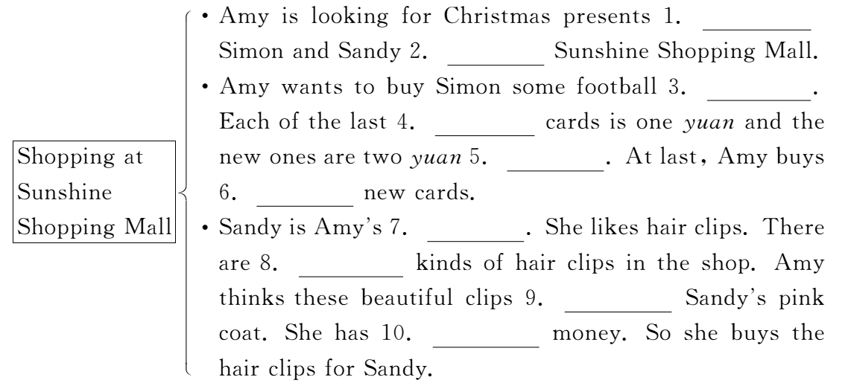
Period 2 Reading
课文回顾
for
at
cards
year's
each
five
friend
different
match
enough

