Slide 1
Units 6: Go with Transportation
Clean Cars?
WWW.PPT818.COM

Slide 2
Lead in
I can transport goods!

Slide 3
Go travelling!

Slide 4
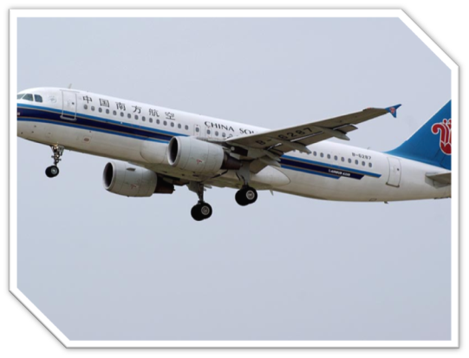
I can fly in the sky!

Slide 5
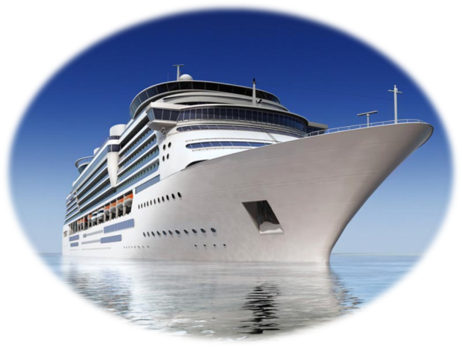
I can float in the sea!

Slide 6
Learning aims:
1. Mastery the new words : pedal, than, energy;
2. Learn to use the expressions:
ask sb. to do sth. (ask sb. not to do sth.)
think about.
3. Sound, voice and noise区别.
4. The main idea of this letter.
5. Learn to protect the environment .

Slide 7
New words
sound v. 听起来
n. 声音
pedal v. 踏…… 的踏板；骑自行车
n. 踏板 than conj. 比
energy n. 能量

Slide 8
Think about it!
Do you think it is important to have a good environment?
How is the environment now and what makes the environment bad?
How can we stop it?

Slide 9
Discuss it!
♠ What’s the transportation like in your city?
♠ What different kinds of fuel may be used in the future?

Slide 10
Read the letters and answer the questions
What did Jenny do this week?
What things did her teacher ask her to do?
What is Danny’s presentation?
What would Jenny like to invent?

Slide 11
language points
transport
transporter
transportation
ask sb. (not) to do
think about /of
present …to…
invent/inventor/invention

Slide 12
Let’s do it!

Slide 13
The teacher asked us ___________ (think) about the future.
A horse is much___________(heavy) than a cat.
Lucy goes to school _________________(骑自行车) every day.
He doesn’t know _________________(说什么).
We ______________(不得不) think of an invention, and present it to the class.
Today the meeting in the school hall____________ (进行的顺利).

Slide 14
Homework
1.Finish “LET’S DO IT” in Lesson 36.
2.Finish the activity book.

Slide 15
Thank you!

