Slide 1
人教精通版五年级下册
Unit 5 I’m cleaning my room.
WWW.PPT818.COM

Slide 2
>>Warm-up
Let’s chant

Slide 3
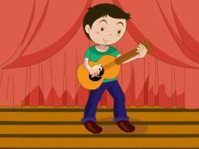
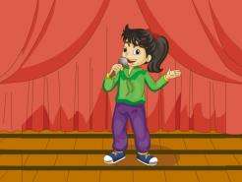
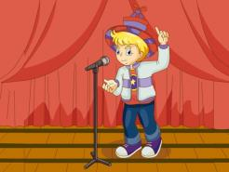
>>Lead-in
Let’s review
play the guitar
sing a song
play the violin
tell a story

Slide 4
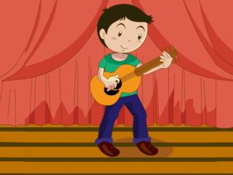
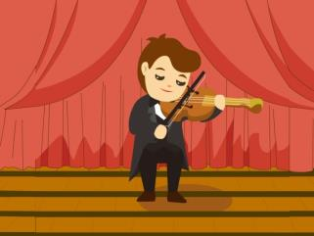
>>Lead-in
Let’s review
---What’s he doing?
---What’s he doing?
---He’s ________________.
playing the guitar
---He’s ________________.
playing the violin

Slide 5
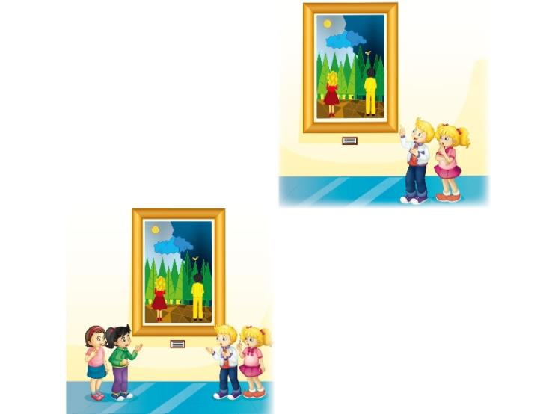
>>Lead-in
Discuss
1. What are they doing?
2. What’s the man in the
picture doing?

Slide 6
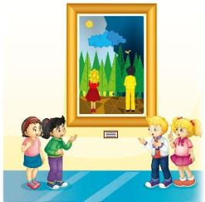
>>Presentation
Just talk
looking at the sun
Peter thinks the man is _________________.
looking at the moon
Kate thinks the man is ___________________.
just standing there
Li Yan thinks the man is ___________________.
singing over there
Cousin thinks the man is __________________.

Slide 7
>>Presentation
Just talk
Peter: Hi, Kate! What are you doing here?
Kate: I’m looking at the picture. Look at the
man in it. Is he looking at the moon?
Peter: No, he isn’t. He’s looking at the sun.
Kate: I don’t think so. He’s looking at the
moon. It’s not the sun.

Slide 8
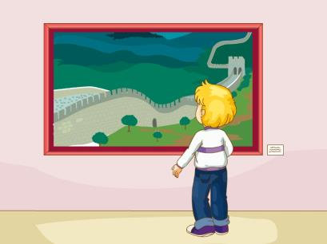
>>Presentation
look at the picture
He is looking at the picture.

Slide 9
>>Presentation
Just talk
Li Yan: Hi, Peter and Kate. This is my cousin.
Cousin: Hello! Glad to meet you.
Li Yan: What are you doing here?
Peter: We are talking about this picture.

Slide 10
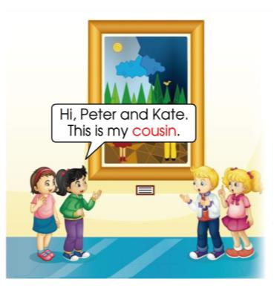
>>Presentation
cousin
This is my cousin.

Slide 11
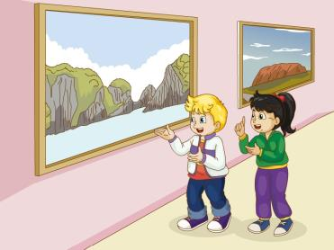
>>Presentation
talk about
They’re talking about this picture.

Slide 12
>>Presentation
Just talk
Kate: Li Yan, look at the man in the picture.
Is he looking at the moon?
Peter: Is he looking at the sun?
Li Yan: No, he isn’t. He is just standing there.
Cousin: No. He’s only singing over there.

Slide 13
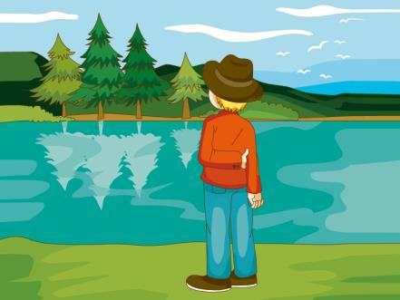
>>Presentation
stand
He’s standing there.

Slide 14
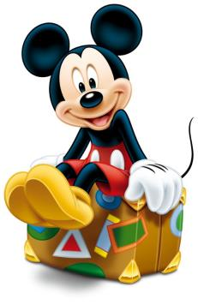
>>Practice
1. ---________________
---No, he’s sitting there.
What is he doing?
Is he sitting there?
Is he standing there?

Slide 15
>>Practice
2. ---Is he looking at the sun?
---________________
I’m looking at the picture.
This is my cousin.
No, he isn’t.

Slide 16
>>Practice
Group Work
分角色朗读

Slide 17
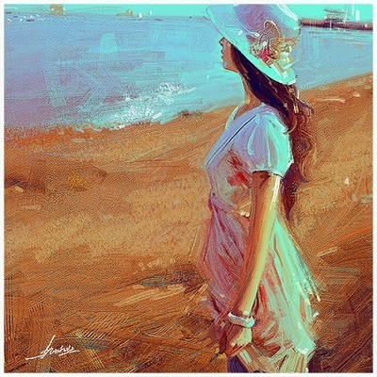
>>Practice
Pair Work
What’s she doing?
Is she…?
No. She’s…

Slide 18
>>Summary
重点词汇：
look at the picture
cousin
talk about
stand
如何表达“他正在看月亮吗”？
Is he looking at the moon?

Slide 19
>>Homework
1. 观看课文动画，按照正确的语音、语调朗读课文。
2. 熟练表演本课的对话。
3. 预习Lesson30。
close

