Slide 1
Unit 4
What’s the best movie theater?
WWW.PPT818.COM

Slide 2
Good, better, best,
Never let it rest.
Till “good” be “better”,
And “better” “best”.

Slide 3
GOOD , BETTER, BEST
Remember:
We should try to do everything the best ,not the worst.(尽力把所有事情做到最好.)

Slide 4
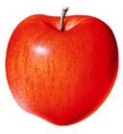
big
bigger
This apple is the biggest of all.

Slide 5
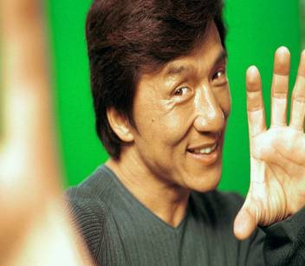
Guessing game
He’s the most popular actor, and he’s famous for doing Chinese kung fu.
the most popular actor
5

Slide 6
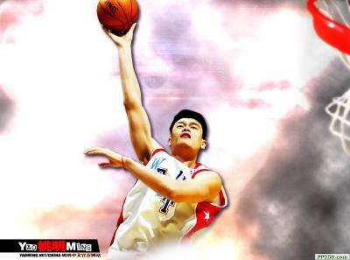
He is the tallest basketball
player in China .
the tallest basketball player
6

Slide 7
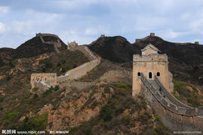
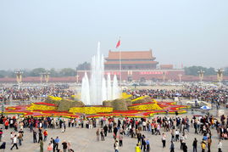
It is the longest wall in China.
It is the biggest square in China.

Slide 8
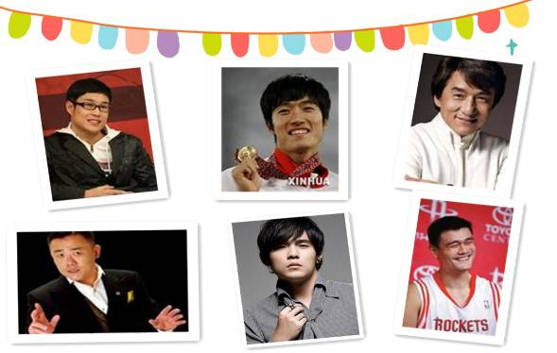
Discuss
Do you like to go to the movies?
Who do you want to go with?
Why?
guests
嘉宾

Slide 9
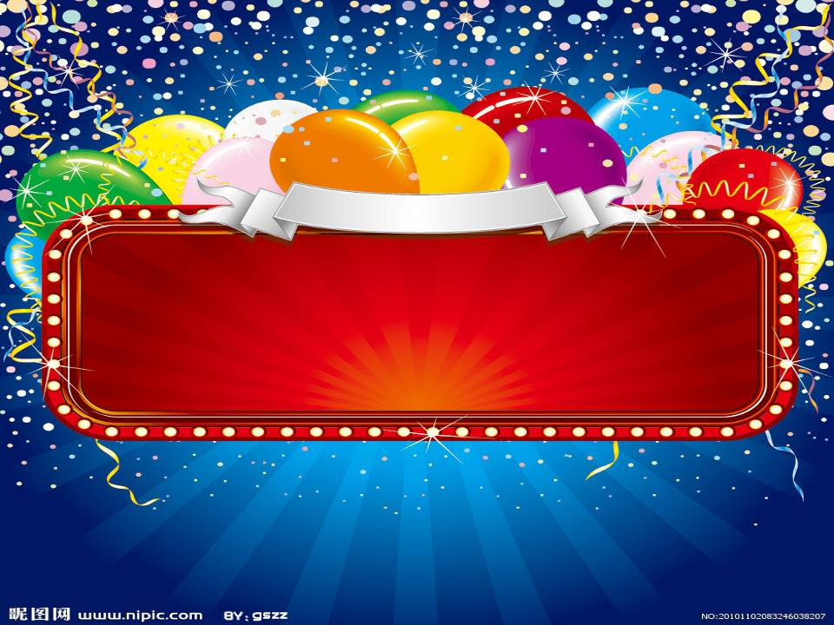
go to the movies

Slide 10
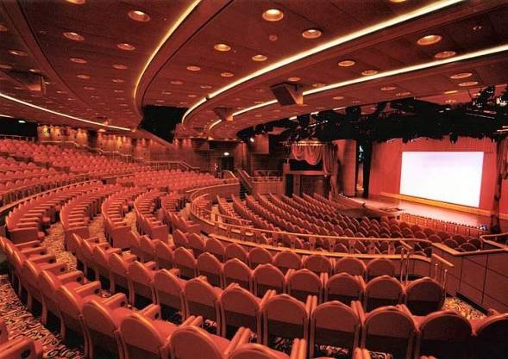
What’s the best movie theater to go to ?
/'θiət ə/
movie theater
=
cinema

Slide 11
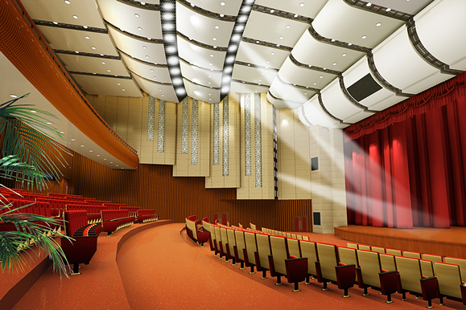
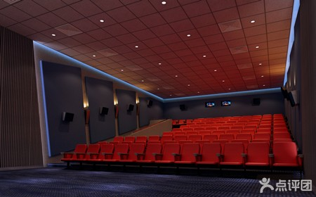
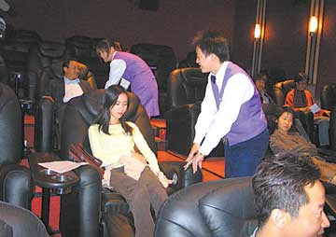
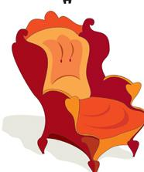
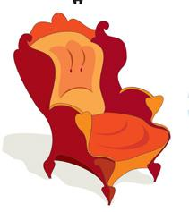
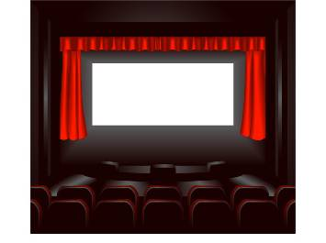
As for the theater, what is important to you?
It has - - - - - -
big screen
/'skri:n/
comfortable seats
/'kʌmfətəbl/ /si:t/
the best theater
best sound
friendly service
/'səvis/

Slide 12
1a
How do you choose which movie theater to go to? Write the things in the box under “Important” or “Not Important”.
comfortable seats big screens best sound cheap new movies close to home buy tickets quickly popular
Important | Not Important

Slide 13
be close to 接近于； 在 ... 的近旁
The population of the city is close to a million.
这个城市的人口接近一百万。
My home is close to the cinema, so I often go to see a film.
我家离电影院很近，所以我经常去看电影。

Slide 14
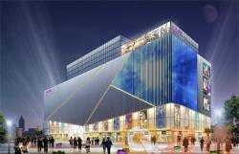
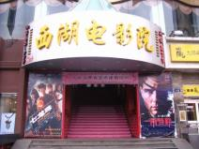
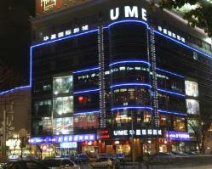
2km
0.5km
3km
home
UME Movie City is close to my home.
West Lake Cinema
is _______ to my home than UME Movie City.
closer
the closest
Hangzhou Theater is ___________to my home.

Slide 15
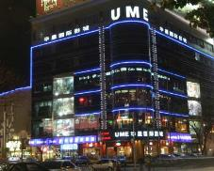
The tickets to Hangzhou Theater are _________.
cheap
￥60
The tickets to UME Movie City
are ________.
cheaper
￥50
The tickets to West Lake Cinema
are ___________.
the cheapest
￥30

Slide 16
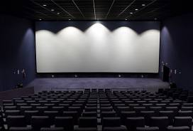
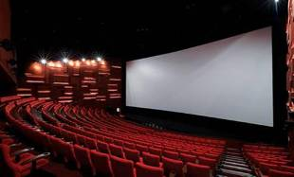
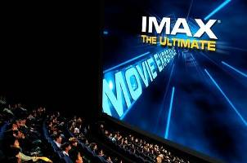
big
The first cinema
has a big screen.
The second cinema
has a bigger screen.
The third cinema
has the biggest screen.

Slide 17
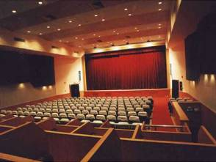
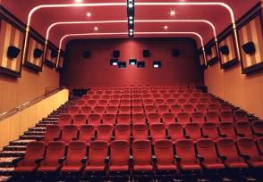
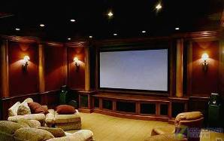
comfortable
The first cinema
has comfortable seats.
The second cinema
has ____________ seats.
more comfortable
The third cinema
has the most comfortable seats.

Slide 18
1b
Listen and answer the questions.
1. What is conversation 1 talking about?
A. Movie World B. Town Cinema C. Screen City
2.What is conversation 2 talking about?
A. Movie World B. Town Cinema C. Screen City
3.What is conversation 3 talking about?
A. Movie World B. Town Cinema C. Screen City

Slide 19
Listen and match the statements with the movie theaters.
1b
Qualities | Movie theaters
It has the biggest screens.
It’s the most popular near here.
It’s the closest to home. | Town Cinema
It has the shortest waiting time.
It has the best sound.
It has the most comfortable seats.
You can buy tickets the most quickly.
Movie World
Screen City
Town Cinema
Screen City
Movie World

Slide 20
Listen to a reporter interviewing a boy. Circle the boy’s answers.
2a
Green City Survey
1. Which is the best clothes store?
a. Miller’s b. Blue Moon c. Dream Clothes
2. Which is the best radio station?
a. 970 AM b. 97.9 FM c. 107.9 FM

Slide 21
Listen again. Write the correct store or radio station next to each statement.
2b
Miller’s
Blue Moon
Dream Clothes
Clothes stores
_________ It’s the most expensive.
_________ It has the best clothes.
_________ It’s the worst store.
_________ You can buy clothes the most cheaply there.
Blue Moon
Miller’s
Dream Clothes
Miller’s

Slide 22
Listen again. Write the correct store or radio station next to each statement.
2b
Radio stations
_______ It has the worst music.
_______ They play the most boring songs.
_______ The DJs choose songs the most carefully.
_______ It’s the most popular.
970 AM
97.9 FM
107.9 FM
970 AM
97.9 FM
107.9 FM
97.9 FM

Slide 23
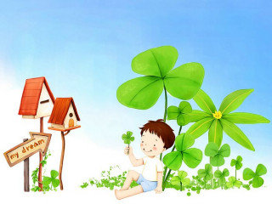
Student A, you are the reporter. Student B, you are the boy. Role-play a conversation.
2c

Slide 24
PAIRWORK
A: Hello! I’m a reporter. Can I ask you
some questions?
B: Sure.
A: What’s the best clothing store in town?
B: I think Miller’s is the best.
A: Why do you think so?
B: Well, Miller’s has …

Slide 25
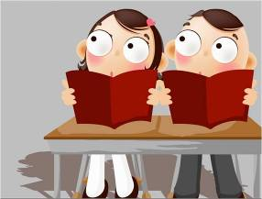
2d
Greg is new in town. Here is a dialog between Greg and Helen, one of his warm-hearted neighbors. Please read the dialog silently first and underline all superlative forms of adjectives and adverbs.

Slide 26
Greg: Hi, I’m new in town.
Helen: Hi, I’m Helen. Welcome to the neighborhood! How do you like it so far?
Greg: It’s fantastic, but I still don’t really know my way around.
Helen: Well, the best supermarket is on the Center Street. You can buy the freshest food there.
Greg: Oh, great. Is there a cinema around here? I love watching movies.
Helen: Yes, Sun Cinema is the newest one. You can sit the most comfortably because they have the biggest seats.
Greg: Thanks for telling me.
Helen: No problem.

Slide 27
Greg: Hi, I’m new in town.
Helen: Hi, I’m Helen. Welcome to the neighborhood! How do you like it so far?
Greg: It’s fantastic, but I still don’t really know my way around.
Helen: Well, the best supermarket is on the Center Street. You can buy the freshest food there.
Greg: Oh, great. Is there a cinema around here? I love watching movies.
Helen: Yes, Sun Cinema is the newest one. You can sit the most comfortably because they have the biggest seats.
Greg: Thanks for telling me.
Helen: No problem.

Slide 28
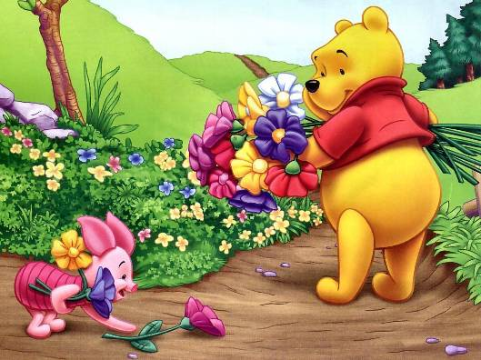
Listen and role-play the conversation.

Slide 29
Summary
cheap -cheaper - cheapest
close - closer - closest
comfortable - more ~ - the most ~
good - better - best
bad - worse - worst
big - bigger - biggest
short - shorter - shortest
popular - more popular - most popular

