Slide 1
Unit5 Is this your schoolbag?
五年级上册
WWW.PPT818.COM

Slide 2
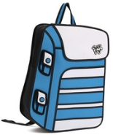
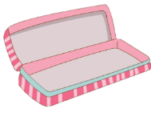
>>Review
Play a game
I say you do
Show me your pen.

Slide 3
>>Presentation
Look and say
schoolbag
This is my schoolbag.

Slide 4
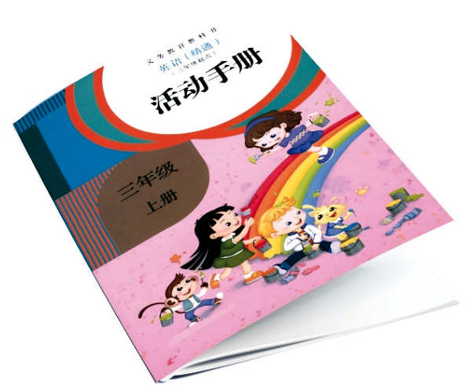
>>Presentation
Look and say
activity book
Is this your activity book?
Yes, it is.
No, it isn’t.

Slide 5
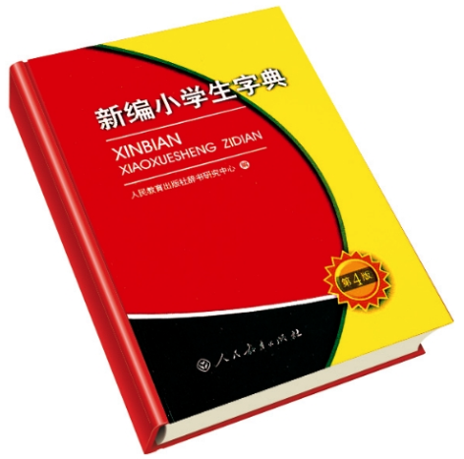
>>Presentation
Look and say
dictionary
Is this your dictionary?
Yes, it is.
No, it isn’t.

Slide 6
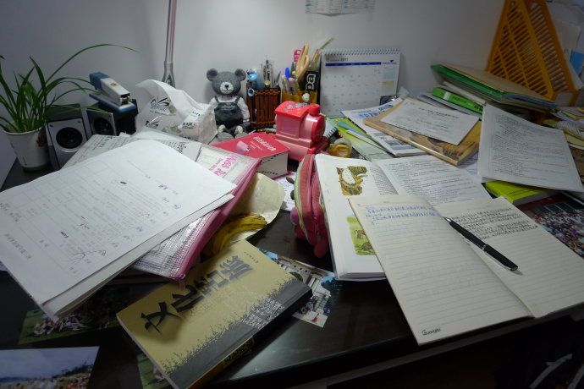
>>Presentation
Look and say
Don’t leave your things like this.

Slide 7
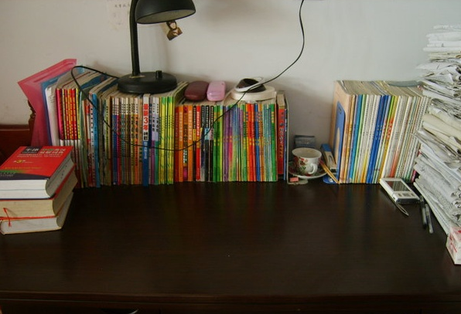
>>Presentation
Look and say
Put them away.

Slide 8
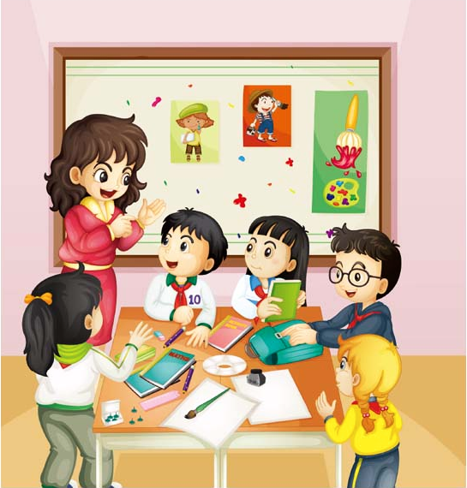
>>Presentation
Look and guess
Our friends Mike, Ann and Jim put their school things on the desk. Guess, what will the teacher say?

Slide 9
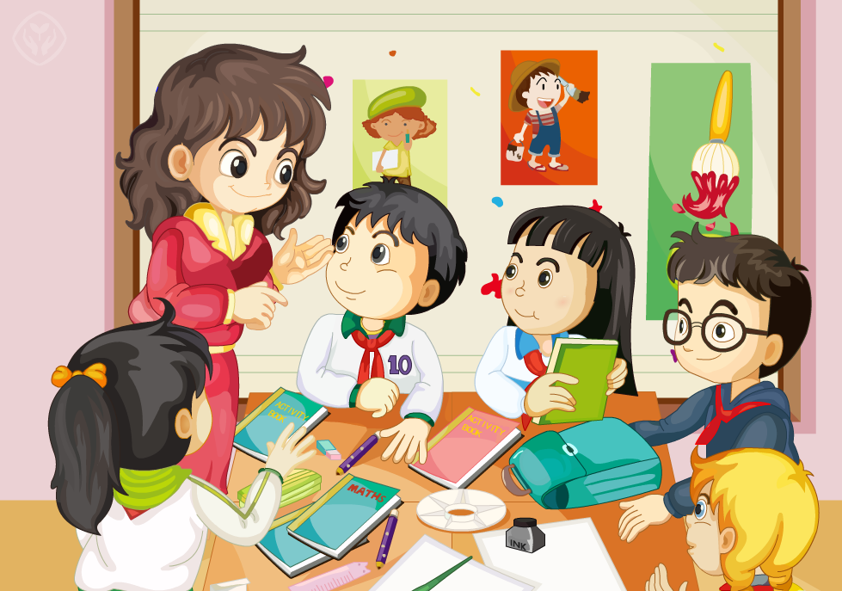
>>Presentation
Just talk
Let’s watch

Slide 10
>>Presentation
Just talk
Listen and imitate
Teacher: Hey, boys and girls! Don’t leave your
things like this. Put them away.
Students: OK!
Teacher: Mike! Is this your schoolbag?
Mike: Yes, it is.
Teacher: Is this your activity book, Ann?
Ann: No, it isn’t. That’s my activity book.

Slide 11
>>Presentation
Just talk
Listen and imitate
Teacher: Is this your ruler, Jim?
Jim: Yes, it is.
Teacher: Remember to put your things away
after class.
Students: OK, we will.

Slide 12
>>Practice
Read it by yourself for one minute .
自读对话一分钟。
一分钟倒计时
60
Learning tip :
10
10
50
自己读对话，比一比看谁能在一分钟内读完，并且读得准确、流利！
20
20
40
30
30

Slide 13
>>Practice
Show time
小组合作，练习对话并表演，其他同学评价。
Pronunciation (语音) |  | Fluency (流利) | Cooperation (合作)
OK!
Great!
Super!

Slide 14
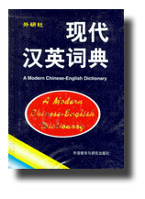
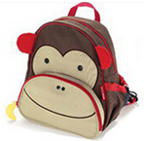
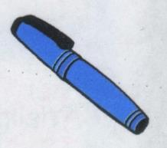
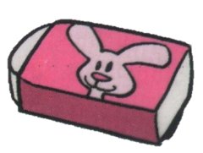
>>Practice
Ask and answer
A: Is this your dictionary?
B: Yes, it is. / No, it isn’t.

Slide 15
>>Practice
Game
寻找主人
学生四人一组，收集各不相同的文具，然后其中一名组员拿出其中一样文具，随意询问组内一名同学：Is this your …, XXX? 若学生回答：Yes, it is. 该学生用手势和语言(Yeah!)做开心状，简单描述该文具后把它归还给本人。若学生回答：No, it isn’t. That’s my ... 该学生用手势和语言(I’m sorry.)表示失望，把属于学生的文具归还给本人。

Slide 16
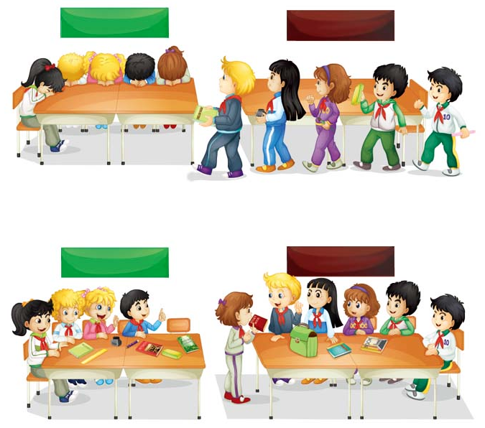
>>Practice
Let’s act
GREEN BIRD GROUP
BROWN BEAR GROUP
1
Whose storybook is this?
2
3
Is this your storybook?
No, it isn’t.
5
No, it isn’t.
4
Is this your storybook?
BROWN BEAR GROUP
GREEN BIRD GROUP

Slide 17
>>Summary
本课的重点单词：
activity book
schoolbag
dictionary

Slide 18
>>Summary
如何询问某物是否属于某人并做否定回答？
—Is this your …?
—No, it isn’t.

Slide 19
>>Homework
1.通过网络、字典、课外书、报纸等资源，进一步查找收集有关文具的词汇，并记录下来，与同学们一起分享交流。
2.预习 Lesson 27。

