Slide 1
Unit 1
Where did you go on vacation?
Section B (第3课时)
WWW.PPT818.COM

Slide 2

学习目标
Key words & phrases:
duck，dislike，take photos，Tian'anmen Square，
the Palace Museum，bring back，shopping center，
have a fun time，school trip，come up
Key sentences:
1. How did you feel about the trip?
2. It was so beautiful that we forgot about the last five
hours!
Write a travel diary about your past
events.

Slide 3
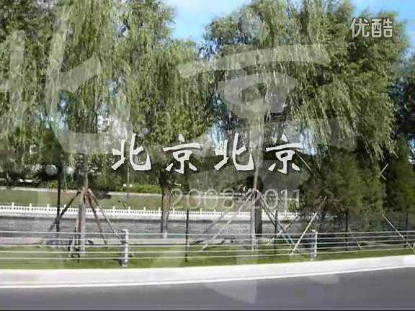
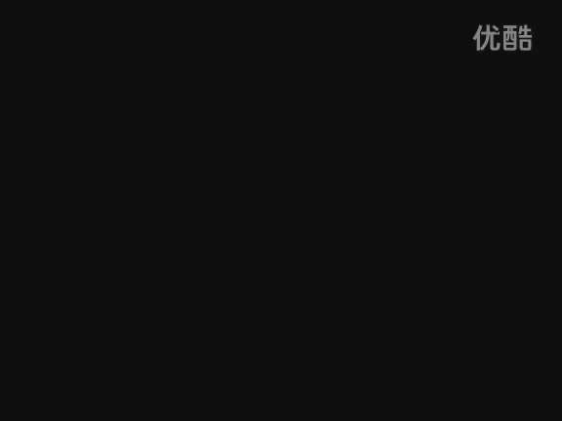
Enjoy the beautiful scenery——

Slide 4
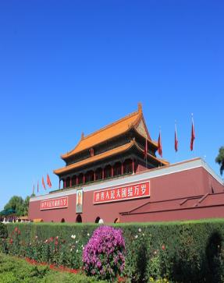
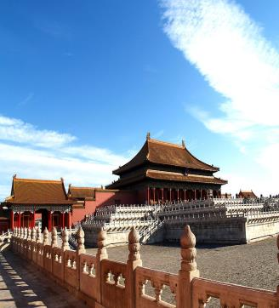
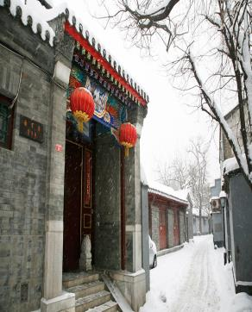
Where did you go on vacation?
Do you know these places?
a Beijing hutong
Tian’anmen
Square
the Palace Museum

Slide 5
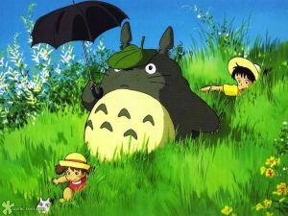
Did you go to the places before?
If you did, when did you go?
What do you think of the places?
If you didn’t, can you describe them out?

Slide 6
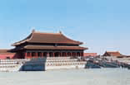
Complete the diary entry about a trip to one of these places.
Use the words and phrases in the box to help you.
3a
Tian’anmen Square
the Palace Museum
a Beijing hutong
hot and sunny tired happy
Beijing duck delicious
take some photos beautiful
buy something special interesting
learn something important August

Slide 7
August
Wednesday, _______20th
Today the weather was _______________.
I went to ____________________________
____________________________. It was ______________________. We ______________________________________.
I liked this place because ___________________________________.
For dinner we had ______________. It was _____________.
In the evening, I felt really ___________.
hot and sunny
Tian’anmen Square/the Palace Museum/ a Beijing hutong
interesting/beautiful
took some photos/bought something special
I learned something important
Beijing duck
delicious
tired

Slide 8
Answer the questions to make notes about a vacation you took.
3b
1. Where did you go?
2. Did you go with anyone?
3. How was the weather?
4. What did you do every day?
5. What food did you eat?
6. What did you like best?
7. Did you dislike anything?
8. How did you feel about the trip?

Slide 9


Write a travel diary like Jane’s on page 5. Use your notes in 3b.
3c
______________________________________
_________________________________________
_________________________________________
_________________________________________
_________________________________________
_________________________________________
_________________________________________

Slide 10
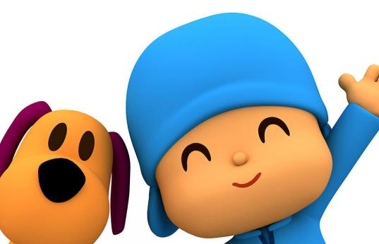
Imagine you are all foreigners on vacation in China. You meet each other at the airport on your way home. Talk about what you did on your vacation.
4

Slide 11
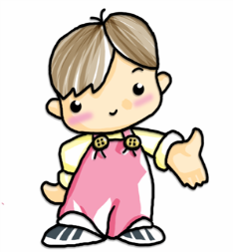
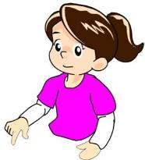
Hi, my name’s
Paul.
Hi, Paul. I’m Anna. Where did you go on vacation?
Oh, I went to Beijing. Did you do anything special in Nanjing?
I went to Nanjing.

Slide 12
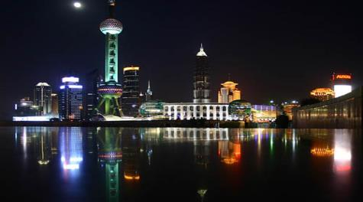
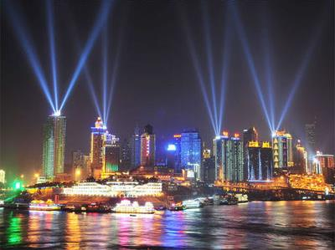
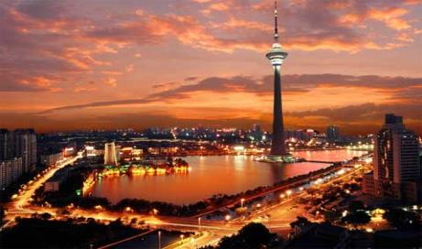
Shanghai
Chongqing
Tianjin

Slide 13
Self Check
Complete the conversations with the correct words in the box.
1
anything
everything
nothing
anyone
everyone
no one
1. A: Did ________ go on vacation with you last month?
B: Yes, my family went to the countryside with me.
anyone

Slide 14
2. A: Did your family go to the beach with you last weekend?
B: No. __________ from my family went, but my friend went with me.
3. A: I didn’t bring back anything from Malaysia.
B: ___________ at all? Why not?
anything
everything
nothing
anyone
everyone
no one
No one
Nothing

Slide 15
4. A: Did you buy _________ in the shopping center?
B: No, I didn’t. _________ was very expensive.
5. A: How was the volleyball game yesterday?
B: Great! ____________ had a fun time!
anything
anything
everything
nothing
anyone
everyone
no one
Everything
Everyone

Slide 16
Complete the passage with the correct forms of the verbs in brackets.
2
Last August, our class _______ (do) something very special on our school trip. We _______ (go) to Mount Tai. We _______ (start) our trip at 12:00 at night. Everyone in our class _______ (take) a bag with some food and water. After three hours, someone looked at the map and _______ (find) out we ________ (be, not) anywhere near the top.
did
went
started
took
found
weren’t

Slide 17
My legs _______ (be) so tired that I wanted to stop. My classmates _______ (tell) me to keep going, so I _______ (go) on. At 5:00 a.m., we got to the top! Everyone _______ (jump) up and down in excitement. Twenty minutes later, the sun _______ (start) to come up. It was so beautiful that we_______ (forget) about the last five hours!
were
told
went
jumped
started
forgot

Slide 18


Summary
1. Simple past tense:
do→did am/is →was are → were v. →v.-ed
2. Indefinite pronouns:
something, someone, anything, anybody…
3. Sentence patterns:
— Where did you go on vacation?
— I went to …
— Did you …?
— Yes, …did. / No, …didn’t.

Slide 19

Homework
1. Complete Self Check on Page 8.
2. Work on your diary entry and make sure
there are no mistakes. Then, write it
down in your exercise book.

