Slide 1
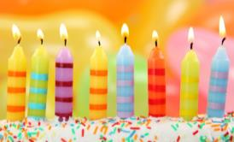
初中英语仁爱版七年级下
Unit7 Topic 1
When is your birthday?
Section D
WWW.PPT818.COM

Slide 2
Review
1
Presentation
2
Consolidation
3
Summary
4

Slide 3
Review
Ask and answer
2013年5月
2
-What’s the date today?
-It’s May 2nd, 2013.
-What was the date yesterday?
-It was May 1st, 2013.
-When were you born?
-I was born on...

Slide 4
Past Simple(I)
were
When _____ you born? I _____ born in January,1999.
When was Kangkang born? He _____ born on May 13th, 2000.
Where ____ he born? He was born in China.
was
was
was

Slide 5
Ordinal Numbers
1st | 2nd | 3rd
 |  | third
12th | 20th
 |  | thirty-first
first
second
21st
twelfth
twentieth

Slide 6
Ordinal Numbers
5th | 8th | 9th
 |  | ninth
40th | 90th | 101st
fifth
eighth
fortieth
ninetieth
one hundred and first

Slide 7
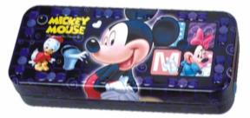
A: shape
B: What shape is it?
C: It’s a rectangle.
A: long
B: How long is it?
pencil-box
24 cm6.4 cm
C: It’s 24 cm.

Slide 8
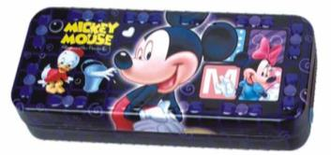
A: wide
B: How wide is it?
C: It’s 6.4 cm.
A: use
pencil-box
24 cm6.4 cm
B: What do we use it for?
C: We use it to keep pencils, rulers,
erasers and so on.

Slide 9
Functions
When is your birthday, Kangkang? May 13th.
What’s the _______ today? It’s May 8th.
What’s the ________ of your present? It’s round.
What________ is it? It’s a circle.
How long/wide is it? It’s 24/6.4 centimeters long/wide.
What do we use it for? We use it to keep pencils, rulers...
date
shape
shape

Slide 10
Listen to 1 and then complete the table.
Object | What shape? | How long? | How wide? | What do we use it for?
computer
pencil-box | rectangle
square
studying or playing games
36cm
36cm
20cm
8cm
keeping pens and pencils

Slide 11
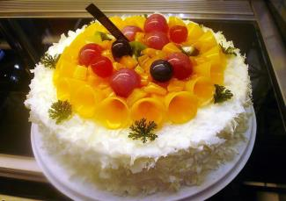
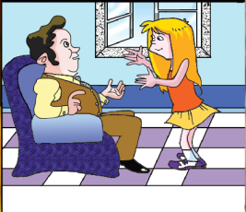
A birthday cake
Presentation
Mrs. Brown
Mrs. Brown’s birthday is coming.

Slide 12
Read the passage and circle T(True) or F(False).
1.May 23rd is Mrs.Brown's birthday.
2.Marry and her father want to celebrate the birthday at home.
3.Marry's father wants to buy some beautiful flowers for his wife.
4.Marry and her father want to make a birthday cake at home.
T F
T F
T F
T F

Slide 13
Written work.
When is your father’s/mother’s birthday?
What will you do to celebrate it?
Check () the things below. Then write your plan.
cook a big dinner
make a cake
buy some flowers
make a birthday card
do some cleaning
sing a song

Slide 14
Summary
Review the past simple tense with “was/were”.
Review how to talk about dates.
Review describing objects and features(shapes).

Slide 15
Homework:
1.Write a passage about your father’s/mother’s birthday plan.
2.Finish your workbook(Setion D).

