Slide 1
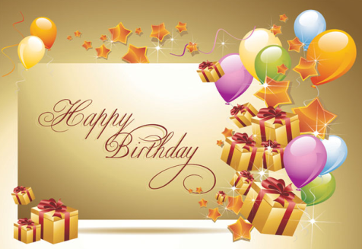
Happy birthday
第一课时
WWW.PPT818.COM

Slide 2
Sing a song
Happy birthday!
Notes:
2

Slide 3
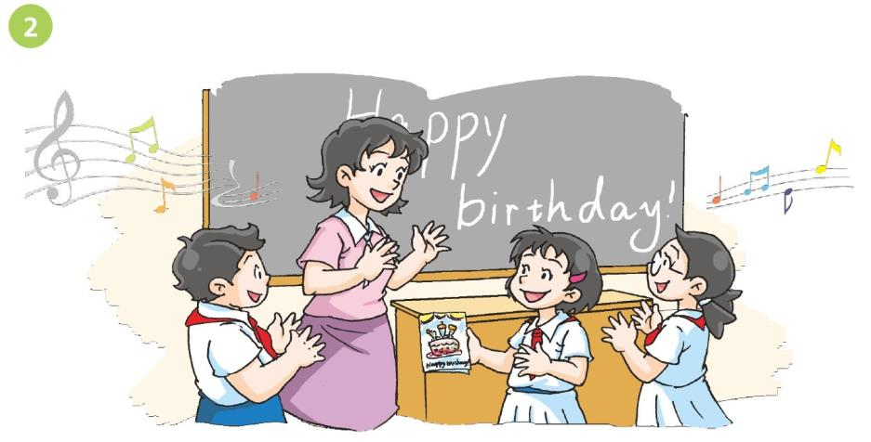
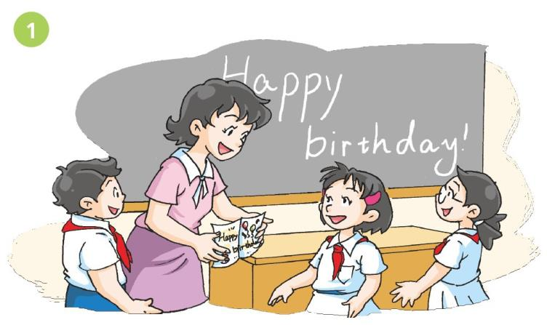
Notes:
3

Slide 4
Read and answer
How old is Alice?
2. What does Miss Fang give Alice?
3. What do Miss Fang and the students do for Alice?
She is nine.
A card.
They sing a song for her.
Notes:
4

Slide 5
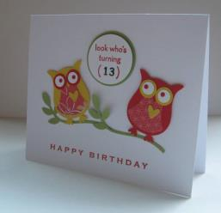
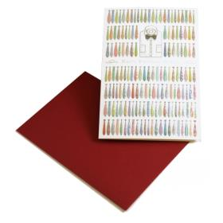
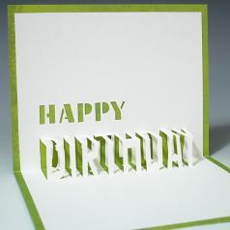
Read and say
cards
birthday cards
Notes:
5

Slide 6
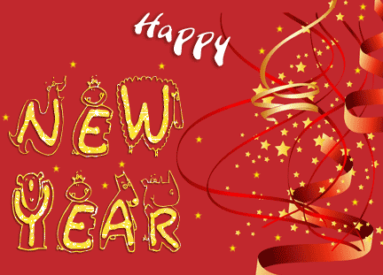
Read and say
cards
Merry Christmas
a birthday card
a New Year card
a Christmas card
Notes:
6

Slide 7
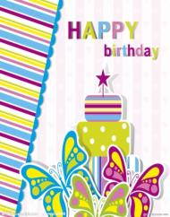
Read and say
Here’s a card for you.
Notes:
7

Slide 8
Say and do
Here’s for you.
Thank you. I like it.
Thanks. I like it very much.
Notes:
8

Slide 9
Read out loud
Here’s a card for you.
Here’s a song for you.
Notes:
9

Slide 10
Sing a song
Happy birthday!
Notes:
10

Slide 11
Listen and read
Happy birthday, Alice!
Here’s a card for you.
Thank you, Miss Fang.
How old are you, Alice?
I’m nine.
Notes:
11

Slide 12
Listen and read
Let’s sing “Happy birthday” together.
Happy birthday to you! Happy birthday to you! Happy birthday, dear Alice. Happy birthday to you!
Notes:
12

Slide 13
Act it out
Notes:
13

Slide 14
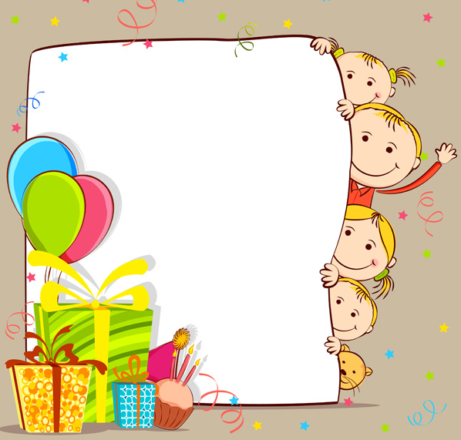
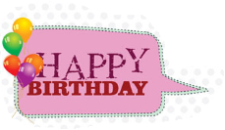
Homework
1 Read and act Listen and say.
2 Sing the song “Happy birthday”.
Notes:
14

