Slide 1
Unit 8 Natural disasters
第3课时
WWW.PPT818.COM

Slide 2
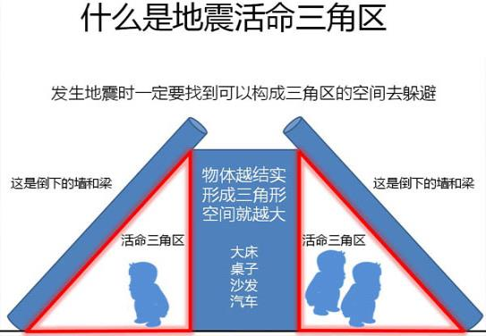

Slide 3
B Timmy and the earthquake
B1)Sandy does not know the meanings of some words in the story. Help her match the words on the left with the meanings on the right. Write the correct letters in the blanks.
1 shake(lind 5) ______
2 scream (line 5) ______
3 come down (line 8) ______
4 silent (line 9) ______
5 at last (line 20) ______
6 safe (line 20) ______
a finally
b fall to the ground
c give a loud high cry
d not in danger
e move quickly from side to side, up and down, etc.
f quiet
e
c
b
f
a
d

Slide 4
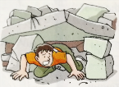
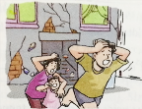
B2)Timmy put some pictures he drew on his web page. Help Sandy write the correct caption in the blank under each picture.
I saw the bright daylight. The walls came down.
I screamed for help. Some people ran out of the building.
I was trapped. The earth started to shake.
Some people ran out of the building.
I screamed for help.
____________________
____________________

Slide 5
I saw the bright daylight. The walls came down.
I screamed for help. Some people ran out of the building.
I was trapped. The earth started to shake.
I saw the bright daylight.
____________________
The earth started to shake.
____________________
____________________
I was trapped.
____________________
The walls came down.
____________________

Slide 6
B3)Sandy is telling her classmates about Timmy's story. Check whether she remembers everything correctly. Write a T if a sentence is true or an F if it is false.
1 Timmy was asleep when the earthquake started. ______
2 At first, Timmy heard a loud noise like thunder. ______
3 People ran in the same direction in the street. ______
4 Timmy was trapped in a dark place after the earthquake stopped. ______
5 There was not enough space for Timmy to pull himself through. ______
6 People found Timmy soon after he was trapped. ______
T
F
F
T
F
F

Slide 7
B4)Sandy is writing about what happened to Timmy in her diary. Help her complete her diary entry with the words in the box.
beating bricks calm fear mind nervous
pulled safe saved sleeping thunder trapped
When the earthquake hit Taiwan in 1999，Timmy was (1) ________. He heard a loud noise like (2) ________. Then the noise became louder, like bombs under the ground. People screamed in (3) ________.Then pieces of glass and (4) ________ fell down.
sleeping
thunder
fear
bricks

Slide 8
beating bricks calm fear mind nervous
pulled safe saved sleeping thunder trapped
When the noise and shaking stopped, Timmy was (5)_______ and could not get out. He felt (6) ________ and his heart was (7) ________ fast. A moment of fear went through his (8) ________. Then he tried to (9) ________ down and (10) ________ himself slowly through the dark. Finally, people came and heard his cry for help. They moved away the bricks and (11) ________him. Timmy was (12) ________ at last.
trapped
nervous
beating
mind
calm
pulled
saved
safe

Slide 9
知识点
come down 崩塌，坍塌
1
come down 是不及物动词短语，其后不能跟名词。
eg: The building came down last night.
那栋楼昨晚倒塌了。
考向
come down还可作“落下”讲。
eg: The snow comes down from the sky.
雪从天空中落下来。

Slide 10
归纳：come from来自；come in流行；come into继承；
come into one's mind想起；come out出现，出版；
come over突然感到；come true实现；
come up被提及；come up with找到(答案)

Slide 11
知识点
2
silent /'saɪlənt/ adj.寂静的
eg: The room was silent. 房间里一片寂静。
考向一
silent的副词形式为silently；名词形式为silence。
考向二
silent还有“沉默的；不说话的”的意思。
eg: He couldn't speak English and was completely silent during the visit.
他不会说英语，参观过程中一言不发。

Slide 12
知识点
3
after /'ɑːftə(r)/ conj. 在……以后
考向一
作连词，引导时间状语从句。
eg：You can play football after you finish your homework.
你完成作业后可以踢足球。

Slide 13
考向二
after还可作介词，意为“在……之后；在……后面”。
eg: I go swimming every day after work.
每天下班后我都去游泳。
after还可作副词，意为“后来；以后”。
eg: What comes after?
后来怎样？
考向三

Slide 14
考向四
after的反义词是before，意为“在……之前”。
搭配：after all 终究；毕竟；
the day after tomorrow 后天；
look after照顾；run after追赶；
day after day日复一日

Slide 15
典例
The science teacher says that the sun ________ in the east.
A．falls B．gets C．rises D．goes
C
【点拨】本题用词语应用法。rise可指日月星辰的升起。

Slide 16
根据汉语意思完成句子
1. 听到枪声，鸟儿们朝四面八方飞去。
Hearing the gunshot, the birds flew_____ _____ _________.
2. 这座楼房太旧了，在地震中可能很容易倒塌。
The building is too old and it may _______ ______easily in the earthquake.
in all directions
/ in every direction
come down

Slide 17
3．虽然我们现在身处困境，但是我们确信我们能够找到出路。
We are in trouble now, but we are sure we can ________ ________ ________ ________．
4．你能把那块石头移开吗？
Can you ________ ________ the stone?
5．我竭尽全力跑出了房间。
I tried my best to ________ ________ ________ the room.
find
our way out
move away
run out of

Slide 18
6．碎玻璃和砖块往下掉的时候，人们四处逃散。
People were running_______ _______ __________ while _______ _______ glass and bricks were _______ _______.
7．我感到紧张，并且我的心跳加快。
I _______ _______ and my _______ was ______ ______.
8．她把整篇演讲稿都背熟了。
She has learnt the whole speech off________ ________.
in all directions
pieces of
falling down
felt nervous
heart beating fast
by heart

Slide 19
9．我什么也看不见，不知道是否有其他人在我周围。
I could ________ see anything ________ ________, and I did not know if anyone else was around me.
10．人们互相惊恐地看着对方。
People looked at _______ _______ _______ _______.
not at all
each other in fear

Slide 20
本节课主要学习了以下知识点，请同学们及时巩固练习：
come down
silent , after

