Slide 1
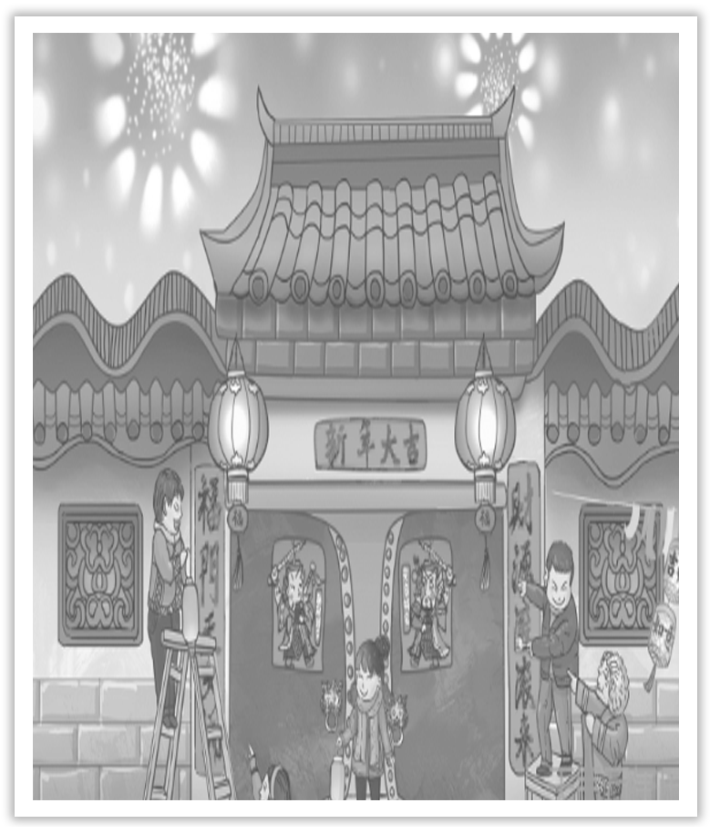
Unit 1 Festivals And Celebrations
Section Ⅲ Reading and Thinking(2)
WWW.PPT818.COM

Slide 2
Ⅰ.单词语境记忆——根据英汉提示写出单词的适当形式
1.Students can choose from a wide ____________(一系列) of options.
2.I ____________(认为) that you wouldn’t come.
3.Try to ____________(收获) the fruit before the first frost.
4.The teacher went round the class to ____________(收集) the papers.
range
figured
harvest
gather

Slide 3
5.This is a ____________(重大的) contribution to knowledge.
6.The picture is ____________(type) of its kind.
7.China is abundant in ____________(agriculture) produce.
8.The event was widely covered by the mass ____________(medium).
9.There is nothing more natural than a child’s ____________(believe) in his parents.
10.Any help or donations will be ____________(grateful) received.
significant
typical
agricultural
media
belief
gratefully

Slide 4
Ⅱ.短语语境填空——根据汉语提示写出适当的短语
1.Her children’s ages ________________________________(3岁到18岁之间).
2.The colour of the cloth will _______________(逐渐褪色) little by little.
3.__________________(尽管) his anger，his remarks were restrained.
4.He always __________________(利用) the good weather to go for a walk.
5._____________(媒体) can either be your friend or your enemy.
6.What do these two bikes _____________________(相同)?
range from three to eighteen
fade away
In spite of
takes advantage of
The media
have in common

Slide 5
Ⅲ.句式语境仿写
1.Online shopping websites and social media apps have made it much easier for the public to spend more on gifts for their loved ones.
网上购物网站和社会媒体软件使大众为他们的爱人买更多的礼物变得更容易了。
[仿写] 她是外国人的事实使得她在那个国家很难找到工作。
The fact that she was foreign ___________________________________ in that country.
made it difficult for her to get a job

Slide 6
2.They help us understand where we came from，who we are，and what to appreciate.
他们帮我们理解我们来自哪里，我们是谁以及我们应该感恩什么。
[仿写] 问他这些人来自哪里，谁替他们付钱。
Ask him ________________________________ and ________________________.
where these people came from
who paid for them

Slide 7
记单词
Ⅰ.语境串记多义词
A bicycle manufacturer produces a wide range of bicycles ranging in price from a couple hundred dollars to several thousand dollars.
一个自行车制造商生产各式各样的自行车，价格不等从几百元至数千元。

Slide 8
Ⅱ.构词法助记派生词
形容词后缀：－ous，－ful，－al，－ical
religion(n.)→religious(adj.)
joy(n.)→joyful(adj.)
agriculture(n.)→agricultural(adj.)
type(n.)→typical(adj.)

Slide 9
句型公式
1.make it...(for sb) to do...意为“使(某人)做某事成为……”，it是形式宾语，to do...是真正的宾语。
2.连接词where，who引导名词性从句，在句中作宾语。

Slide 10
Understanding in context
WHY DO WE CELEBRATE FESTIVALS?
Festivals are celebrated all around the world.They have a wide range of origins，such as the seasons of the year，religions，famous figures，and important events.Every festival has its different customs and unique charms.However，no matter how different they may seem，all over the world，the spirit of sharing joy，gratitude，love，or peace is common in all festivals.

Slide 11
[文化视窗]
中西方节日的起源
我国古代长期以农为本，节日具有浓厚的农业色彩。在古代，春节、清明节(古代称三月节) 等都是重要的农事节日。西方文化由于长久受基督教的影响，其传统节日起源带有浓厚的宗教色彩。

Slide 12
1.range n.一系列；范围；界限 vi.包括；(在一定范围内)变化
[合作探究] 体会range的用法和意义
①The observational work is carried out on a range of telescopes.
观测工作借助于____________望远镜。
②The price of the car is out of/beyond his range.
这辆车的价格超过了他的承受范围。
③Improvement is within the range of possibility.改善是可能的。
④Prices range from ￡6 to ￡10.＝Prices range between ￡6 and ￡10.
价钱________________________。
各种
从六英镑到十英镑不等

Slide 13
[自主发现]
⑤____________ range of... 一系列的；各种各样的
⑥____________ one’s range＝out of/beyond the range of sb
超过某人承受的范围；某人能力达不到的
⑦within the range ____________... 在……的范围之内
⑧range ____________...____________...＝range between...and...
处于某范围内；在……到……的范围内变化
a
out of/beyond
of
from
to

Slide 14
[巩固内化] 介词填空/补全句子
①The supermarket keeps a wide range ____________ goods.Their prices range ____________ just only a few yuan to several hundred yuan.
②Maybe the question is ________________________________ human understanding.
或许这个问题超越了人类理解的范围。
③But few see everything that is ________________________ their vision.
但很少有人能看清视力范围内的每一件东西。
of
from
out of/beyond the range of
within the range of

Slide 15
2.figure n.人物；数字；身材；画像；人影 v.认为；认定；估计；计算；理解
[合作探究] 体会figure的用法和意义
①They have figured in the cost of our food for the trip.
他们已把我们旅游的食物费用____________进去了。
②I am so confused that I can’t figure out how to do this.
我很困惑，因此____________怎样做这件事。
[自主发现]
③figure sth in 将某事物包括在内；计算在内
④figure out 弄清楚；计算出
计算
弄不懂

Slide 16
[巩固内化] 写出句中figure的词性和含义
①She is dieting to keep her figure although she is slim.____________
②Can you read this figure? Is it a three or an eight？____________
③He was one of the great figures of his age.____________
④I can’t figure out why she said so.____________
n.身材
n.数字
n.人物
v.理解

Slide 17
Understanding in context
Of all the traditional festivals，the harvest festival can be found in almost every culture.This important agricultural festival takes place after all the crops have been gathered in.People celebrate to show that they are grateful for the year’s supply of food.In ancient Egypt，the harvest festival was celebrated during the springtime—the Egyptian harvest season.It featured a parade and a great feast with music，dancing，and sports.Today，in some European countries，people decorate churches and town halls with flowers and fruit，and get together to celebrate over a meal.During the Mid-Autumn Festival in China，families gather to admire the shining moon and enjoy delicious mooncakes.

Slide 18
[文化视窗]
收获节是庆祝丰收的节日。不同的地区，不同的习惯，然而相同的是收获的喜悦，不同的国家和民族选择不同的日子，采用不同的仪式载歌载舞来为这个节日庆祝，为了收获的喜悦，为了劳动的成果。在节日里，交流着文化，也增进了感情。

Slide 19
3.gather vi.聚集；集合 vt.聚集；搜集；收割
[合作探究] 体会gather的用法和意义
①We sent three men to gather up firewood for the fire.
我们派出3个人去____________生火用的柴火。
②The people gathered round，curious to know what was happening.
人们____________，好奇地想知道发生了什么事儿。
③The farmers are busy gathering in the crops in the field.
农民们在田野里正忙于____________庄稼。
搜集
聚集在一起
收割

Slide 20
[自主发现]
④gather together/____________ 聚集；收拢
⑤gather ____________/around 围拢
⑥gather ____________ 收割；收获
up
round
in

Slide 21
[巩固内化] 单句语法填空
①All the children gathered ____________ the old man to listen to his stories.
②People are grateful because their food ____________(gather) for the winter and the agricultural work is over.
[思考] gather和collect有何区别？
______________________________________________________________________
______________________________________________________________________
round/around
is gathered
gather意为“聚集；集合”，表示把分散的人或物聚集到一起。collect意为“收集；搜集”，表示精心地、有选择地收集。

Slide 22
4.grateful adj.感激的；表示谢意的
[合作探究] 体会grateful的用法和意义
①I’m so grateful to you for all that you’ve done.
对于你所做的一切我都____________。
②He was grateful to have someone to talk to.
他很____________有人跟他谈话。
③She would be very grateful if you could give her an early reply.
____________早点给他答复，她将非常感激。
非常感激
感激
如果你能

Slide 23
[自主发现]
④be grateful ____________ sb ____________ sth 因某事而感激某人
⑤be grateful ____________ sth 因做某事而感激
⑥I would be grateful ____________ you could do... 如果你能……，我将感激不尽。
to
for
to do
if

Slide 24
[巩固内化] 补全句子
①I ____________________________ give me some advice.
如果你能给我一些建议，我将不胜感激。
②I __________________ and determined to repay him one day.
我非常感激，决意改天一定要回报他。
would be grateful if you could
was very grateful

Slide 25
5.decorate vt.装饰；装潢；授予……勋章/奖章 decoration n.装饰；装潢；装饰品
[合作探究] 体会decorate的用法和意义
①Decorate the house with decorations you make.
用自己做的装饰物来____________房子。
②He was decorated for bravery.
他获____________英勇勋章。
[自主发现]
③decorate...____________ 以……装饰……
④decorate sb ____________ 因为……而授某人勋章
装饰
颁发
with
for

Slide 26
[词块积累]
decorate a room with flowers 用花装饰房间
decorate a house for New Year 装饰房子过新年
[巩固内化] 单句语法填空
①The exhibition hall is decorated ____________ many paintings.
②The girl was decorated ____________ saving the child from drowning.
with
for

Slide 27
Understanding in context
Customs play a significant role in festivals，but sometimes they can change over time.With the development of modern society and the spread of new ideas，some traditions may fade away and others may be established.One example is the typical Chinese Spring Festival custom of lighting firecrackers to drive away the evil spirits and celebrate the new year.Nowadays，many big cities have given up this custom in order to avoid air pollution.Another example is Halloween，which slowly became an exciting festival for children，in spite of its religious origins.

Slide 28
[文化视窗]
万圣节源自古代凯尔特民族(Celtic)的新年节庆，此时也是祭祀亡魂的时刻，在避免恶灵干扰的同时，也以食物祭拜祖灵及善灵以祈平安渡过严冬。前一天晚上(也就是万圣节前夜)，小孩们会穿上化妆服，戴上面具，挨家挨户收集糖果。

Slide 29
6.significant adj.有重大意义的；显著的；重要的 significance n.意义；意思；重要性；重要意义 significantly adv.重大地，明显地，显著地；意味深长地；含义深远地
[合作探究] 体会黑体部分的用法和意义
①It is significant that the children should not tell lies.
＝Significantly，the children should not tell lies.
孩子们不说谎____________。
很重要

Slide 30
②The new drug is very significant for the treatment of the disease.
＝The new drug is of great significance for the treatment of the disease.
这种新药对于这种病的治疗____________。
③What he thinks about it is of no significance.
他对此事的想法______________。
[自主发现]
④__________________...(＝significantly) ……很重要
⑤be very significant＝be ____________ great significance 有重大意义
⑥be ____________ little/no significance 不太重要/不重要
有重大意义
没有什么意义
It is significant that
of
of

Slide 31
[巩固内化]
单句语法填空/补全句子
①The most ____________(significance) thing you should keep in mind is that most of the questions are easy if you make use of correct methods.
②His university was aware of the ____________(significant) of his work.
③The proposals she put forward in this report ____________________________________.
她在这篇报告中提出的建议具有重大意义。
significant
significance
are very significant/are of great significance

Slide 32
7.fade away逐渐消失；(身体)变得虚弱
①The sound of the cheering faded away.欢呼声逐渐消失。
[短语记牢] 记牢下列短语
fade out (声音、画面)逐渐模糊；渐淡
fade in (声音、画面)逐渐清晰；渐强
②Their voice fades out as they go off stage together.
他们一起走下舞台，声音逐渐变小。
③A view of the prairie faded in.一个草原的景象渐显。

Slide 33
[巩固内化] 副词填空
①The closing music fades ____________ when the hero rides off into the sunset.
②He saw the monitor black out and then a few words faded ____________.
out
in

Slide 34
8.typical adj.典型的；有代表性的；平常的 typically adv.典型地；有代表性地；一向；总是
[合作探究] 体会黑体部分的用法和意义
①The film Red Sorghum is typical of Zhang Yimou’s early works.
电影《红高粱》是张艺谋早期的____________。
②It is typical of her to narrow her eyes because she is short-sighted.
因为近视，她有眯着眼睛看人的习惯。
[自主发现]
③be typical ____________... 是……特有的，是……的特点
④It is typical of sb ____________ 某人一向……；某人有做某事的习惯
代表作
of
to do sth

Slide 35
[巩固内化] 单句语法填空
①It is typical of him ____________(take) hard jobs.
②It ____________ (typical) takes a day or two，depending on size.
③She threw her hands into the air.“That is just typical ____________ you，isn’t it？”
to take
typically
of

Slide 36
9.in spite of不顾；不管；尽管
①In spite of all his efforts he failed.
尽管他很努力还是失败了。
②In spite of the fact that it is snowing，she is going out for a walk.
＝Although/Though it is snowing，she is going out for a walk.
尽管正在下雪，她仍然要出去散步。
[自主发现]
③in spite of＋n. 尽管……
④in spite of the fact that...＝although/though... 尽管……

Slide 37
[巩固内化] 补全句子
①He has modern ideas ____________________ his great age.
尽管他年事已高，但思想观念却很入时。
②_______________________ they are against it，we are going on doing it.
不顾他们反对，我们继续干下去。
in spite of
In spite of the fact that

Slide 38
Understanding in context
Festivals are becoming more and more commercial，with businesses taking advantage of the celebrations.Online shopping websites and social media apps have made it much easier for the public to spend more on gifts for their loved ones.Although some believe festivals should not be commercialised，others believe the increase in spending is good for the economy and public happiness.

Slide 39
[文化视窗]
传统节日迸发新的生机，这在现代商业化应用中已经很普遍了。如何处理好它们之间的微妙关系，首先要追根溯源，理解传统文化精神精髓所在，其次要找到和现代商业的关联之处。

Slide 40
10.take advantage of利用；欺骗；占……的便宜
①In the meantime，you can take full advantage of it.在此期间，您可以充分利用它。
[短语记牢] 记牢下列短语
make use of 利用；使用
make good/full/little use of 好好/充分/不充分利用
make the best of 充分利用
make the most of 充分利用
②We should make full use of the Internet.我们应充分利用因特网。
③She really tries to make the most of herself by dressing well.
她确实想通过穿着漂亮尽量发挥自己的优势。

Slide 41
[词块积累]
take advantage of various factors利用各种各样的因素
take advantage of a man like him 占像他这样的人的便宜；欺骗像他这样的人
[巩固内化] 单句语法填空
①He has made up his mind to make good use ____________ every minute to study.
②He’s joining the club in order to take advantage ____________ the others.
of
of

Slide 42
11.Festivals are becoming more and more commercial，with businesses taking advantage of the celebrations.节日变得越来越商业化，由于商家利用了节日庆典。

Slide 43
①He came into the room，with his face red.
他面色红润地走进房间。(形容词作补语，with的复合结构表示伴随)
②With a red handkerchief in his hand，he shouted at Mary crazily.
他手里拿着一条红手绢，发疯似地朝玛丽叫喊。(介词短语作补语，with的复合结构表示伴随)
③She could finish her work，with me to help her.
有我的帮助，她能够完成工作。(不定式作补语，with的复合结构表示原因)
④With her eyes closed，she touched the gift gently.
她闭上眼睛，轻轻地抚摸这件礼物。(过去分词作补语，with的复合结构表示伴随)

Slide 44
[巩固内化]
单句语法填空/补全句子
①A little boy with two of his front teeth ____________(miss) ran into the house.
②With the key ____________ (lose)，he had to wait outside the door.
③With a lot of things ____________ (settle)，I can’t go to see a film.
④Mother asked her if/whether she was very hot _______________________.
母亲问她穿这么多衣服热不热。
⑤She came to a river ___________________________________________________.
她来到了一个两边长着红花绿草的小河边。
missing
lost
to settle
with so many clothes on
with green grass and red flowers on both sides

Slide 45
Understanding in context
Festivals are an important part of society.They reflect people’s wishes，beliefs，faiths，and attitudes towards life.They are occasions that allow us to relax and enjoy life，and forget about our work for a little while.They help us understand where we came from，who we are，and what to appreciate.And if you study festivals carefully，you may be surprised to find that different cultures actually have a lot in common after all.
[文化视窗]
我们要传承我们的传统节日，保护好包括民俗文化在内的所有传统文化，因为它们饱含着丰富厚重的文化精髓，是中华民族前进航行中的灯塔。

Slide 46
12.reflect vt.显示；反映；反射；映射；思考 vi.思考 reflection n.反射；反照；反映；映像；沉思，深思
[合作探究] 体会reflect的用法和意义
①He stared at his own image reflected in the water.
他凝视着自己在水中的____________。
②I’m sitting in the small yard，reflecting on the plan.
我坐在小院子里，____________这个计划。
③The light is reflected from the moon.
光从月球____________出来。
倒影
想着
反射

Slide 47
[自主发现]
④reflect sb/sth ____________ sth (指镜子等)映出某人/物的影像
⑤reflect sth ____________ sth 从某物(表面)反射(光、热、声等)
⑥reflect ____________ sth 思考某事
in
from
on

Slide 48
[巩固内化]
单句语法填空/补全句子
①The reason why he is lost in ____________ (reflect) is that he is reflecting ____________ the problem，which ____________ (reflect) in the list.
②I’m sitting in the warm night air with a cold drink in my hand and ________________________ the day—a day of pure magic!
我坐在温暖的夜空下，手里拿着一瓶冷饮，回忆着当天的事情——这是神奇的一天！
reflection
on
is reflected
reflecting on

Slide 49
13.faith n.宗教信仰；信任；相信；信念 faithful adj.忠实的
[合作探究] 体会faith的用法和意义
①He has blind faith in what she says.
他盲目____________她所说的每一句话。
②He is so strong-minded that he never loses faith in the future.
他很坚强，从不对未来____________。
[自主发现]
③have faith ____________ sb/sth 对某人/某事有信心
④lose faith ____________ 不再信任；对……失去信心
信赖
失去信心
in
in

Slide 50
[巩固内化]
单句语法填空/补全句子
①Have faith ____________ yourself，be ____________ (faith) to your work and ____________ (faith) live up to your promise and then you are sure to succeed.
②He told us ________________________ ourselves.
他让我们不要对自己失去信心。
in
faithful
faithfully
not to lose faith in

Slide 51
14.have sth in common(兴趣、想法等方面)相同；有相同的特征；有共同点；共享……
①In pairs discuss what they have in common.
两人一组，讨论一下它们有什么相同之处。
[短语记牢] 记牢下列短语
have much/a lot/something/little/nothing in common (with...)
(与……)有许多/一些/很少/毫无共同之处
in common with... 与……一样；和……很像

Slide 52
②They found that they had a lot in common and got on well with each other.
他们发现他们有很多共同之处，且彼此相处很好。
③In common with many young people，he prefers pop music to classical music.
和许多年轻人一样，他更喜欢流行音乐，不太喜欢古典音乐。

Slide 53
[巩固内化] 补全句子
①They are brothers，but they ____________________________.
他们虽然是兄弟，但毫无共同之处。
②_________________________，I think the adventure will be a success.
与你一样，我也认为这次冒险将会是成功的。
have nothing in common
In common with you

