Slide 1
Module1 Unit 1
You and me
WWW.PPT818.COM

Slide 2
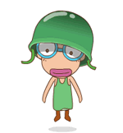
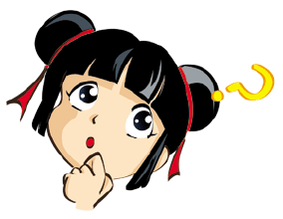
Warm up
I’m tall ,tall , tall.
Who is taller, you or me?

Slide 3
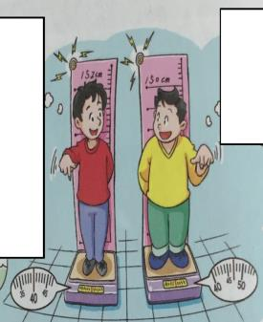
Listen and blank
Joe is visiting his cousin George in the countryside.
I weigh ____ kilograms.
I’m _____ centimetres tall.
40
I weigh ____ kilograms.
I’m _____ centimetres tall.
47
152
150
_______ is taller. _____ is heavier.
George
Joe

Slide 4
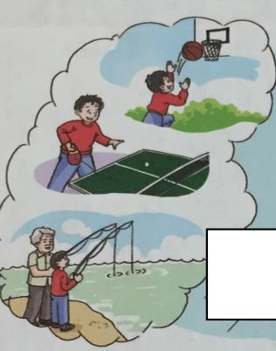
Listen and answer
What does Joe do after school?
He usually plays basketball and table tennis. Sometimes he goes fishing with his grandpa.

Slide 5
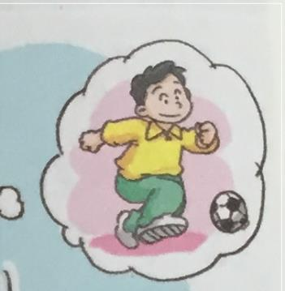
Read and answer
What does George usually do after school?
He usually plays football after school.

Slide 6
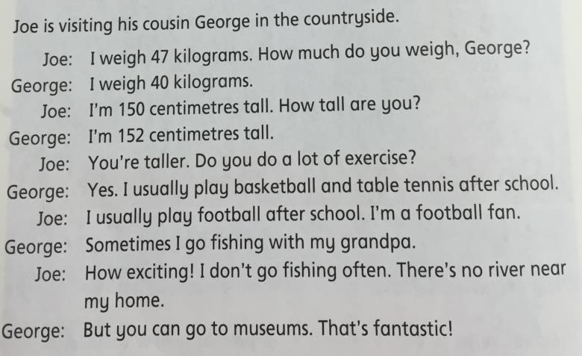
Read and repeat

Slide 7
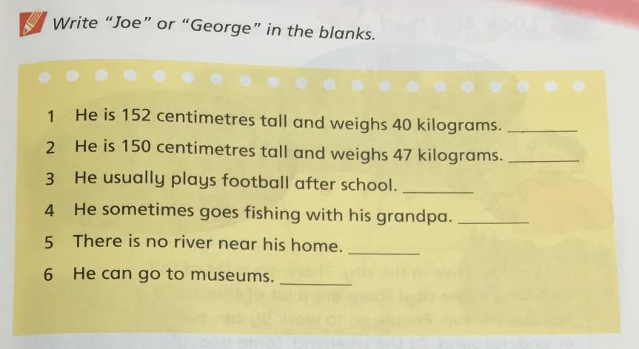
Read and write
George
Joe
Joe
George
Joe
Joe

Slide 8
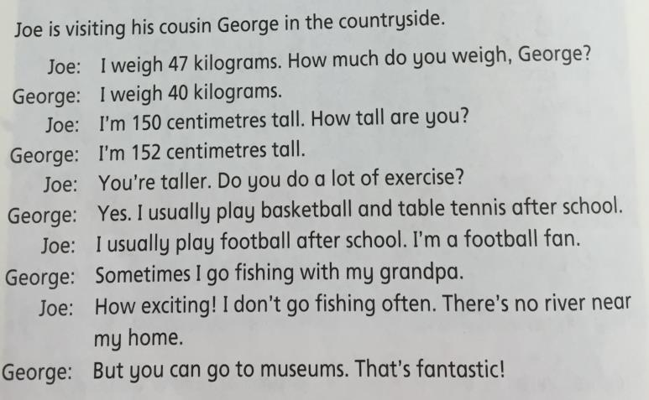
Role-play

Slide 9
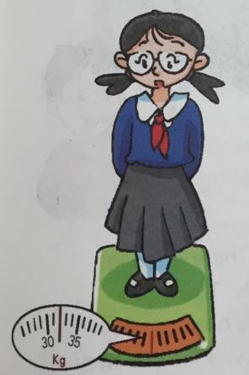
Presentation
weigh
How much do you weigh?
I weigh ... kilograms.

Slide 10
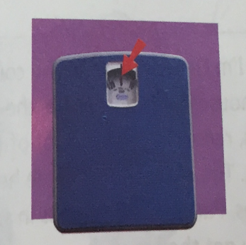
Presentation
How much do you weigh?
I weigh … kilograms.
kilogram

Slide 11
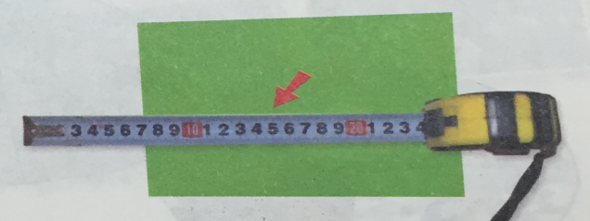
Presentation
centimetre
How tall are you?
I’m … centimetres tall.

Slide 12
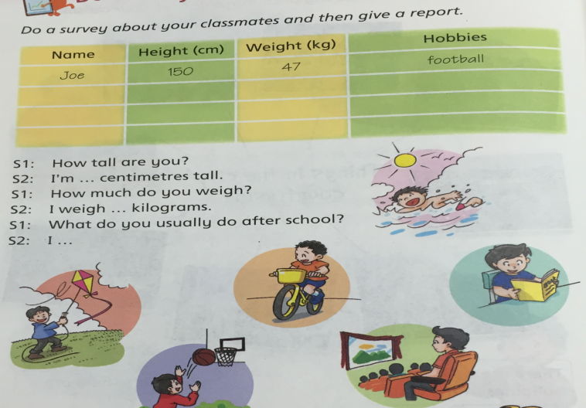
Do a survey

Slide 13
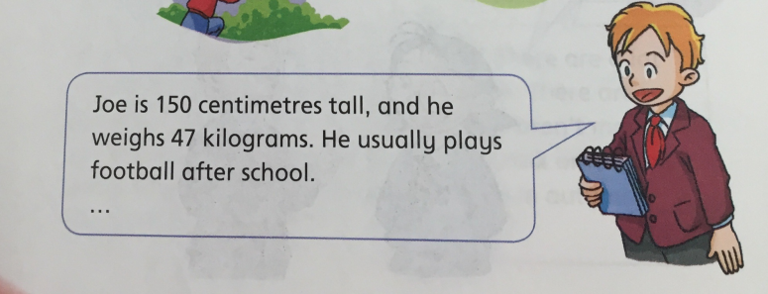
Have a try
Show time

Slide 14
Summary
本课重点句型：
How tall are you?
I’m … centimetre tall.
How much do you weigh?
I weigh … kilograms.
What do you usually do after school?
I …
学会询问及回答个人基本信息，并会介绍给其他朋友。

Slide 15
Homework
Do a survey about your parents and then give a report.

